Slide 1
Updated staffing reporting in quickbase
Rebecca fallen, rn

Slide 2
Objectives
Understand the new rules
Understand the reporting deadlines
Work through a mock report

Slide 3
New guidelines
Provide direct care services by direct care staff each month equivalent to at least 3.36 average direct care hours per resident day (Arkansas Code § 20‐10‐1402(a)(2))
On or before the 15th of each month electronically report to the department the facility’s actual average direct care hours per resident day for the prior month (Arkansas Code § 20‐10‐1402(b))

Slide 4
Definitions
“Average Direct Care Hours Per Resident Day” means the total number of hours of direct care services provided by direct care staff in a calendar month, divided by the number of calendar days in that month and the facility’s average daily resident census for that month. (Arkansas Code § 20-10-1401(1)).

Slide 5
definitions
“Direct care services” means nursing and nursing-related services; clinical, diagnostic, therapeutic, and rehabilitative services; physical, occupational, respiratory, and speech therapy services; delegated physician tasks; behavioral health services; care management, care coordination, and care transition activities; medication administration; assistance with activities of daily living; assessment, evaluation, planning, and implementation of care plans; coordination and consultation with residents’ physicians and other healthcare providers; and other services and supports provided for nursing facility residents in response to individual resident needs. However, the definition of “direct care services” excludes food preparation, laundry, housekeeping, and other maintenance of a nursing facility’s physical environment. (Arkansas Code § 20-10-1401(3)).

Slide 6
definitions
“Direct care staff” means a person who provides any direct care services to a nursing facility resident through interpersonal contact with residents or resident care management, including without limitation: registered nurse, advance practice nurse, nurse practitioner, certified nurse aide, nurse aide in training, medication assistant; physician; physician assistant; a licensed physical or occupational therapist or licensed therapy assistant; a registered respiratory therapist; licensed speech-language pathologist; infection preventionist; and other licensed or certified healthcare professionals. (Arkansas Code § 20-10-1401(3), (4), (6), (8), and (9)).

Slide 7
Reporting deadlines
Monthly report – 15th for the previous month
Quarterly – report is able to be amended within 15 days of your pbj submission to cms, if there are any necessary changes.

Slide 8

Report instructions
Open your quickbase and choose your facility (for this example we will choose a random nursing facility)
Click on the pencil icon to go to the next screen

Slide 9
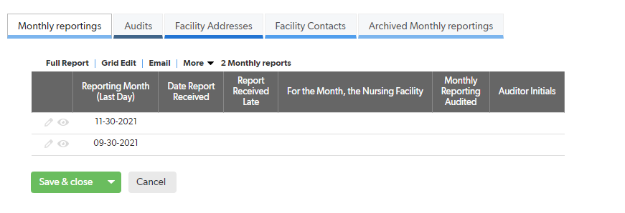
Report instructions
This will open a page with your demographic information and the monthly reporting ability at the bottom
click the pencil Icon for the month that you are reporting (this should be the previous month unless you are amending an earlier report)

Slide 10
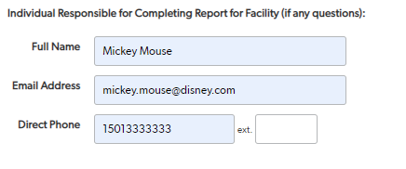
Report instructions
This will open your monthly report with the month, year, report type, facility name, vendor number, and county all prepopulated at the top
You will need to enter the information for the person filling out this report in the boxes.

Slide 11
Report instructions
Direct Care Hours Provided by Direct Care Staff in the Month:
  This table is for entering the direct care hours provided by direct care staff in the month. Enter hours in cells using two decimal places (e.g., XX.XX). Use “rule of five” in rounding.
  For each type of staff position listed for which the facility had direct care staff (employed, contracted, agency, and consultants) providing any direct care services in the month, enter the total number of direct care hours by all staff in that position combined.
  If you have direct care hours for a direct care position not specifically listed, enter these under “Other Direct Care Positions with Direct Care Hours, If Any.” Specify the job type and job code. For consistency, use only PBJ-recognized labor titles and job codes (e.g., dentist and job code 32).

Slide 12
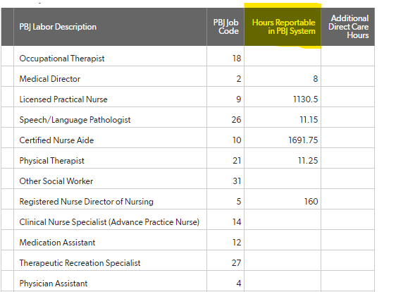
Report instructions
Column A – Hours Reportable in PBJ System:
  In Column A, enter hours as reportable in the CMS Payroll-Based Journal (PBJ) system and applicable to that calendar month.
  follow the latest CMS Payroll-Based Journal manual and technical instructions to determine the aggregate number of hours reported for each labor description. For example, for the certified nurse aide (CNA) PBJ labor description and job code, the report would show the aggregate total of all direct care hours provided by all the facility’s CNAs combined.

Slide 13
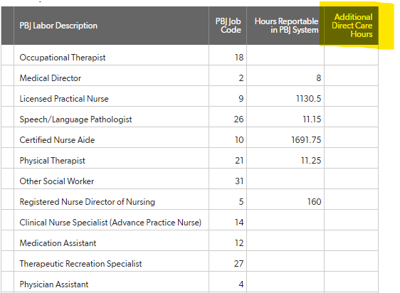
Report instructions
Column B – Additional Direct Care Hours Provided:
  In Column B, enter the hours in the month that meet the statutory definitions of direct care services and direct care staff but are not reportable in PBJ for whatever reason. The statutory definitions of direct care services and direct care staff are described above.
  For example, your DON, medical director, a nurse practitioner, physician assistant, or hospice organization may have provided additional hours on the floor providing direct care to residents, but these hours are not credited in PBJ. Column B is for reporting these types of additional direct care hours.

Slide 14

Report instructions
Grand Total Hours for Month:
  Based on the hours you entered, the reporting system will auto-generate subtotals for Column A and Column B and combine these for a grand total of direct care hours in the month.

Slide 15

Report instructions
Average Daily Resident Census for Month:
  Enter your facility’s MDS-based average resident census (total residents) for the month. Enter using two decimal places (e.g., XX.XX). Refer to the MDS Census Summary Report and MDS Census Detail Report tools in the CMS CASPER system.
  Private pay-only nursing facilities: Private pay-only nursing facilities do not report MDS data. For the average daily resident census for the month, enter the sum of (a) the total of each daily resident census for each calendar day of the month divided by (b) the number of calendar days in the month. In your records, document your private pay-only facility’s daily resident census, the consistent manner your daily census is determined (adjusted for admissions, discharges, temporary transfers, and deaths), and a spreadsheet with the above calculation for each month reported.

Slide 16
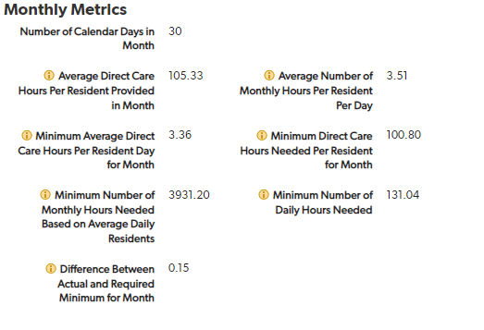
Report instructions
The system will calculate the averages for you.
If at any point you want to see what your numbers are you can click the save and continue button to see the calculations.

Slide 17

Report instructions
Check the box at the bottom of the page that certifies that you are ready to submit your report When you are completely satisfied that you have entered your information correctly.

Slide 18
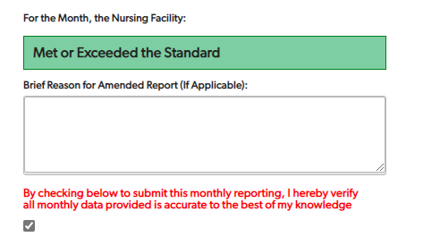
Report instructions
The system will then complete the calculations and report if you met or did not meet the required direct care hours for this report.
You can now click the save and close button and exit the system.

Slide 19
Important points
Do Not Duplicate of Hours Reported in Columns A and B or a Specific Job Type:
  Be careful not to duplicate or double count hours reported in Column A and Column B or under particular job types.
  For example, hours reported under Column B should not be counted in Column A or vice versa.
  Similarly, hours reported under one job type in a column should not be reported under any other job type. For example, hours reported under “Registered Nurse Director of Nursing” or “Registered Nurse with Administrative Duties” should not also appear “Registered Nurse” line.

Slide 20
Important points
Universal Workers:
  Nursing facilities using the CNA as universal workers should only report direct care service hours provided by the CNA. Do not report any CNA non-direct care hours (e.g., housekeeping, laundry, and food preparation) in Column A or Column B.

Slide 21
Important points
Fully Document All Reported Hours in Your Records:
  All hours reported in Column A or Column B must be sufficiently documented in your records to ensure complete and accurate monthly reporting and facilitate efficient auditing anytime by DPSQA.
  Employee hours are commonly well documented through payroll systems. However, facilities need to use other methods to adequately document reported direct care hours provided by contracted staff, consultants, and other health professionals providing care in the facility.
Acceptable methods for documenting direct care hours by non-employees include without limitation:
  A time tracking system;
  Signed time sheets; or
  Contractor and consultant invoices with hours provided detailed.

Slide 22
Amended reports
If adjustments are needed, file an amended report for the month(s). Amended monthly reports are due no later than 15 days following the CMS deadline for PBJ data submission for the corresponding quarter.

Slide 23
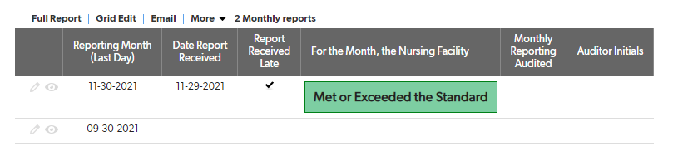
Amended reports
Open your facility reports as if you were going to enter a new report
Choose a report that has already been submitted and click the pencil icon

Slide 24
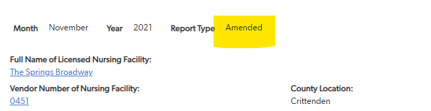
Amended reports
Upon opening you will see that the report type has changed to amended report
Amend the report as needed using the same rules as an original report.

Slide 25
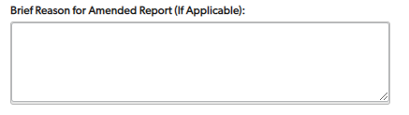
Amended reports
Prior to submission you will be required to enter a brief description of the reason for filing an Amended Report.

Slide 26
Questions?
Contacts:
Rebecca Fallen (501)396-6422 or rebecca.fallen@dhs.arkansas.gov
Stacey.Williams@dhs.arkansas.gov
Kyilexus.Wesley@dhs.arkansas.gov

