Slide 1



How to submit a PT 95 NT application?

Slide 2
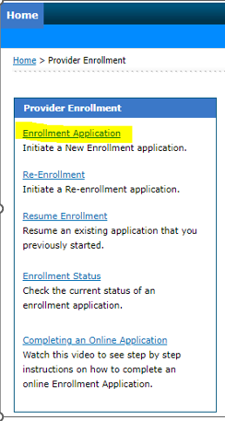
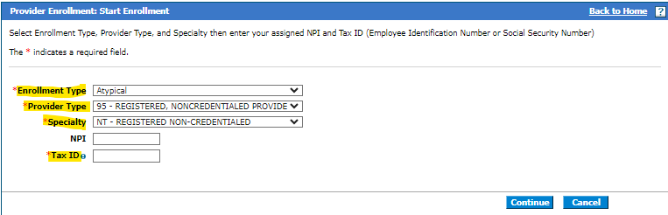
Starting the application
Click the link to - Start your application
Select “Enrollment Application”
Select the options below
Enrollment Type: Atypical
Provider Type: 95
Specialty: NT
TAX ID: List the SSN of the enrolling personal care aide.

Slide 3
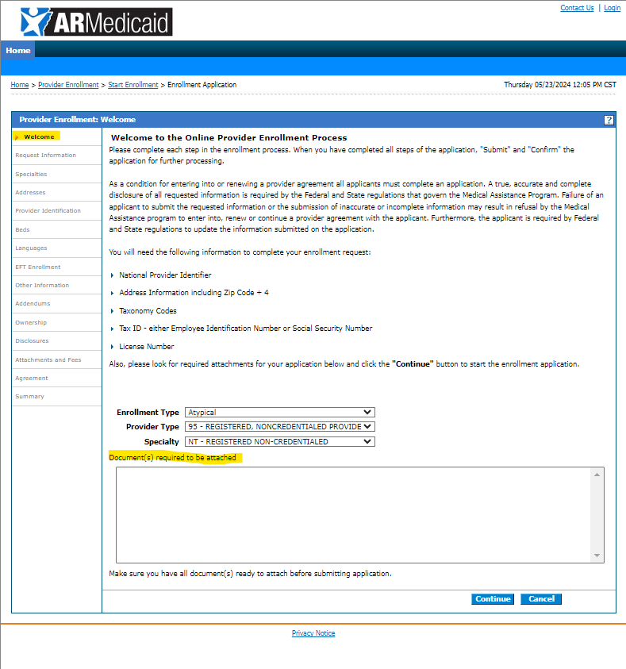
Entering the application data: Welcome tab
The welcome tab details key information that will be asked during the application process. At the bottom, the online application shows if any documentation needs to be attached towards the end of the application. For PCA enrollments, no additional documentation is needed to submit the application electronically.
If submitting through the portal it is recommended not to add any additional paper documents unless additional information is requested or
Hit continue to proceed with the application.

Slide 4
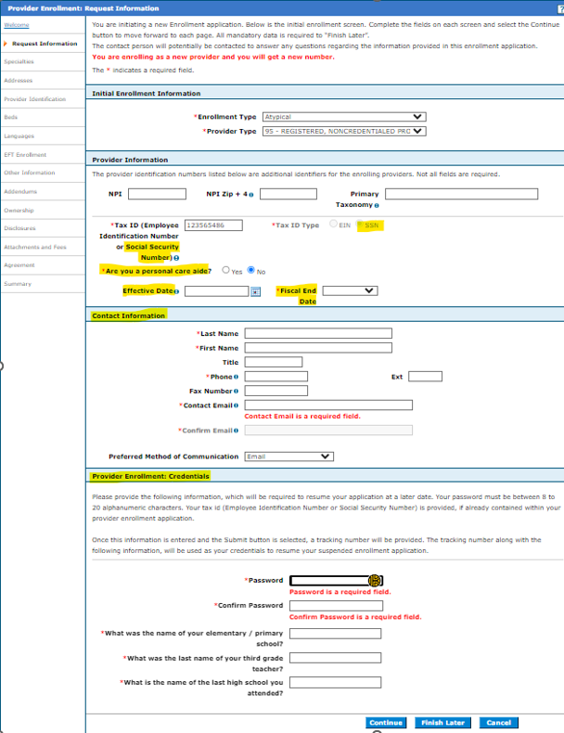
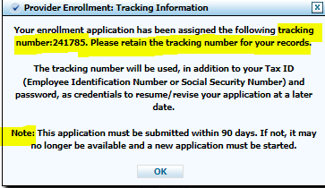
Entering the application data: Requested Information
NPI & Taxonomy: Not required.
TAX ID: List the SSN of the enrolling personal care aide.
Effective date – List a requested effective date or place today’s date.
Fiscal Year End: Enter December unless the fiscal year ends on another date.
Complete Contact Information: This section will receive email notifications if the ATN is RTP’d. RTP = Returned to Provider for review/corrections. The contact information listed here is only for the application record.
Provider Enrollment Credentials: Note the password and security questions you completed for your application. If you need to check the status online or re-access the application after RTP to resubmit for processing, this information will be asked and can't be reset.
Once all sections have been completed, hit continue and a message will pop up with your application tracking ID. An email notification will also be sent.

Slide 5
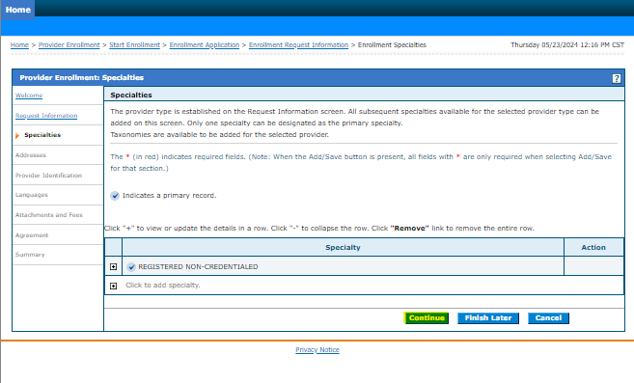
Entering the application data: Specialties tab
Hit continue to proceed with the application.

Slide 6
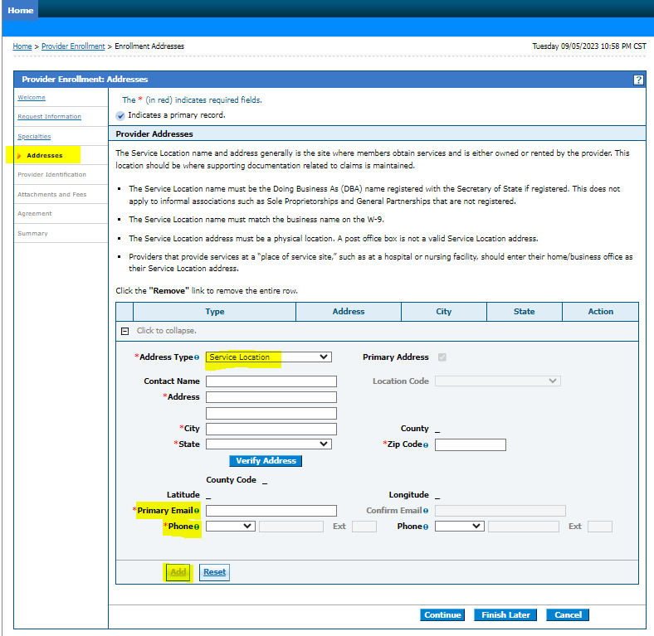
Entering the application data: Addresses
Service location is required. Once entered, you must hit “Verify Address” before the application will allow you to save the information.
Complete address info for the Home Office, Mail to, and Pay to. If these sections are not completed, the information listed on the service location will be copied to all addresses upon enrollment.

Slide 7
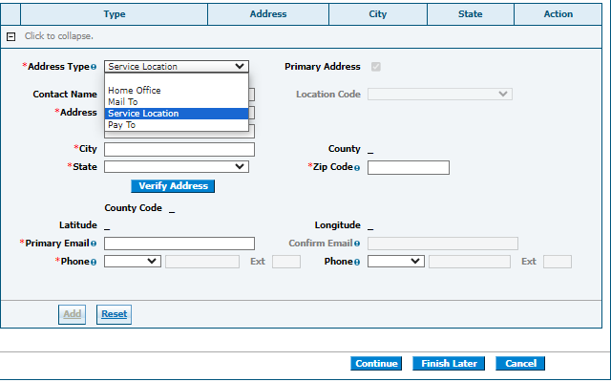
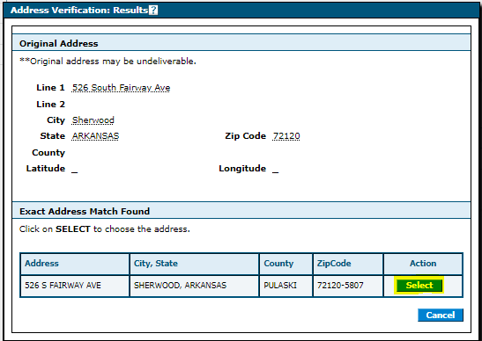
Entering the application data: Addresses

Slide 8
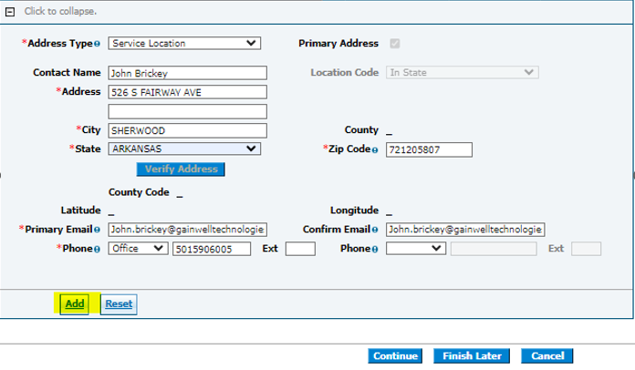
Entering the application data: Requested Information

Slide 9
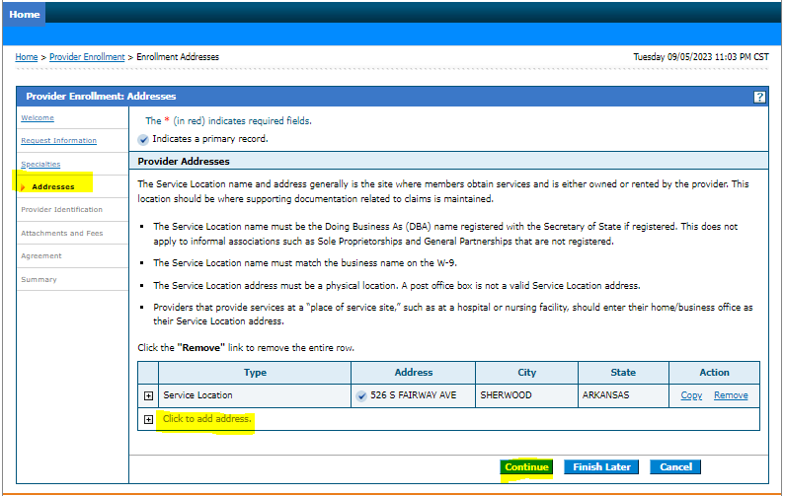
Entering the application data: Requested Information

Slide 10
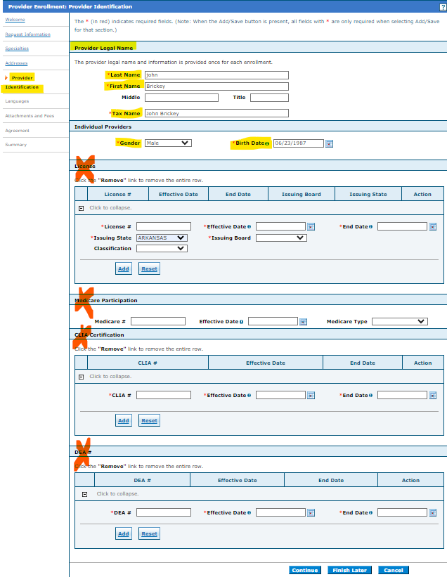
Entering the application data: Provider Identification
Provider Legal Name: List the Individual personal care aides’ legal name.
Tax Name: This section should match the same individual name.
Gender/DOB: Enter the gender & DOB of the Personal Care provider.
License, Medicare, CLIA, and DEA – These sections do not apply to enrolling PCA providers. Should be left blank, and the application will allow you to continue through submission.

Slide 11
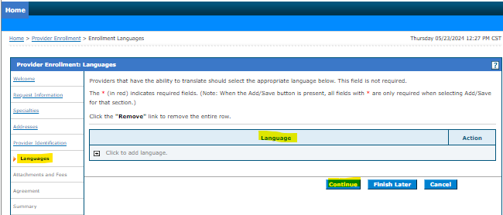
Entering the application data: Languages
Language is optional – You can list any language or continue to proceed with the application.

Slide 12
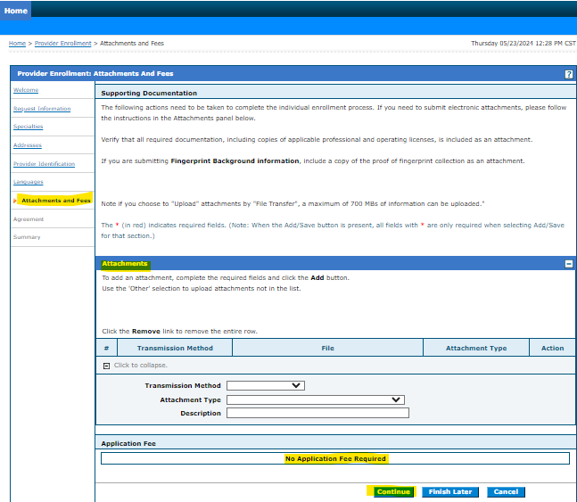
Entering the application data: Attachments and Fees
The application doesn’t require attachments to be with the initial submission.
It is recommended not to attach any additional documents to the initial submission unless additional information is being requested.
Paper pin forms should not be uploaded when submitting applications electronically through the portal website.
All optional listings are only needed if applicable or requested.

Slide 13
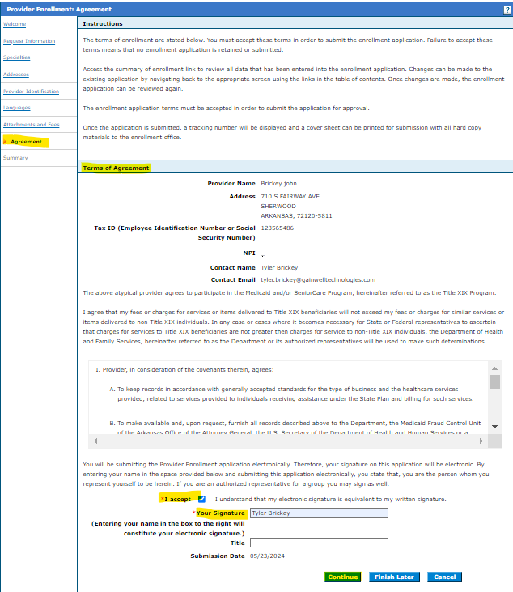
Entering the application data: Agreement
Click “I Accept” to terms of agreement
Enter the providers legal name and title to finalize the signature page for the application.

Slide 14
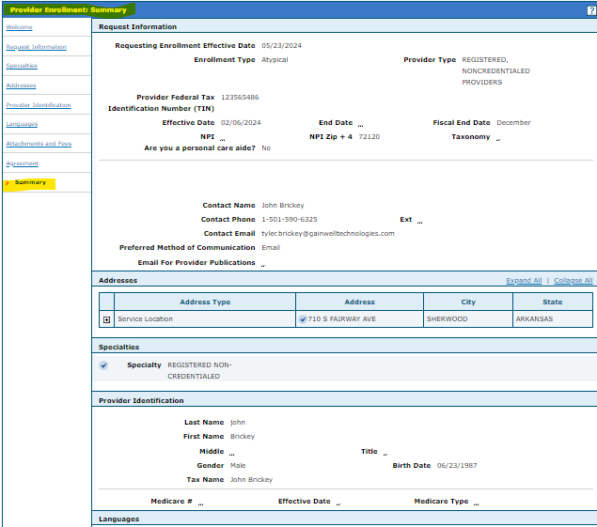
Entering the application data: Summary
This is a preview of your application before you complete your submission.
Hit “Print Preview”
Save a copy of the application summary for your records.
Must go to the bottom of the page to complete the submission of the application.

Slide 15
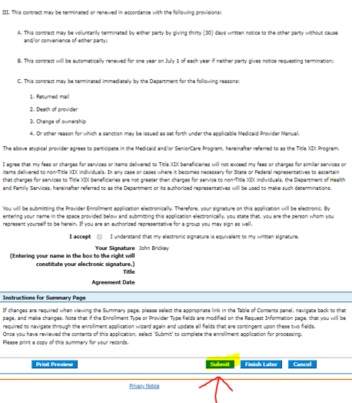
Entering the application data: Finalizing Submission
Must go to the bottom of the page to complete the submission of the application.
Hit “Submit” to complete the application. Save the tracking ID for your records.

Slide 16
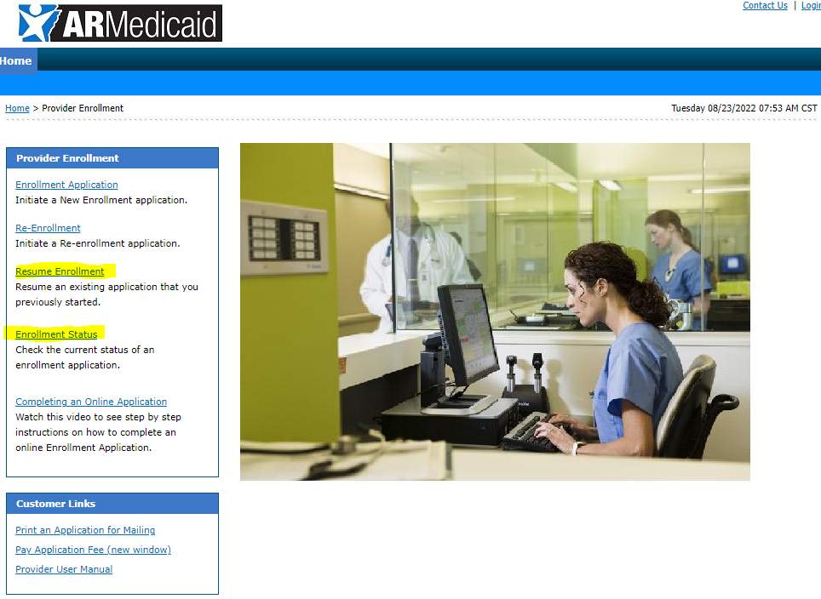
Applications submitted on portal
You can check the status of any application submitted and see any notes for corrections or documents needed to complete your application.
If corrections are needed, you can click the “Resume Enrollment” to access the previously submitted application and upload any document or make changes need for your application and resubmit.

