Slide 1

Division of Youth Services
Attachment G
Transformation Plan

Slide 2
Arkansas Division of Youth Services Core Beliefs
1. Youth are best served in least-restrictive settings located close to home, when appropriate; evidence-based rehabilitative services are available; and removing youth from the home should be the option of last resort.
2. Families, schools, law enforcement, and courts need a wide array of service options, including graduated sanctions outside the courtroom.
3. Decision-making should be data-driven, and programs and services should be supported by data demonstrating their effectiveness in improving outcomes for youth and families.
4. Effective community-based services can reduce the use of confinement and commitment to the Division of Youth Services (DYS) and result in significant savings in state revenue.
5. Treatment and placement decisions should be individualized, based on comprehensive, standardized assessments, and actively involve youth and families in the planning process.
6. All youth in DYS custody should be provided effective education and vocational training opportunities.
7. Limiting length-of-stay recommendations in order to recognize that the effectiveness of treatment provided in institutional settings is diminished after six months, notwithstanding correctional and public safety goals.
8. Collaboration with local school districts is critical to a youth’s successfully returning home to his or her community, along with effective aftercare and prevention programs.
9. Funding allocation across residential and community-based services must be rebalanced.
10. All children and youth in the state should have equal opportunities for services and success, without regard to gender, race or ethnicity, disability, geographic location, or income level.

Slide 3

Moving the Juvenile Justice System Forward
  DHS contracted with the Center for Child Law and Policy (CCLP) in March 2018 to complete a review of the DYS residential treatment system for youth adjudicated delinquent and committed to the custody of DYS.
  As a result of this study, and previous studies that looked at the Arkansas Juvenile Justice System, we have developed a set of initial action steps designed to begin moving the system forward in cooperation with the Judiciary, Community-Based Providers, and other Stakeholders in the Juvenile Justice System.
  It should be noted that these changes are occurring at the same time that the Governor-appointed Youth Justice Reform Board is working to develop legislative proposals designed to reduce the use of secure out-of-home placements and expand the use of community-based options such as diversion and family support services.
DYS Transformation Plan

Slide 4
Juvenile Justice Transformation: Phase 1 Goals
November 2018 through June 2020
  Ensure all youth are quickly placed in the least restrictive, most effective, quality treatment setting
  Ensure treatment progresses timely and youth transition to a home setting as quickly as possible
  Ensure the appropriate supports are in place for the youth to successfully return to home and community
  Ensure all parties involved in the youth’s treatment and return to a home setting have the information and data they need to do their job
  Establish the foundation for continued rebalancing of the system in Phase Two for youth to be placed directly at home or in a setting near home, when appropriate
DYS Transformation Plan

Slide 5
Phase 1 Transformation Actions
By June 30, 2019:
  All youth go immediately into assessment and from assessment into the best setting for their individual treatment plans.
  Treatment plans are individualized and developed by experts in Juvenile Justice, Behavioral Health & Substance Abuse, and Education, along with the Aftercare Provider.
  All youth have a treatment team that stays with them through their time with DYS. Treatment progress is reviewed and adjusted (if necessary) at least every three months. Discharge is recommended by the treatment team.
  Family engagement and reintegration of the youth with the family as part of the treatment plan.
  All parties involved with the youth receive regular reports on the youth’s treatment progress.
July 2019 – July 2020:
  New residential contracts begin July 1, 2019.
    Residential facilities reduced.
    Behavioral Health Treatment included in contract
    Treatment requirements strengthened
    Family engagement requirements
    Virtual Arkansas education platform continues
  New Group & Specialty Placement contracts begin July 1, 2019.
    Beds expanded by forty-one (41), doubling total beds.
    Strengthened requirements for treatment & family engagement
    Geographic expansion of group homes
  New Community-Based provider contracts begin July 1, 2019.
    Additional funding to focus on and strengthen aftercare, field evaluations, and ensure successful reintegration of youth in family and community settings, laying foundation for Phase Two of transformation.
    Diversion funding to encourage placements in communities and home continues.
    Reporting requirements strengthened
  Replacement for DYS case information system, Rite Track, completed and actionable reports provided to all stakeholders (Judiciary, Community Based Providers (CBPs), etc.) by June 2020
  Quality and safety measures are built into the system.
DYS Transformation Plan

Slide 6
Strengthening Treatment – By July 2019
Individualized treatment plans and treatment teams
  Each youth to receive a personalized treatment plan developed and regularly reviewed by a robust team focused on that youth
  Addition of licensed behavioral health clinicians, education specialists, and vocational/work professionals to the treatment planning and review team for each youth
  Addition of the Aftercare Provider and potentially a PASSE Care Coordinator to the treatment planning and review team for each youth
  Treatment plan to include a family/community component, focused on ensuring successful re-integration of the youth into family and community following completion of treatment. The family and community evaluation produced by the Aftercare Provider is key to developing this portion of the treatment plan.
  Treatment progress reviews by the youth’s treatment team at one- to three-month intervals.
  Through consistent monitoring, the treatment team will be able to gauge when the youth is ready to return home and make recommendations to the director in order to begin the process for discharge to a home setting.
DYS Transformation Plan

Slide 7
Strengthening Treatment by July 2019
Improve internal operations to ensure time youth spend in DYS custody is effective
  Improved intake process ensures youth go directly into an assessment bed and from assessment directly into a treatment placement.
    DYS will ensure all information needed for assessment is available
    Juvenile Detention Center use pending assessment or placement will be reduced/eliminated before June 2019
  Improved discharge process streamlines youth’s return to the community when treatment is completed
  Reporting developed so that stakeholders (Judiciary and CBPs) can track progress of youth from intake, through treatment, to discharge
Family engagement becomes core component of the youth’s treatment plan
  Aftercare Providers become part of the youth’s treatment team from the beginning
  Expanded timely field evaluations prepared by the Aftercare Provider will provide critical information for developing the youth’s treatment plan and identifying supports needed for the youth to return home
    New incentive payments to Aftercare Providers for field evaluations will start January 2019
    Care coordinators, focused on behavioral health, medical needs, and other supports are members of the youth’s treatment team
DYS Transformation Plan

Slide 8
Strengthening Placement Options by July 2019
Residential facilities rebalanced and improved
  Facilities reduced from seven (7) to five (5) by July of 2019
    Colt and Dermott 11-17 closed
  Harrisburg converted to an all-female facility
  Infrastructure investments to improve facilities
    Locking system at AJATC
    Sewer and other repairs at Mansfield
    HVAC system at Dermott 18-21
  Vocational program expanded at Dermott 18-21
    Equipment purchase to allow for on-site vocational training
Group Home and Specialty Placement Beds Increased
  Ten (10) additional beds to be added in January of 2019
  Total of forty-one (41) additional beds to be added in July of 2019
    Doubles the total number of group home and specialty beds
    New procurements will seek additional beds around the state
    Treatment requirements will be strengthened
    Enhanced Quality Assurance
      Enhanced health and safety monitoring conducted by the Division of Child Care and Early Childhood Education;
      Treatment monitoring conducted by the Division of Provider Services and Quality Assurance;
      Financial monitoring by the Office of Payment Integrity and Audit
DYS Transformation Plan
DYS Transformation Plan

Slide 9
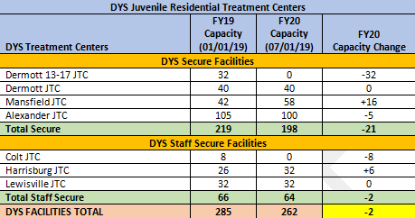
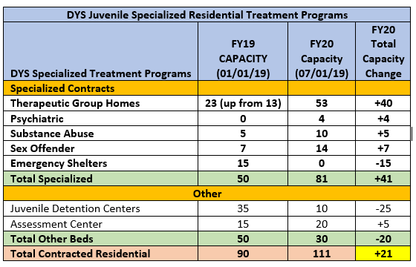


The additional assessment beds are being removed from AJATC treatment beds.
Specialized contracts are up for renewal 7/1/19. The vendors are unknown at this time.
DYS will add an additional four (4) psychiatric beds.
DYS will add an additional five (5) substance abuse beds.
DYS will add an additional seven (7) sex offender beds.
Therapeutic group home beds will be increased by forty (40). (DYS will repurpose the fifteen (15) emergency shelter beds and add an additional twenty-five (25) new beds.)

