Slide 1
Oscar Insurance Company
Presentation to the Arkansas Health and Economic Outcomes
Accountability Oversight Advisory Panel
August 25, 2021
Presented by:
Alyssa Canter, Director, Government Affairs
Tamara Ward, VP, Central Region
Dr. Meera Atkins, Central Region Medical Director
Notes:
Note: full name of panel is: Health and Economic Outcomes Accountability Oversight Advisory Panel

Slide 2
Founded in 2012, Oscar is a health insurance company built around a full stack technology platform, strong provider partnerships, and a relentless focus on serving our members.

Slide 3
Oscar in 2021
INTRODUCING OSCAR
Oscar 2021 National Footprint
291 Counties across 18 States² where Oscar offers
at least one type of health insurance plan.
18 total states
291 total counties
3 lines of business
~560,000¹ total members
2,000+ employees
Existing State, Existing Counties
New County
Existing State, New Counties
¹As of June 30, 2021
New State, New Counties
Existing County
²As of January 31, 2021

Slide 4
Oscar Corporate Structure
OHI
Oscar Health, Inc. (“OHI”) is the sole parent
owner of its Oscar insurance subsidiaries, including Oscar Insurance Company (“OIC”) and Oscar Management Corporation (“OMC”). Oscar Insurance Company is domiciled in Texas; OMC is an administrative services company.
OMC
(Services Co)
Oscar Insurance Subsidiaries
Collectively referred to as “Oscar”

Slide 5
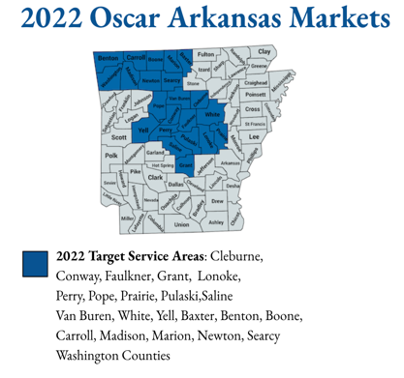






Oscar in Arkansas
2022 Rating Areas: Fayetteville MSA (AR03) & Little Rock MSA (AR01). By 2023, Oscar plans to have a statewide network.
Oscar’s 2022 network partners* include:
*Oscar intends to expand partners for 2023.

Slide 6
Proprietary & Confidential Information
The Oscar model
Built for consumers…
All the features on one system with the best engagement in healthcare. We help members to find the right care at the right time.
…on custom-built, integrated networks
Supported by concierge & clinical teams built in collaboration with our network partners.
…using full stack insurance technology.
We have built all insurance & delivery functions on our own technology stack.

Slide 7

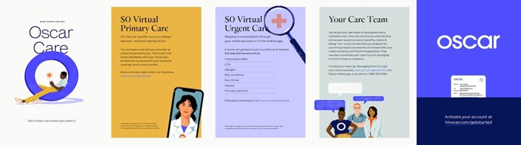

Starts with our Member Onboarding Experience

Slide 8

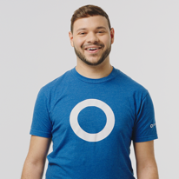



Powered by our Care Teams
Our approach to customer service is different.
It's personalized care. And it's one of the
reasons Oscar's member satisfaction is 2x
the industry average.
Your very own care team.
With Oscar, you get paired with your own Care Team – a team of care guides and a nurse who can help answer questions and save money by finding you the most affordable, highest quality care in your area.
Getting help is easy.
We can help you better understand your
plan benefits.
We'll help you find local, in-network doctors.
We can help you prepare for visits and procedures.
We can help you get the most out of your plan.

Slide 9
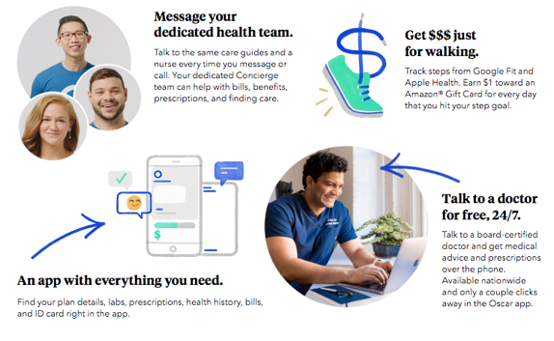
Trust Fosters Engagement
Through industry-leading technology and customer service, Oscar makes it easy for members to navigate their healthcare.
40
4
Oscar NPS
Industry NPS
Ranked top 3 insurer
in online member reviews.

Slide 10

Oscars clinical & population health programs encompass 4 areas of focus that provide an integrated approach to member care
Keeping members healthy
Acute & Chronic Condition Management
Managing members with emerging risk
Patient Safety and Outcomes across settings
By combining our innovative programs, industry leading member engagement and health & economic independence incentives we are able to improve the lives of the members we serve

Slide 11
Thank you

