Slide 1


Provider Update from the Division of Provider Services and Quality Assurance
Training for Options
Counseling QuickBase
humanservices.arkansas.gov

Slide 2
Division of Provider Services & Quality Assurance
DPSQA is comprised of 3 units who work together in investigating maltreatment:
Office of Long-Term Care – They license and inspect nursing facilities, intermediate care facilities, and psychiatric residential treatment facilities; license nursing facility administrations; investigate complaints against long-term care facilities and their employees; and determine medical eligibility for Medicaid for long-term care facility placement and waiver services.
Office of Community Services – They license, certify, and regulate home- and community- based programs, ARChoices waiver, and alcohol and other drug abuse treatment providers and review concerns, complaints, and allegations of substandard quality of care as it relates to facility practices.
Office of Performance and Engagement – One of our first points of contact for allegations of maltreatment. They receive calls and emails through various sources and send them to the appropriate unit for investigations.
humanservices.arkansas.gov

Slide 3

Options Counseling QuickBase
The link to visit the Options Counseling QuickBase is:
https://ardhs.quickbase.com/db/bti8ymhe2
humanservices.arkansas.gov

Slide 4
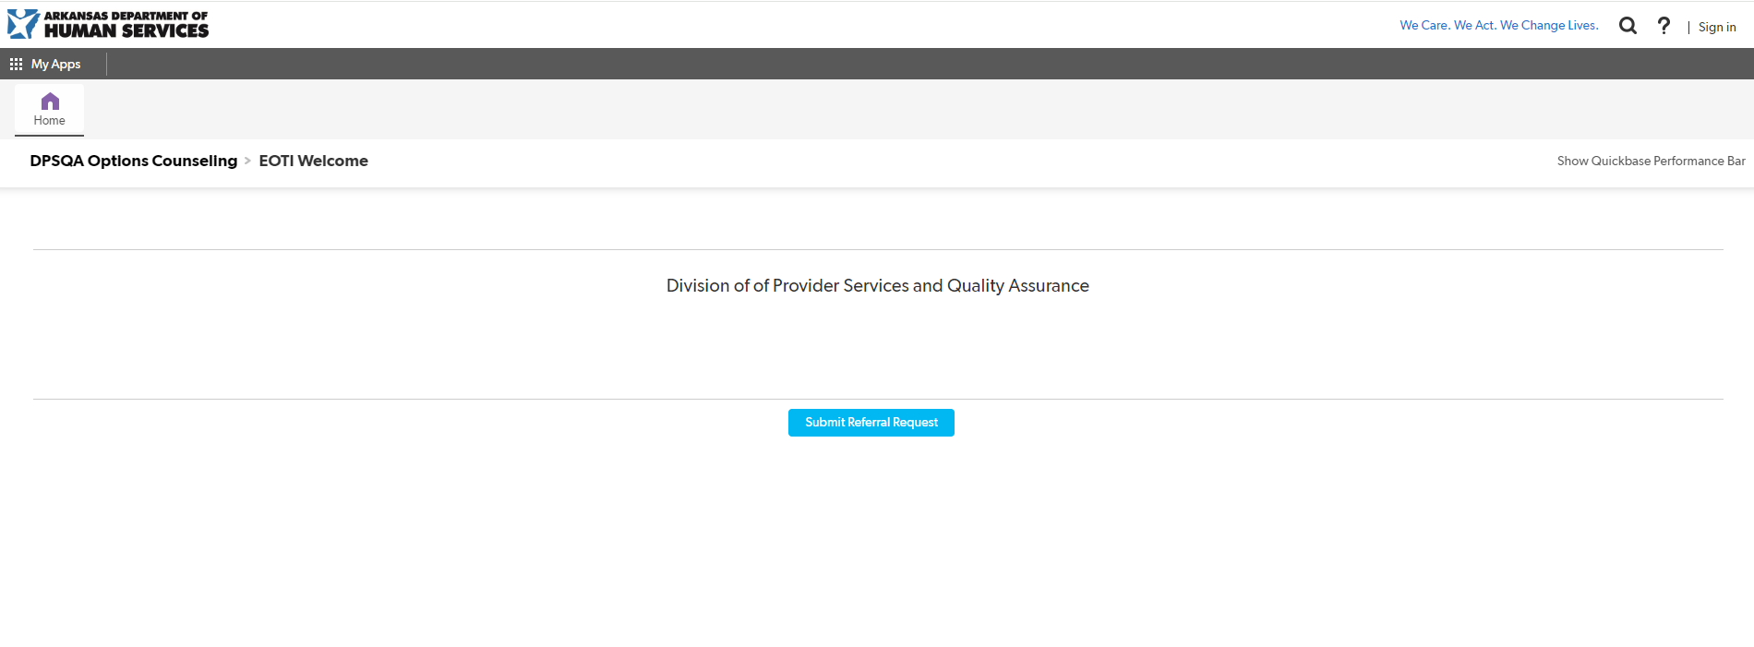
Options Counseling QuickBase
humanservices.arkansas.gov

Slide 5
Options Counseling QuickBase
humanservices.arkansas.gov

Slide 6
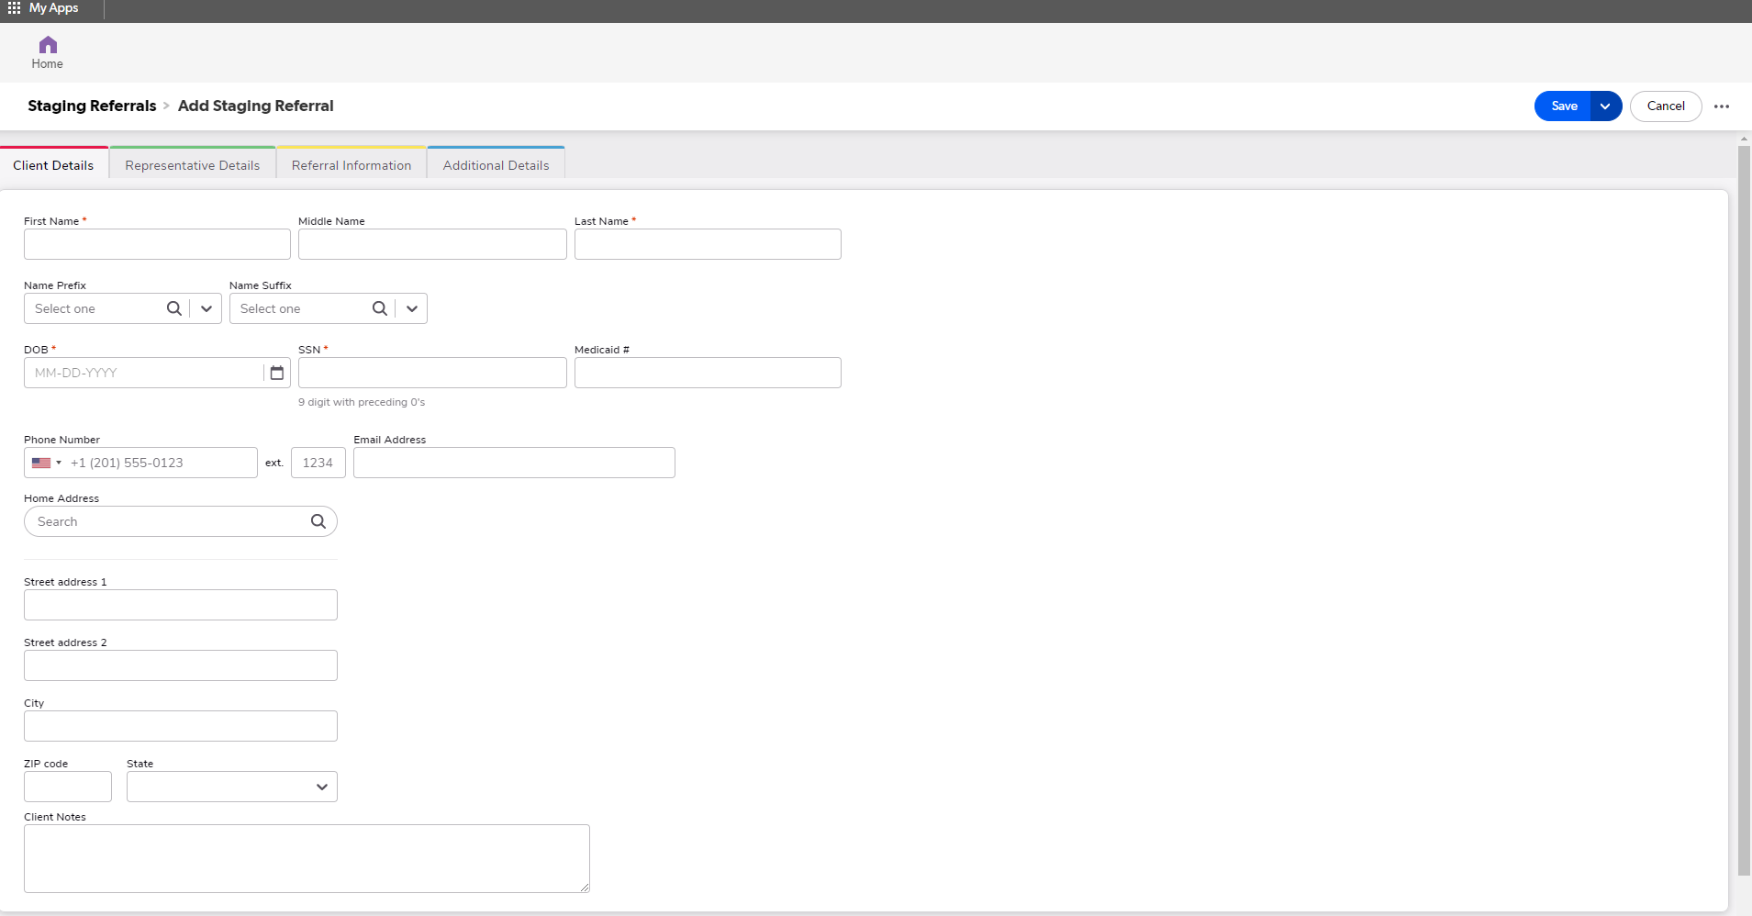
Options Counseling QuickBase
humanservices.arkansas.gov
Notes:
Any field with a red asterisk is a required field. You will not be able to save the referral until that information is completed.

Slide 7
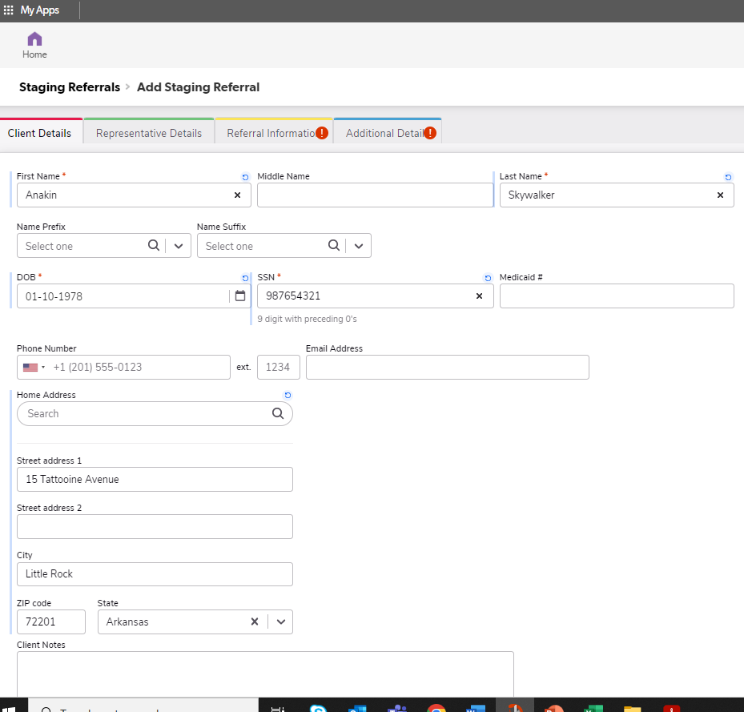
Options Counseling QuickBase
humanservices.arkansas.gov

Slide 8
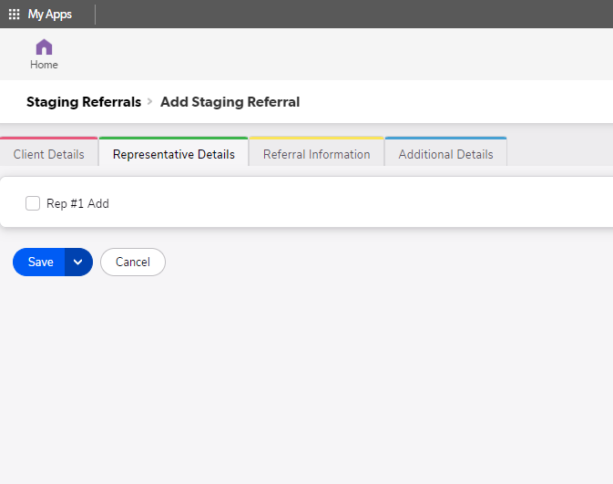
Options Counseling QuickBase
humanservices.arkansas.gov

Slide 9
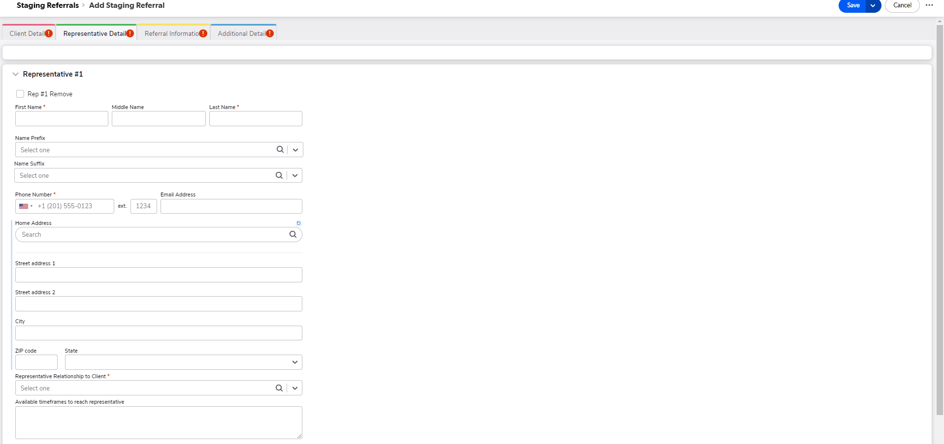
Options Counseling QuickBase
humanservices.arkansas.gov
Notes:
In the “Representative Relationship to Client” field, there is a list of drop-down options from relatives to neighbor, or guardian.

Slide 10
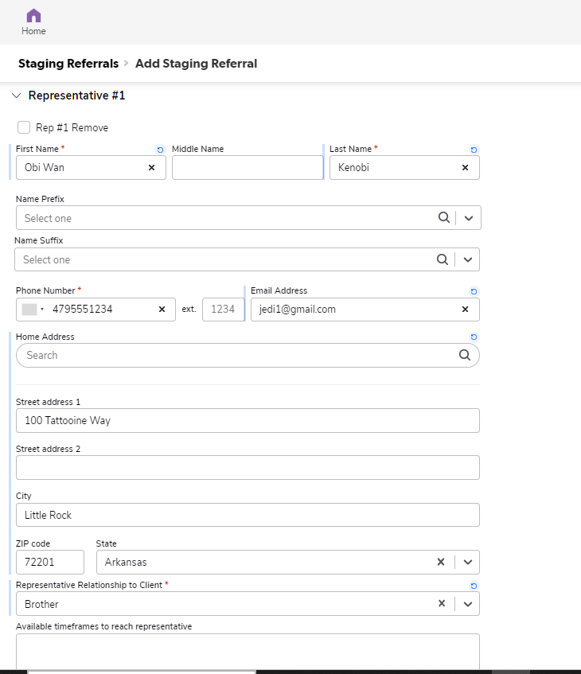
Options Counseling QuickBase
humanservices.arkansas.gov

Slide 11
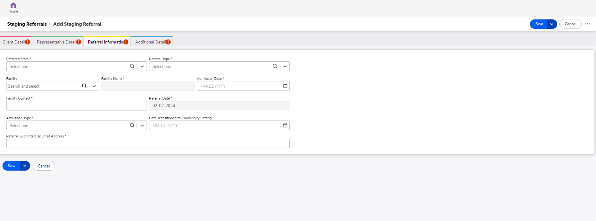
Options Counseling QuickBase
humanservices.arkansas.gov
Notes:
Under referral, the drop-down options include Money Follows the Person or Nursing Home Options Counseling. Referral type options include new admissions and prescreens. There is also the ability to search for the facility name. Admission Types are: long term, short term, hospice, rehab, and other.

Slide 12
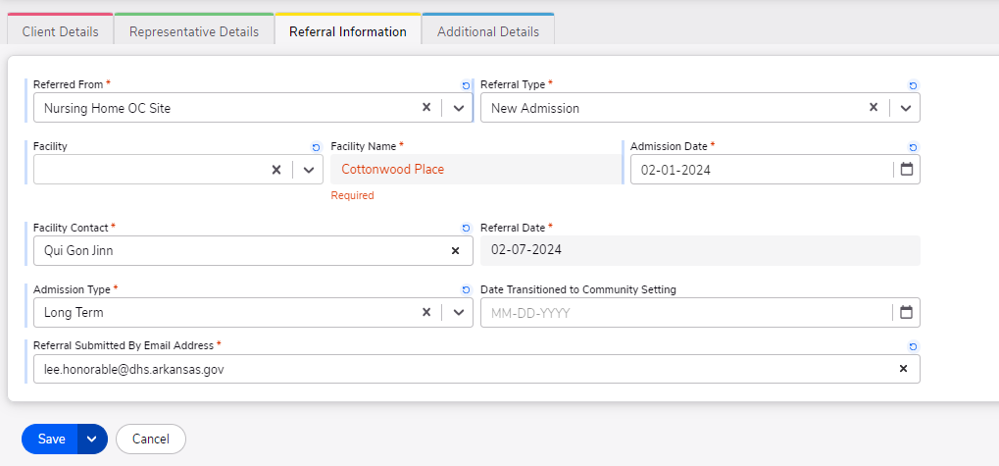
Options Counseling QuickBase
humanservices.arkansas.gov

Slide 13
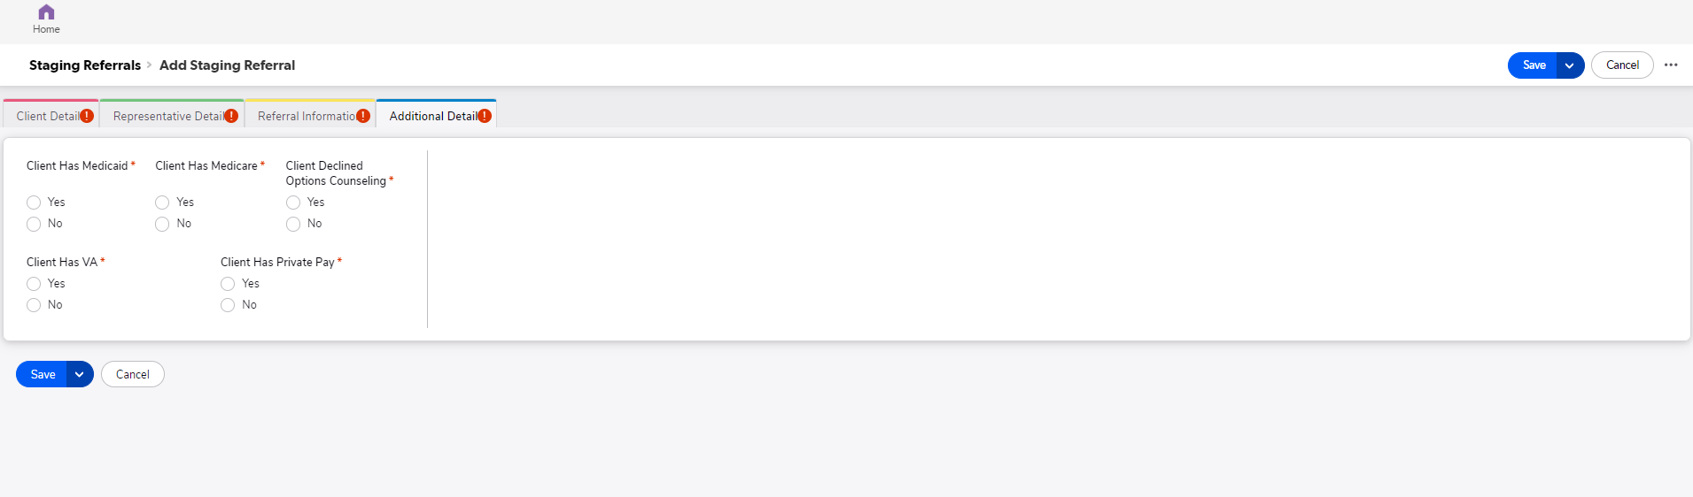
Options Counseling QuickBase
humanservices.arkansas.gov

Slide 14
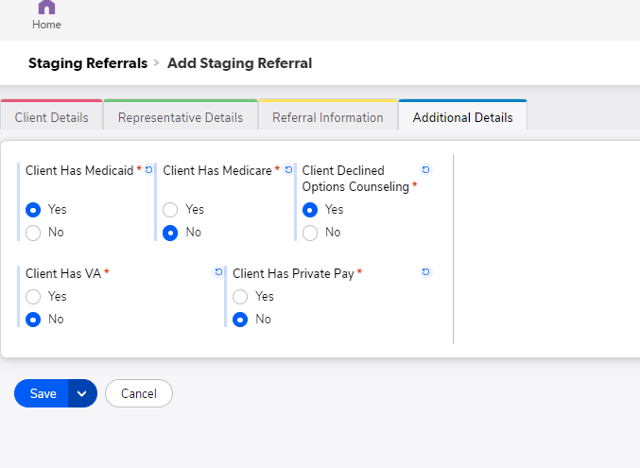
Options Counseling QuickBase
humanservices.arkansas.gov

Slide 15
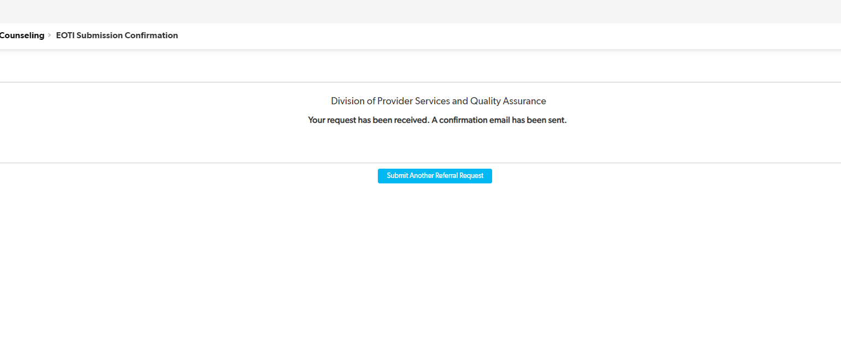
Options Counseling QuickBase
humanservices.arkansas.gov

Slide 16
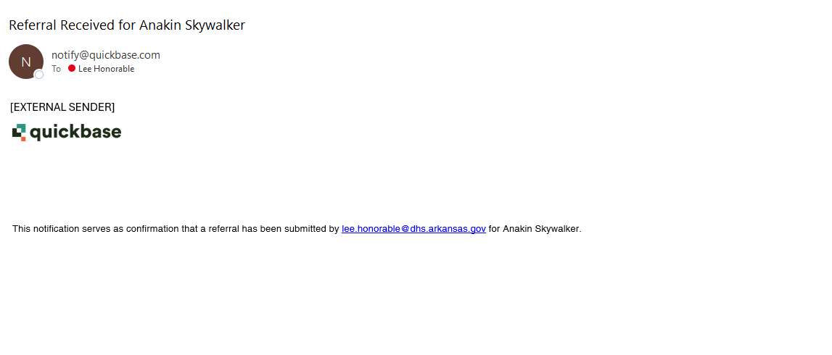
Options Counseling QuickBase
humanservices.arkansas.gov

Slide 17

Options Counseling QuickBase
Facilities will have the capability to print to maintain copies for their records for possible surveys, and to maintain potential requests from regulatory agencies.
humanservices.arkansas.gov
Notes:
Facilities are required to maintain a copy of the referral for 18 months.

Slide 18

Options Counseling QuickBase
Several facilities have been testing the QuickBase and providing feedback. We would like to thank them for their assistance in helping to make this process change as smooth as possible.
humanservices.arkansas.gov

Slide 19




Find Us On…
@ArkDHS
@arkansasdhs
@ARHumanServices
ARHumanServices
Contact Information
Options.Counseling@dhs.arkansas.gov
humanservices.arkansas.gov

Slide 20
Title Line
We Care. We Act. We Change Lives.
humanservices.arkansas.gov

