Slide 1




Health & Nutrition Unit Outreach Overview
Health & Nutrition Programs
USDA is an equal opportunity provider, employer, and lender.

Slide 2



Our mission….
to increase food security and reduce hunger by providing children and low-income people access to food, a healthy diet and nutrition education in a way that supports American agriculture and inspires public confidence.

Slide 3

Arkansas Food Security concerns…..
More than 200,000 children in Arkansas are at risk of hunger and not getting the food they need to lead healthy, active lives.
More than 28% of children in Arkansas live in poverty.
Nearly 30% of households with children in Arkansas struggle to afford enough food for themselves and their families.
Many children lose access to breakfast and lunch when school is not in session.

Slide 4

CACFP
CACFP
The Child and Adult Care Food Program (CACFP) provides reimbursements for nutritious meals and snacks to eligible children and adults who are enrolled for care at participating childcare centers, day care homes, and adult day care centers.
2021: 331 Sponsors
141(Highest) Child Sites/51 Adult Sites)
CACFP At-Risk
At-Risk Afterschool Meals component of the Child and Adult Care Food Program (CACFP) offers Federal funding to Afterschool Programs that serve a meal or snack to children in low-income areas.
2021: 74 Sponsors (272 Sites)

Slide 5

SFSP
The Summer Food Service Program (SFSP) reimburses providers who serve free healthy meals to children and teens in low-income areas during the summer months when school is not in session.
2021:
72 Sponsors/960 sites

Slide 6

NSLP
The National School Lunch Program (NSLP) operates in public and nonprofit private schools and residential childcare institutions. It provides nutritionally balanced, low-cost or no-cost lunches to children each school day. The program was established under the Richard B. Russell National School Lunch Act, signed into law by President Harry Truman in 1946.
2021: 24 Programs

Slide 7

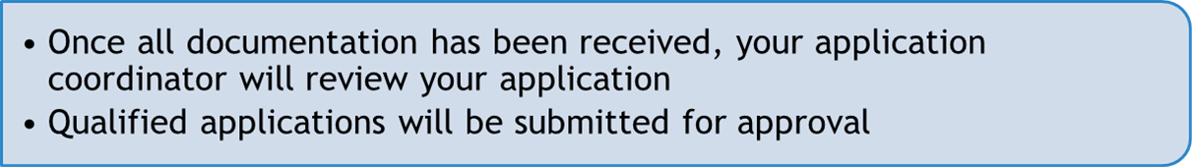
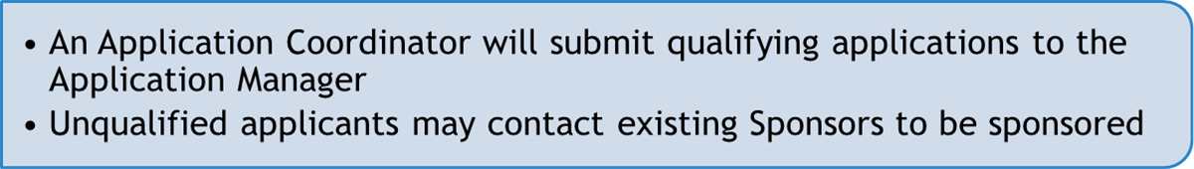
Application
Submit an Inquiry (SNP Website)
  An Onboarding Specialist will review your information using a checklist of requirements
Application
Approval or
Denial
https://dhs.arkansas.gov/dccece/snp/WelcomeSNPM.aspx

Slide 8
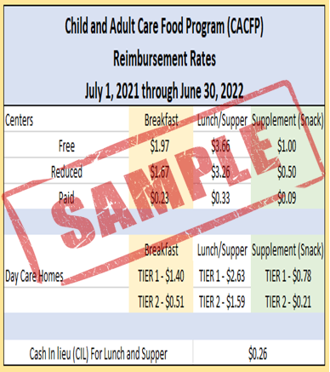
Reimbursement Rates
Reimbursement rates are used to determine how much reimbursement is available per child for each claimed meal.
Children are categorized based on Income Eligibility Forms in a free, reduced, or paid category.
Cash in lieu is an additional reimbursement amount for lunch/supper that is offered to programs who do not participate in the Commodity Program.
Reimbursement rates are updated annually for each program.

Slide 9

Training
7 CFR 225.15(d) - Sponsors are required to train both their administrative and site staff before they undertake their responsibilities and maintain records that document: date of training, attendance, and topics covered.
Below are the required and optional trainings that are provided by HNU Training Team:
Required Annually
New Participant Training- 6 hours (required)
Refresher Training- 3 hours
At Risk Training- 6 hours
NSLP- 7 hours
Optional
Application Training- 3 hours (optional)
1-on-1 Technical Assistance- 2-3 hours per sponsor
Training is offered 2-3 times a week during the application cycle

Slide 10

Review TEAM
Site Review
Monitoring
Technical Assistance
Corrective Action Plan

Slide 11

The DCCECE Commodity
Distribution Unit
Allocates USDA dollars to be spent on Food Distribution based on previous meals served
USDA dollars can be used to purchase commodities from a list of available USDA foods. Examples: meats, vegetables and fruits, processing foods, and DOD Fresh Fruits and Vegetables
CACFP
CACFP at Risk
SFSP
NSLP (both DHS and ADE)

Slide 12
Commodity Distribution Unit
Administering Agency: DCCECE Commodity Unit
USDA Foods Processing
Allows State Distributing Agencies (CDU) and eligible Recipient Agencies, such as school districts, to contract with commercial food processors to convert raw bulk USDA foods into more convenient, ready-to-use end products.
The Emergency Food Assistance Program (TEFAP):
Assists in supplementing the diets of low-income Americans by providing them with emergency food assistance at no cost.
Commodity Supplemental Food Program (CSFP):
Assists to improve the health of low-income persons at least 60 years of age by supplementing their diets with nutritious USDA foods.
USDA Foods during Disasters:
As part of the National Response Framework, USDA Food Distribution has the primary responsibility of supplying food to organizations like Red Cross, Salvation Army for mass/congregate feeding or household distribution.

Slide 13

Commodity Distribution Unit
Administering Agency: DCCECE Commodity Unit
State Food Purchasing Program
Administering Agency: AR DHS Division of County Operations (DCO)/AR Hunger Relief Alliance
Provides approximately $1 million to the AR Hunger Relief Alliance through the Tobacco Tax to purchase food and provide funds for capacity building grants to member agencies.
Coming Soon!
Farm to Food Bank Program
As part of the TEFAP program this will provide additional administrative funds to food banks to cover farmers costs of picking and packaging produce for food bank distribution.

Slide 14

USDA Non-Discrimination Statement
In accordance with Federal civil rights law and U.S. Department of Agriculture (USDA) civil rights regulations and policies, the USDA, its Agencies, offices, and employees, and institutions participating in or administering USDA programs are prohibited from discriminating based on race, color, national origin, religion, sex, gender identity (including gender expression), sexual orientation, disability, age, marital status, family/parental status, income derived from a public assistance program, political beliefs, or reprisal or retaliation for prior civil rights activity, in any program or activity conducted or funded by USDA (not all bases apply to all programs). Remedies and complaint filing deadlines vary by program or incident.
Persons with disabilities who require alternative means of communication for program information (e.g., Braille, large print, audiotape, American Sign Language, etc.) should contact the responsible Agency or USDA's TARGET Center at (202) 720-2600 (voice and TTY) or contact USDA through the Federal Relay Service at (800) 877-8339. Additionally, program information may be made available in languages other than English.
To file a program discrimination complaint, complete the USDA Program Discrimination Complaint Form, AD-3027, found online at How to File a Program Discrimination Complaint and at any USDA office or write a letter addressed to USDA and provide in the letter all of the information requested in the form. To request a copy of the complaint form, call (866) 632-9992. Submit your completed form or letter to USDA by: (1) mail: U.S. Department of Agriculture, Office of the Assistant Secretary for Civil Rights, 1400 Independence Avenue, SW, Washington, D.C. 20250-9410; (2) fax: (202) 690-7442; or (3) email: program.intake@usda.gov.
USDA is an equal opportunity provider, employer, and lender.
Arkansas Special Nutrition Program Website: https://dhs.arkansas.gov/dccece/snp/WelcomeSNPM.aspx

Slide 15









www.facebook.com/ArkDHS
@ARHumanServices
@arkansasdhs
Arkansas DHS
Social Media

