Slide 1
Arkansas Medicaid
Dental Services
Transitioning to Fee-for-Service (FFS) – Traditional Medicaid
October 9, 2024

Slide 2
Agenda
Transition Overview and Beyond
AFMC Provider Relations
Diamond Plan
Provider Enrollment
Provider Portal
Verifying Beneficiary Eligibility for Dental Services
Prior Authorization (PA) Submission
MMIS Dental Billing
Benefit Limits
Dentures
Orthodontia
Questions and Resources
Notes:
Tabitha

Slide 3
Dental Services Transition and Beyond
Beginning November 1, the dental program will return to fee for service. That means dental providers will bill Medicaid directly for the eligible dental services they provide. Clients will use their Medicaid ID to receive services, not their MCNA or Delta Dental cards.
Why is this change occurring? Arkansas Medicaid must ensure beneficiaries receive needed health services while serving as a good steward of taxpayer dollars. DHS analyzed statewide quality measures for dental care along with dental managed care expenditures and determined that a return to the fee-for-service model was the best way forward.
DHS is aware that the program needs some updates. We will immediately begin a comprehensive review of the entire dental program once the FFS transition has gone live and stabilized. This review will include rates, services, procedure codes, billing rules, and limits, as well as thorough review of our policy manual.
We have scheduled regular meetings with the Arkansas State Dental Association to discuss the review, beginning October 11.
Notes:
Nell

Slide 4
AFMC Provider Relations
Tabitha Kinggard, Manager, Outreach Services
Notes:
Tabitha

Slide 5
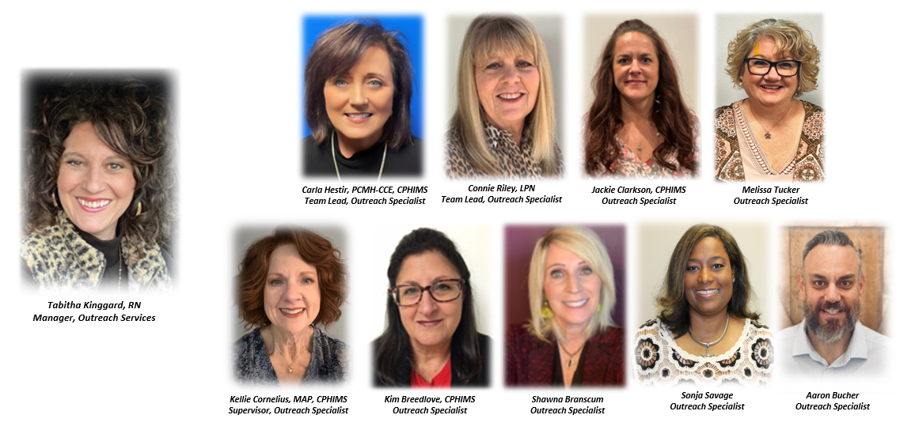
AFMC Provider Relations Team
Notes:
Tabitha

Slide 6
Provider Relations Updates
Educational Outreach
E-Blast Messaging
  AFMC Provider Relations: providerrelations@afmc.org
  Opt-in: https://info.afmc.org/opt-in
Demographic Updates: Provider Enrollment
  Section 141.000
  Section V – Medicaid Manual (DMS-673)
  Job Aid – Uploading Documents: https://humanservices.arkansas.gov/wp-content/uploads/MMIS_JobAid_UploadingDocuments.pdf
Notes:
Tabitha

Slide 7
Provider Relations Updates
Member Letter
  https://medicaid.afmc.org/dental
  AFMC Website: https://medicaid.afmc.org/dental
Medicaid Manual: Dental Providers
  https://humanservices.arkansas.gov/divisions-shared-services/medical-services/helpful-information-for-providers/manuals/dental-prov/
Official Notice: Released 9/27/24
  https://humanservices.arkansas.gov/divisions-shared-services/medical-services/official-notices/
Notes:
Tabitha

Slide 8
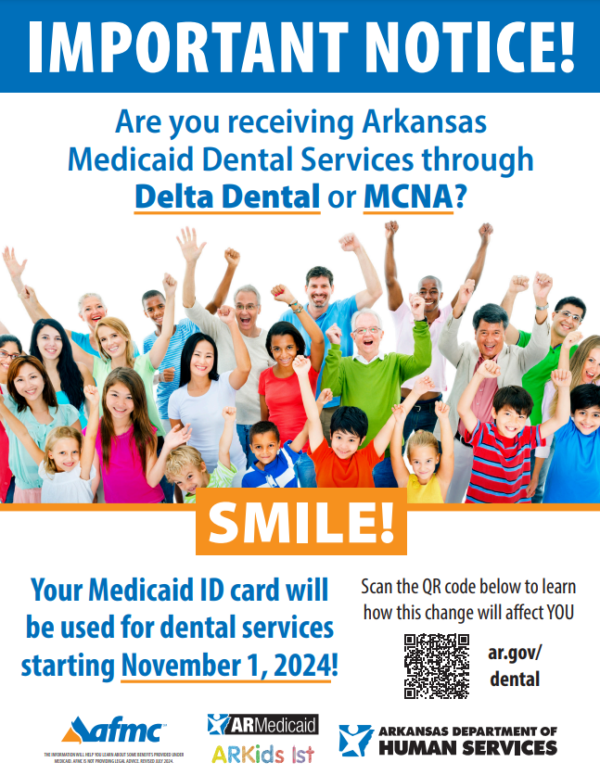
Provider Office Tools
AFMC Provider Relations Website
  https://medicaid.afmc.org/dental
  Dental Flier – Provider Office
  Dental Flier – Beneficiary Outreach
  Medicaid Handbook
  Member Letter
  Provider FAQs
    https://humanservices.arkansas.gov/divisions-shared-services/medical-services/healthcare-programs/dental/dental-providers/
  Provider Questions
    dentalproviderquestions@dhs.arkansas.gov
Notes:
Tabitha

Slide 9
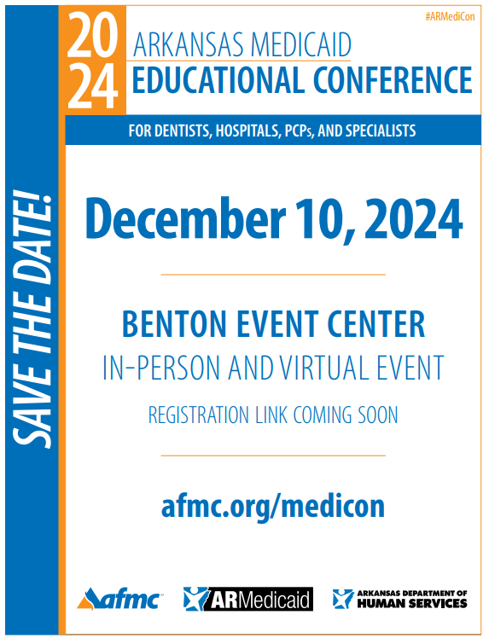
Notes:
Tabitha

Slide 10
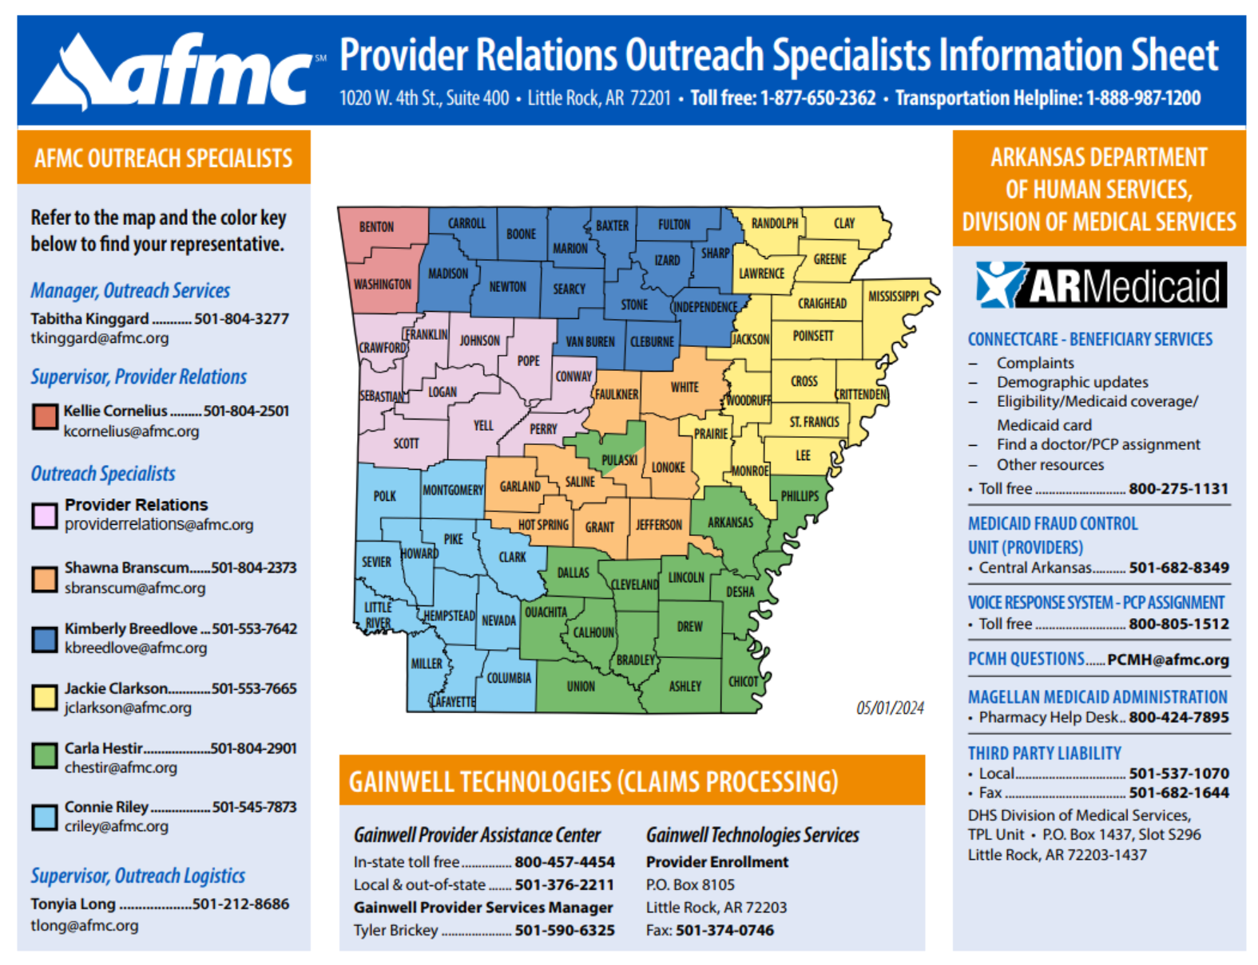
AFMC Provider Relations Outreach Specialists
AFMC’s policy and education outreach specialist team serve as the link between health care providers and Arkansas Medicaid. We help providers navigate the Medicaid system and stay up-to-date on policies and procedures.
During provider visits, our outreach specialists offer feedback and educational tools as needed to help providers implement quality utilization and improvement.
https://medicaid.afmc.org/images/PROREL_AFMCProviderRelationsOutreachSpecialistsMap_20240430_v114.pdf
Notes:
Tabitha

Slide 11
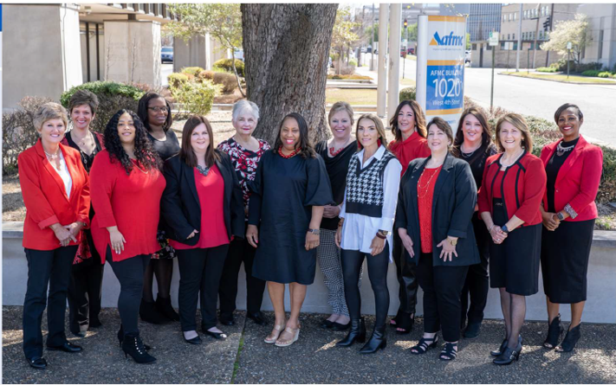
MMIS Outreach Team
Notes:
Tabitha

Slide 12
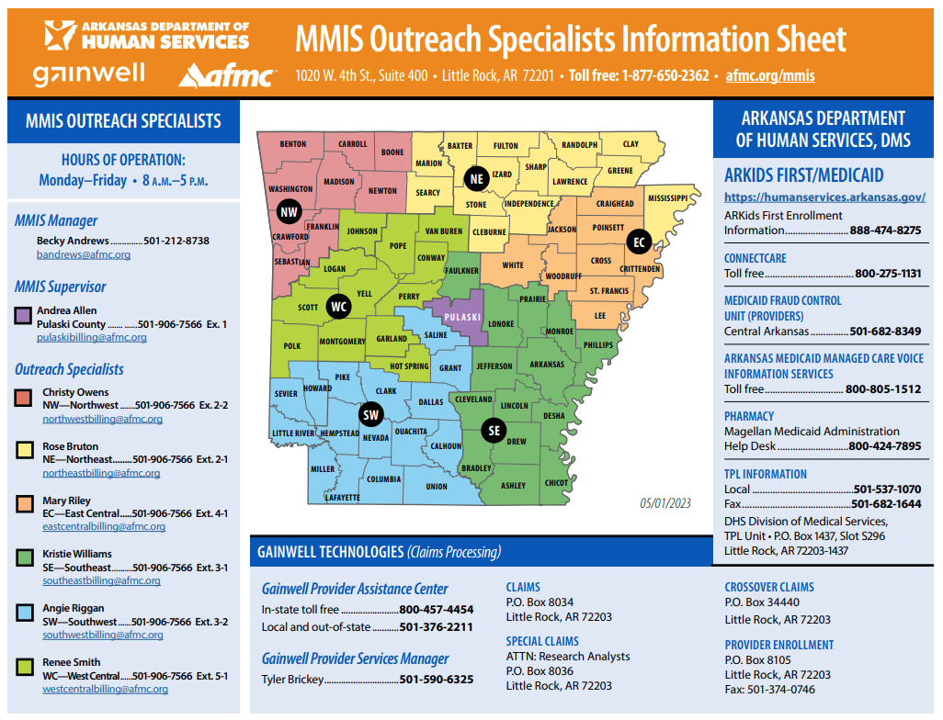
AFMC MMIS Outreach Billing Specialists
AFMC's MMIS Outreach billing specialists are available to help providers with questions about billing requirements and claim processing. Our specialists are adept researchers, problem solvers, and decision-makers.
https://medicaid.afmc.org/images/MMIS_OutreachSpecialistsMap_Updated_20230424_v10.pdf
Notes:
Tabitha

Slide 13
Arkansas Diamond Plan
Robert Jones
Notes:
Tabitha

Slide 14
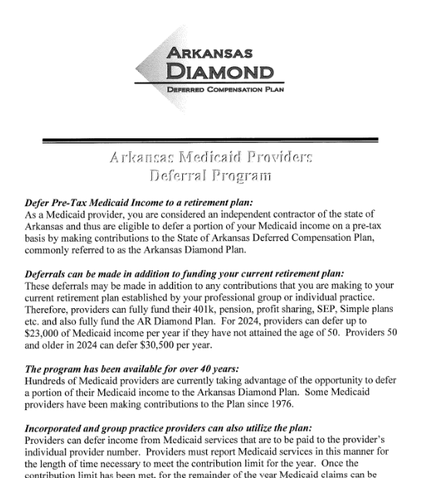
Arkansas Diamond Plan
What is Deferred Compensation?
  https://humanservices.arkansas.gov/divisions-shared-services/medical-services/helpful-information-for-providers/provider-faqs/
How does it work?
Can I defer if I am in a group setting?
Is this in addition to funding current retirement?
How much can be deferred in 2024?
Contact information:
  rjones@stephens.com
  501-377-8112
Notes:
Robert

Slide 15



Provider Enrollment
U.S. State & Local Human Services
Notes:
Tyler

Slide 16
Requirements for submitting EFT
Individual Providers
Submitting EFT doesn’t change who the claim is paid to Individual VS Group. The claim will pay to the provider listed as the biller on the claim.
Individual Providers:
Completed EFT Form
Must submit voided check or bank letter with EFT form.
  Voided Check: Voided check must match the individuals name on the application or must submit a bank letter.
  Bank Letter:
    Must be signed by the bank.
    Needs to include the following information: account holder name, account number, routing number.
    If the account name doesn’t match the individual providers, then the letter needs to detail the individual has depositing rights into the account.
Its often easier to submit the individuals EFT information under their personal account rather than submitting the groups.
Notes:
Tyler

Slide 17
Requirements for submitting EFT
Group/Facility Providers
Submitting EFT doesn’t change who the claim is paid to Individual VS Group. The claim will pay to the provider listed as the biller on the claim.
Group/Facility Providers:
Completed EFT Form
Must submit voided check or bank letter with EFT form.
  Voided Check: Voided check must match the groups legal name or DBA on the application or must submit a bank letter.
  Bank Letter:
    Must be signed by the bank.
    Needs to include the following information: account holder name, account number, routing number.
    If the account name doesn’t match the groups legal name or DBA name listed on the application, then the letter needs to detail the individual has depositing rights into the account.
Notes:
Tyler

Slide 18
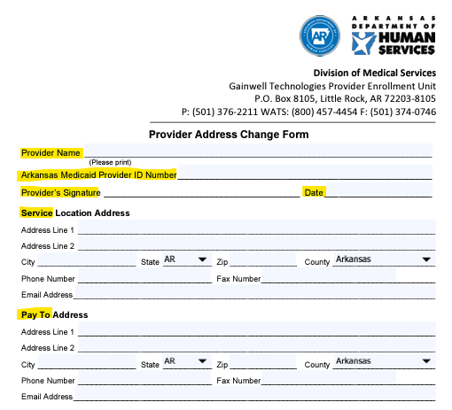
How to update demographic & contact information
To update any demographic or contact information with Arkansas Medicaid, the address change form must be completed to update the information on file.
Enrollment forms can be found on the DHS website below.
Home > Divisions & Shared Services > Division of Medical Services > Provider Enrollment
Printable Enrollment-Related Forms
Notes:
Tyler

Slide 19
MMIS Outreach Team
Dental Billing Resources
Karen Young, Training and Program Developer, MMIS, AFMC
Notes:
MMIS

Slide 20
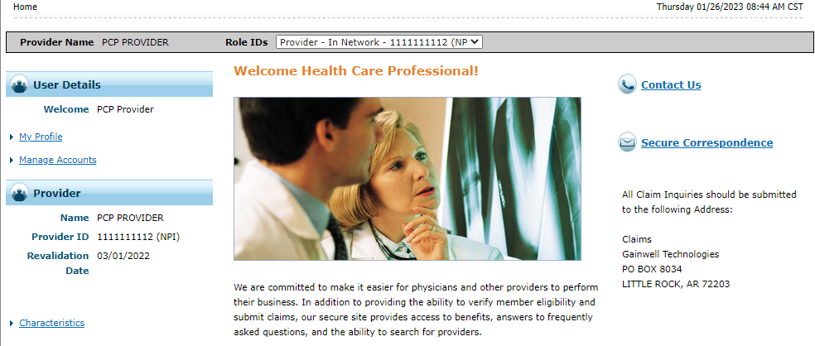
Healthcare Provider Portal portal.mmis.arkansas.gov/ARMedicaid
Notes:
MMIS

Slide 21
Healthcare Portal Features
Online provider enrollment application
Eligibility verification
Submit all claim types (professional, institutional, dental, crossover, and third-party)
Ability to edit (adjust), void, and copy claims
View status of claims
Attachments for claims
Real-time claims processing
Remittance advice held up to
seven years
Secure correspondence
Notes:
MMIS

Slide 22
Verifying Beneficiary Eligibility for Medicaid Dental Services
Notes:
MMIS

Slide 23
Tools for Determining Beneficiary Eligibility
Section I (124.100) of your Provider Manual
  Dental-specific Benefit Plans Crosswalk
Dental Eligibility Verification Job Aid
  https://humanservices.arkansas.gov/wp-content/uploads/MMIS_JobAid_DentEligibility.pdf
Notes:
MMIS

Slide 24
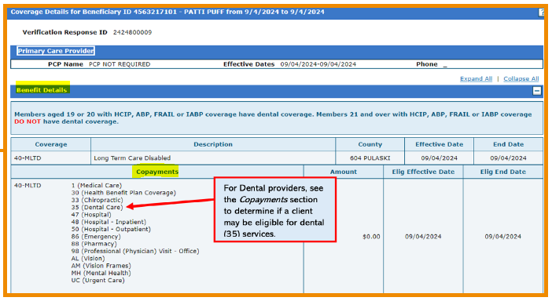
Beneficiary Eligibility for Medicaid Dental Services
In “Eligibility” tab, under “Benefit Details,” and “Copayments” look for “35 (Dental Care)”
Notes:
MMIS

Slide 25
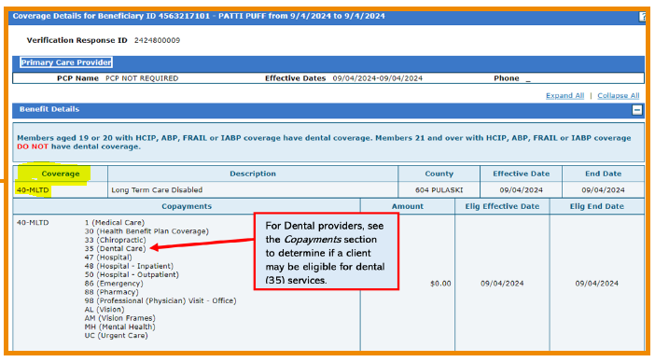
Notes on Beneficiary Eligibility
The benefit plan under “Coverage” determines whether client is eligible for Medicaid and has coverage for dental services
Section I (124.100) of your Provider Manual provides Dental-specific Benefit Plans Crosswalk
Beneficiaries enrolled in HCIP, IABP, and ABP benefit plans are eligible for dental services ONLY if they are 19 or 20 years old or they are American Indian/Native Alaskan.
Notes:
MMIS

Slide 26
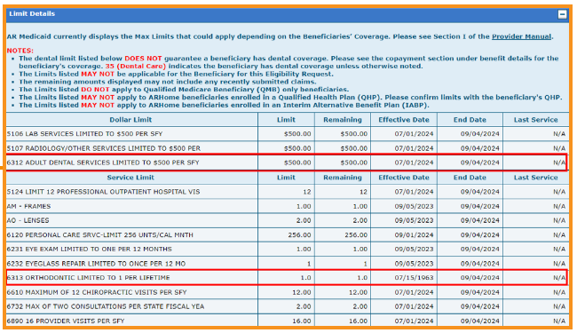
Verifying Benefit Limits
DO rely on benefits table for benefit limits and remaining benefits for clients who are eligible for dental services.
Notes:
MMIS (Nell to chime in if additional information to add)
DO NOT rely on the benefits limit table to determine eligibility.

Slide 27
Notes on Benefit Limits
Annual benefit limits are based on a state fiscal year (July 1-June 30), not a calendar year.
Cleanings are allowed once every six months and one day.
Claims from DMOs will transfer to Medicaid for reference in applying lifetime limits.
Notes:
MMIS

Slide 28
Ways to Submit Claims for Processing
Arkansas Medicaid Provider Healthcare Portal:
  portal.mmis.arkansas.gov/ARMedicaid
Paper: Although paper submission is allowed, we highly recommend that you only submit a paper claim when you are asked to do so. Paper claims can take up to 30-45 days to process. Using the paper claim option could greatly postpone provider’s payment.
Vendor: Specifications are available on the Medicaid website at:
  https://humanservices.arkansas.gov/divisions-shared-services/medical-services/helpful-information-for-providers/systemdocs/ -
Notes:
MMIS

Slide 29
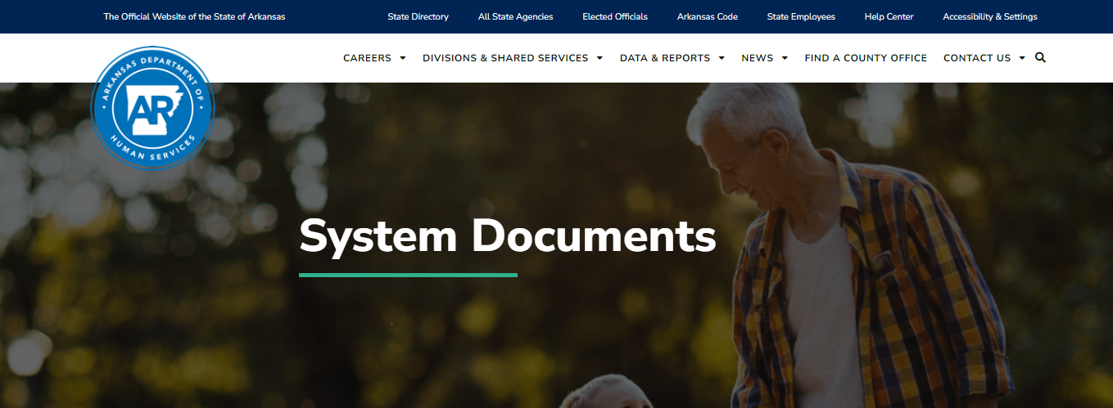
Vendor Specifications
Link: https://humanservices.arkansas.gov/divisions-shared-services/medical-services/helpful-information-for-providers/systemdocs/
For additional information contact:
Gainwell Technologies-EDI Department at
1-800-457-4454
Notes:
MMIS

Slide 30
New Dental Claims Training Tools
  How to Submit a Dental Claim
  How to Submit a Dental Claim video
Notes:
MMIS

Slide 31

AR Medicaid Dental Provider Manual https://humanservices.arkansas.gov/divisions-shared-services/medical-services/helpful-information-for-providers/manuals/dental-prov/
Notes:
MMIS

Slide 32

Procedure Code Tables https://humanservices.arkansas.gov/wp-content/uploads/DENTAL_ProcCodes.xlsx
Description of the procedure code
Modifier required?
Prior Authorization required?
Eligible age range
Notes:
MMIS

Slide 33
Dental Fee Schedule
https://humanservices.arkansas.gov/wp-content/uploads/DENTAL-fees.pdf
Notes:
MMIS

Slide 34
Notes on Billing
All claims for dates of service before Nov. 1 should be sent to the dental managed care organization (Delta Dental or MCNA) in which the beneficiary was enrolled on the date of service. For clients enrolled in a DMO, only claims for dates of service on or after Nov. 1 should be submitted to Medicaid.
If you are submitting a paper claim form when billing—you must use this version of the ADA claim form (also known as ADA-J430 in the dental provider manual).
You may provide composite posterior restorations, but you must bill for the amalgam reimbursement rate. This is an allowable practice as documented by the state Office of Medicaid Inspector General. 2024.10.03-OMIG-Ackowledgement-Re-Nov-1-2024-Dental-Transition-Billing-Guidance-Dental-Transition.pdf (arkansas.gov)
Notes:
Nell

Slide 35
Acentra Health
Kerri Brazzel
Notes:
Tabitha

Slide 36
Acentra Health
AR Medicaid Dental Vendor – Prior Authorizations (PA)
Acentra Health Portal – https://atrezzo.acentra.com/
Training and PA FAQs - https://ar.acentra.com/dental-services/
  Dental Atrezzo Registration
  Dental Prior Authorization Submission
Notes:
Kerri - Acentra

Slide 37
Prior Authorization Request Timeline
For Beneficiaries Enrolled in Delta Dental or MCNA, you’ll use the following schedule and instructions:
  Any PA’s approved by Acentra Health for dental managed care beneficiaries on or after October 19, 2024, will need to have a Date of Service (DOS) on or after November 1, 2024.
For Beneficiaries Enrolled in Fee for Service Medicaid, enter the PA request in Atrezzo, Acentra Health’s portal.
Notes:
Kerri - Acentra

Slide 38
Notes on Prior Authorizations
If you have an active PA dated prior to November 1, 2024, DHS will honor it after the transition. Delta Dental and MCNA will transfer their PAs to Arkansas Medicaid’s MMIS system for reference in processing claims.
The Acentra Health portal requires an ICD-10 diagnosis code on all PA requests. If you know the correct diagnosis code, enter it in the field. If you do not know the correct diagnosis code, enter R69.
Notes:
Acentra

Slide 39
Dentures and Orthodontics
Nell Smith, DMS
Notes:
Tabitha

Slide 40
PA Process for Adult Dentures
Arkansas Medicaid has a contract with Green Dental lab for the fabrication of ALL ADULT dentures provided to Medicaid beneficiaries.
For adult dentures where PA is required (partial dentures), submit:
1.) PA to Acentra and
2.) Dental Lab Request Form to Green Dental
For adult dentures where PA is NOT required (full dentures), submit:
1.) Dental Lab Request Form to Green Dental

Slide 41
PA Process for Children’s Dentures
Dental providers may use the lab of their choice for children’s dentures.
For children’s dentures, submit:
1.) PA to Acentra and
2.) Any documentation your selected lab requires to that lab

Slide 42
Billing Process for Dentures
Dentures for Adults:
Quick start guide and lab form
  Denture Quick Start Guide
  Dentures Lab Request Form
Medicaid will pay Green Dental for adult dentures fabrication
Dental providers bill Medicaid only for diagnostic cast (D0470) and evaluation (D0140)
Dentures for Children:
Dental providers bill Medicaid for appropriate dentures codes (D5110, D5120, D5211 or D5212)

Slide 43
Notes on Dentures
Delta Dental and MCNA will pay all claims for dentures with a seat date (the date the dentures are delivered to the patient) before Nov. 1. Medicaid will pay claims for dentures initiated before Nov. 1 with a seat date on or after Nov. 1, 2024.
DHS will pay the DMO rate for all dentures started while beneficiaries were enrolled in DMO. These cases will be identified as follows:
  For beneficiaries enrolled in MCNA, those with an MCNA-approved PA for dentures.
  For beneficiaries enrolled in Delta Dental, those with dentures seated in November or December who were enrolled in Delta Dental in October.

Slide 44
Notes on Orthodontia
Orthodontia already in progress: If banding has occurred on or before November 1, 2024, Delta Dental and MCNA will pay the remaining sum. If banding has not occurred, FFS will pay for the services.
For clients who are in Medicaid fee for service, Medicaid pays for orthodontic treatment as an upfront sum when the orthodontic treatment begins.
For limited orthodontic treatment, bill using code D8999.
Notes:
Kerri - Acentra

Slide 45
Provider Resources
Billing:
AFMC/ Gainwell MMIS Billing Team Webpage: https://afmc.org/mmis
Dental Fee Schedules: https://humanservices.arkansas.gov/wp-content/uploads/DENTAL-fees.pdf
Dental Procedure Code Linking Tables: https://humanservices.arkansas.gov/wp-content/uploads/DENTAL_ProcCodes.xlsx
DMS Provider Training Webpage: https://humanservices.arkansas.gov/divisions-shared-services/medical-services/helpful-information-for-providers/training/
Quick Track Training series:
  Eligibility Verification Video
  Eligibility Verification Guide
General:
AFMC Dental Provider Relations: https://medicaid.afmc.org/dental
Benefit Plan Crosswalk for Dental Providers: Dental-specific Benefit Plans Crosswalk
Dental Provider Manuals: https://humanservices.arkansas.gov/divisions-shared-services/medical-services/helpful-information-for-providers/manuals/dental-prov/
DMS Provider website and FAQs: https://humanservices.arkansas.gov/divisions-shared-services/medical-services/healthcare-programs/dental/dental-providers/
Prior Authorizations:
Acentra Health Training: https://ar.acentra.com/dental-services/
Acentra Health Portal: https://atrezzo.acentra.com/
Provider Enrollment: https://humanservices.arkansas.gov/divisions-shared-services/medical-services/provider-enrollment/
Provider Questions: dentalproviderquestions@dhs.arkansas.gov
Notes:
Tabitha

Slide 46
Questions?
Notes:
Tabitha – MMIS will conduct a live demo if time allows before we open up to questions.

