Slide 1
Community Support System Provider
Training
May 15th, 2023
10:00 am to 12:00 pm CT

Slide 2

Training Goals
Define Home and Community Based Services (HCBS) and Client Populations
Understand the Community Support System Provider type and its role in Intellectual and Developmental Disabilities (IDD) and Behavioral Health (BH) services.
Discuss the provider and service mix received by PASSE members.
Identify the various requirements and services associated with Community Support System Provider (CSSP) certifications.

Slide 3
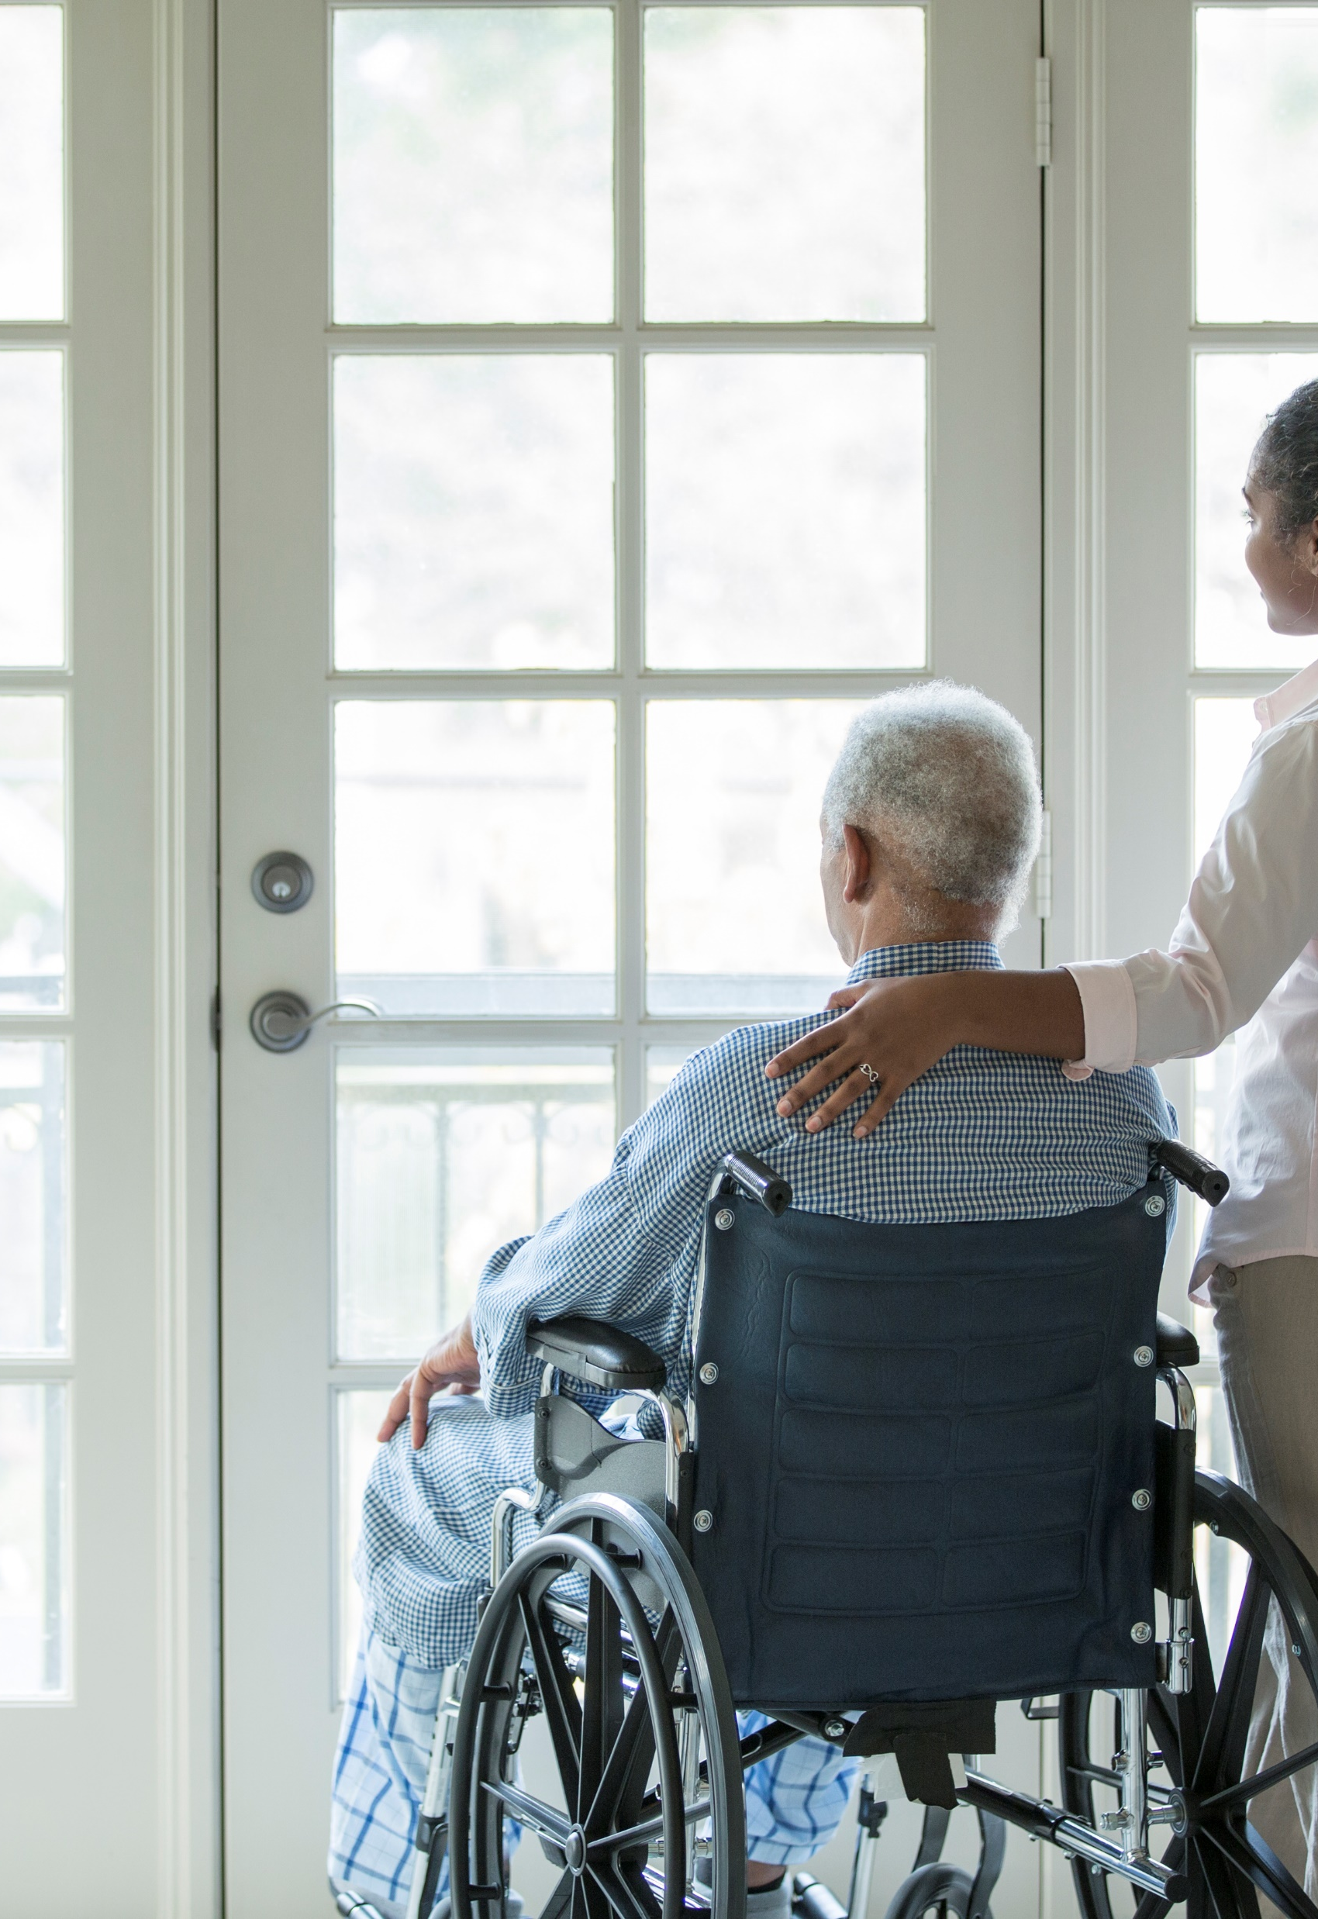
Agenda
Home and Community-Based Services Overview
Populations Served by CSSP
PASSE Overview
CSSP Program Overview
CSSP Client Journeys
Certified Services by Provider Type
Understanding the CSSP Certification Process
Resources for Providers

Slide 4


Home and Community Based Services Overview

Slide 5
What are Home and Community Based Services?
The Centers for Medicare & Medicaid Services defines Home and Community Based Services (HCBS) as types of person-centered care delivered in the home and community. HCBS includes both health services and human services. ¹
Example HCBS Services Include:
Supportive Living
Peer Support
Aftercare Recovery Support
1. https://www.cms.gov/outreach-and-education/american-indian-alaska-native/aian/ltss-ta-center/info/hcbs

Slide 6
Who Receives Home and Community Based Services in PASSE?
Several client populations in the State receive HCBS through PASSE. Clients access HCBS through federal Medicaid vehicles known as “waivers” and “state plan options.” PASSE client populations fall under two federal vehicles.
Federal Vehicle
Population
Example
1915(c)
CES Waiver
Members with Intellectual and Developmental Disabilities
1915(i)
Adult Members with Serious Mental Illnesses
Children/Youth Members with Serious Emotional Disturbance
E.g., Cerebral Palsy, Down Syndrome
E.g., A Mental Health condition like Schizophrenia, Depression, or Anxiety and a Functional Deficit Related to the Diagnosis
E.g., A Childhood Anxiety Disorder and a Functional Deficit Related to the Diagnosis

Slide 7


Benefits of Home and Community Based Services
Home and Community Based Services (HCBS) are an alternative to clients receiving services in institutional settings such as hospitals and residential facilities. Clients receive services in their home and community. HCBS has several benefits.
PROS
More cost effective as clients are routed away from higher cost institutional services CMS estimates HCBS services as less than half the cost of institutional equivalents on average¹ Overall reflects clients’ preferences, who would rather receive services in familiar settings Supports clients to remain integrated in their communities
1. https://www.cms.gov/outreach-and-education/american-indian-alaska-native/aian/ltss-ta-center/info/hcbs

Slide 8
Waiver & State Plan Option Populations Served by CSSPs
People with Intellectual and Developmental Disabilities, Serious Mental Illnesses/ Serious Emotional Disturbances

Slide 9
What are Intellectual and Developmental Disabilities?
Intellectual and Developmental Disabilities (IDD) are disabilities which impact a person’s physical, intellectual and social-emotional development. They are frequently present at birth but can present as late as 22 years of age¹.
Adaptive Behavior
Includes communication, daily living skills, socialization, motor skills, and behaviors
Intellectual Functioning
Typically determined by an IQ test (Score around 70)
Intellectual Disability is determined based on two criteria:
Language Note: “Developmental disability” is an umbrella term that includes many disabilities. Intellectual disability is considered a type of developmental disability.
1. https://www.aaidd.org/intellectual-disability/definition

Slide 10
What are Intellectual and Developmental Disabilities?
People with IDD can have a variety of conditions which impact their physical, intellectual and social-emotional needs:
Some people only have intellectual disability.
Others only have a developmental disability.
Lastly, some people live with both intellectual disability and a developmental disability.
Developmental
Disabilities Including (not exhaustive):
Autism Spectrum
Disorder
Cerebral Palsy
Autism Spectrum Disorder and Intellectual Disability
Intellectual Disability
Cerebral Palsy and Intellectual Disability
For example, people with Autism Spectrum Disorder or Cerebral Palsy may also have intellectual disability.

Slide 11

HCBS Services for People with IDD
Example HCBS Services for People with IDD:
Adaptive Equipment
Equipment or software used to help clients perform daily life tasks, including Personal Emergency Response Systems and vehicle modifications
Supportive Living
Individually tailored services to assist an individual with living in the community, including daily living skills in the home and community
Supported Employment
Support for individuals seeking competitive, integrated employment in their communities

Slide 12
What are Serious Mental Illnesses (SMI)?
Serious mental illnesses are disorders impacting an adult’s thinking, mood, or behavior that interfere with a person’s day-to-day life and functioning.¹
Examples of Serious Mental Illnesses Include:
Bipolar Disorder
Major Depressive Disorder
Schizophrenia
Post Traumatic Stress Disorder
Language Note: You may also hear the term “Behavioral Health.” Behavioral Health is an umbrella term used to discuss both mental health and substance use disorders.
1. https://www.samhsa.gov/serious-mental-illness

Slide 13
What are Serious Emotional Disturbances (SED)?
Mental health illnesses are treated differently for children and adolescents. Serious emotional disturbances are disorders experienced by children and youth under the age of 18* who experience mental, behavioral, or emotional problems which create functional problems at home, at school, or in the community¹.
Examples of Serious Emotional Disturbances Include:
Childhood Schizophrenia
Affective Disorders (such as depression and child anxiety disorders)
Self-Destructive Behaviors
Conduct Disorder
*The eligibility category in the Individuals with Disabilities Education Act (IDEA) is “Emotional Disturbance” and extends to the age of 21 if the student remains in school.
1. https://www.samhsa.gov/data/sites/default/files/SED%20Expert%20Panels%20Summary%20Report.pdf

Slide 14

Services for People with SMI/ SED
Example HCBS Services for People with SMI/ SED:
Peer Support
Clients with SMI receive support from certified peer specialists to help them in healing, self-advocacy, and modeling life skills
Behavioral Assistance
Outcome-oriented intervention provided individually or in a group setting with the child/youth and/or his/her caregiver, including implementing safety plans
Crisis Stabilization Intervention
Clients receive behavioral health stabilizing services after a psychiatric or behavioral health crisis instead of being admitted to an inpatient setting

Slide 15
Complex Care Needs
Complex Care Needs
IDD
Physical Disabilities
SMI/ SED
Substance Use Disorder
People can live with multiple types of conditions. Living with multiple types of diagnoses is often referred to as having “complex care needs.”
Sometimes people with complex care needs can have difficulty accessing the right mix of service supports.
For example, an individual may have both intellectual disability and obsessive-compulsive disorder. The services and supports they need will be different than if they only lived with one diagnosis. Care plans will need to be individualized to meet the services and support needs for the person’s diagnoses.

Slide 16
Habilitation & Rehabilitation Services
HCBS services available to members under PASSE fall under Habilitation and Rehabilitation Services.
Habilitation Services: Services focused on attaining, keeping, or improving skills and functioning for daily living¹
Example Services Include: Supportive Living Consultation Supplemental Supports
Longer-Term Services
Rehabilitation Services: Services focused on regaining functions that have been lost or impaired after an injury or illness¹
Example Services Include: Adult Rehabilitation Day Treatment Behavioral Assistance Partial Hospitalization
Shorter-Term Services
1. https://nationaldisabilitynavigator.org/ndnrc-materials/fact-sheets/fact-sheet-4/

Slide 17
PASSE – Provider-Led Arkansas Shared Savings Entity Overview

Slide 18




What is a Provider-Led Arkansas Shared Savings Entity (PASSE)?
The PASSE program is a Medicaid managed care program serving Arkansans with the highest level of need. PASSEs work with providers across the State to coordinate services for PASSE members.
PASSEs Manage Services for 56,435 Arkansas*
Members with Serious Mental Illnesses and Serious Emotional Disturbances
  34,151 Children and Youth
  14,848 Adults
Members with Intellectual and Developmental Disabilities
  1,626 Children and Youth
  5,810 Adults
1
2
*As of September 2022

Slide 19
Who are PASSE members?
PASSE members are individuals who have intensive levels of treatment or care needs due to serious mental illness or intellectual or developmental disability. Individuals undergo an assessment and are placed in a tier based on level of need.
Assigned to a PASSE
Tier 3
Tier 2
Independent
Assessment
Services are available to all PASSE members regardless of their tier assignment based on a member's functional deficits.

Slide 20




How do PASSE members receive services?
PASSE members work with a designated care coordinator to access services from providers in the community. A PASSE member’s services are detailed in a Person-Centered Service Plan (PCSP) and should be decided upon by the member. Services deemed medically necessary by PASSE utilization management can be added to a member’s PCSP.
PASSE Member
PASSE
Care Coordinator
Person-Centered Service Plan
PASSEs help manage members’ services. However, PASSEs are NOT service providers themselves.
Developmental Disability and Behavioral Health Providers

Slide 21
Community Support System Provider Program Overview

Slide 22
Community Support System Provider Overview
DHS CSSP Program Goals
Align Provider Types with the PASSE Model
Improve Service Delivery for Clients to Full Range of Services
Increase Business Opportunities for Providers
The PASSEs serve members who have met eligibility criteria and receive 1915(i) and 1915(c) intellectual and developmental disability and behavioral health services. The CSSP certification permits agencies to provide services to both populations of Arkansans.
The CSSP certification allows clients to have a “one stop shop” for their service needs. Having one provider type can improve efficiencies in service delivery, ultimately increasing access in underserved areas, including rural areas.
The CSSP certification gives providers the opportunity to increase the array of services they are providing.
1
2
3

Slide 23
Community Support System Provider Overview
A Community Support System Provider (CSSP) is a type of provider eligible for Arkansas Medicaid participation. CSSPs are certified to provide home and community-based services for Medicaid clients with behavioral health and/or intellectual and developmental disability (IDD) service needs.
CSSPs are a provider type certified to provide both IDD and BH HCBS services. CSSP is not a type of service in and of itself.
CSSPs are certified at three increasing levels of service complexity: Base, Intensive, and Enhanced. The HCBS services CSSPs are certified to provide are different under each level.
Services under the CSSP program can be found in the Home and Community Based Services for Clients with Intellectual Disabilities and Behavioral Health Needs Manual.
Only three new HCBS services are being added to the PASSE model and can be performed by a CSSP:
1) Assertive Community Treatment, 2) Intensive In Home for Children, and 3) Complex Care Home. All other services under the PASSE were pre-existing IDD and BH Medicaid HCBS services.

Slide 24
Community Support System Provider Overview
CSSPs are certified to provide a variety of HCBS services for both clients with intellectual and developmental disabilities and outpatient behavioral health needs.
Community Support System Provider (CSSP) is a new licensed Medicaid provider type as of January 1, 2022.
As of January 1, 2023, CSSP provider certification levels also include Intensive.

Slide 25
CSSP Provider Type Combines CES, 1915(i) Behavioral Health, and New Services
CSSP
1915(c) CES Waiver Services
1915(i) Behavioral Health Services
New Services Just Added to the 1915(i) & 1915(c)
The CSSP provider type allows providers to deliver services to clients receiving services under the CES Waiver, the 1915(i) behavioral health services state plan option, or a combination of services.
The CSSP provider certification also allows providers to deliver services not included in the historical CES Waiver provider or 1915(i) BH provider certifications.

Slide 26
HCBS Services by Provider Type
The CSSP program combines services under the CES Waiver, existing services under the 1915(i) (OBHAs), and new services added to 1915(c) and (i).
CES Waiver
CSSP
1915(i) BH
Adaptive Equipment
Community Transition Services
Consultation
Environmental Modifications
Respite
Specialized Medical Supplies
Supplemental Support
Supported Employment
Supportive Living
BASE
Adaptive Equipment
Adult Life Skills Development
Community Transition Services
Consultation
Environmental Modifications
Pharmacological Counseling
by RN
Respite
Specialized Medical Supplies
Supplemental Support
Supported Employment
Supportive Employment
Supportive Living
Supportive Housing
Supportive Life Skills
Development
Therapeutic Host Home
INTENSIVE
Aftercare Recovery Support
(Substance Abuse)
Assertive Community Treatment
Behavioral Assistance
Child and Youth Support Services
Crisis Stabilization Intervention
Family Support Partners
Intensive In Home for Children
Peer Support
Professional Counseling Services
ENHANCED
Adult Rehabilitation Day Treatment
Complex Care Homes
Partial Hospitalization
Residential Community Reintegration
Substance Abuse Detox (Observational)
Therapeutic Communities
Acute Crisis Units*
Adult Life Skills Development
Adult Rehabilitation Day
Aftercare Recovery Support (SU)
Behavioral Assistance
Child and Youth Support Services
Crisis Stabilization Intervention
Family Support Partners
Partial Hospitalization
Peer Support
Pharmacological Counseling by RN
Professional Counseling Services
Residential Community Reintegration
Substance Abuse Detox (Observational)
Supportive Employment
Supportive Housing
Supportive Life Skills Development
Therapeutic Communities
Therapeutic Host Home
New Services
Assertive Community Treatment
Complex Care Home
Intensive In Home for Children
*Acute Crisis Units are an OBHA only certified service.

Slide 27
Benefits of CSSP Certification for IDD and BH Providers
1
Location Flexibility
2
One Certification
CSSPs do not need a physical facility in every county in which they are providing services. One certification covers all of Arkansas.**
** Enhanced level services are certified on an individual facility by facility basis.
The CSSP provider type streamlines the certification process, requiring only one certification to provide IDD and BH services.

Slide 28



HCBS Service Rates Under CSSP
  HCBS Rates
  Fee-for-Service
  DHS Payment Goals
Most rates for Medicaid HCBS services under PASSEs are not published by DHS.
Providers will need to contact each PASSE separately to receive HCBS service rates.
Nearly all HCBS services are paid by the PASSEs on a fee-for-service basis for services approved by the PASSE.
Currently, providers are not paid on a per member basis.
HCBS service rates are the same under 1915(c) CES Waiver, 1915(i), and CSSP providers.
In the future, DHS’ goal is to work with the PASSEs to eventually pay CSSPs outside of the normal fee for service framework.
This could include value-based payment arrangements.
Note: All CSSP providers will fall under a Provider Type 96, Specialty 04, Provider Type 96, Specialty Cl, or Provider Type 96, Specialty C9. All rendering providers (people providing the actual service) will also need to enroll with Medicaid under Provider Type 95 and receive a Medicaid PIN.

Slide 29
CSSP Frequently Asked Questions (FAQs)
Q. Is CSSP a type of service?
  A. No. CSSP is a type of Medicaid provider that is certified to provide services for both the IDD and BH population. CSSPs are certified to provide a variety of HCBS services at Base, Intensive, and Enhanced levels.
Q. Are CES Waiver Providers and Outpatient Behavioral Health Agencies required to become CSSPs?
  A. No. Applying to become a CSSP is not required. Existing CES Waiver Providers and Outpatient Behavioral Health Agencies can maintain their existing certification types. However, CSSP allows providers to maintain only one certification type to provide a wider array of services. If you hold multiple certifications for the same services, DPSQA will license you under all applicable manuals. We recommend when you become a CSSP that you actively close out your former HCBS provider type with DPSQA.
Q. Can all CSSPs provide the same type of services?
  A. No. CSSPs are certified to provide specific HCBS services within three levels: Base, Intensive, and Enhanced.
Q. Are CSSPs required to provide all services for which they are certified?
  A. No. CSSPs may make business decisions about which services they would like to provide and do not need to provide all services for which they are certified

Slide 30
CSSP Client Journeys

Slide 31
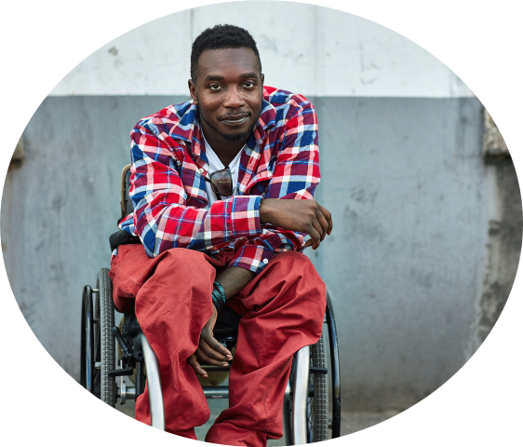

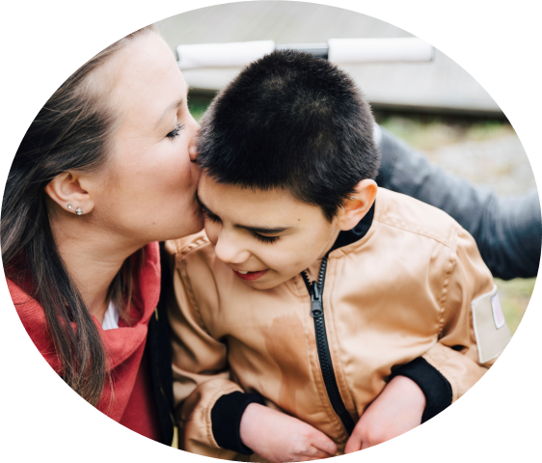
HCBS Service Benefits for Individuals Provided by CSSPs
The CSSP provider allows individuals with both BH and IDD service needs to decide to receive all of their HCBS services from one provider. This provides easier coordination of care and ease of access for individuals if they decide to receive services through a CSSP.
Before: Services from IDD and BH Service Providers
After: Services from a CSSP Only
CES Waiver Provider
1915(i) Behavioral Health Agency
CSSP

Slide 32


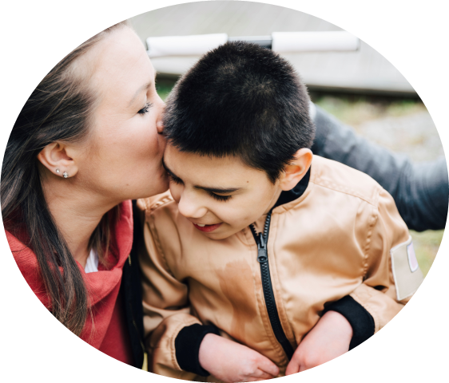
HCBS Service Benefits for Individuals Provided by CSSPs
The following member journeys give examples of how an individual with complex care needs—both IDD and BH needs—can decide to receive a package of services through a CSSP. Note that services may require pre-authorization by the PASSEs.

Slide 33
Case Study #1: John
John is a 42-year-old man with a developmental disability. He lives at home with his older sister and her family. John would like to work part time as an assistant at a local art studio in Fayetteville. John has lived through trauma in his past and experiences functional deficits related to his PTSD diagnosis. Like many adults, John struggles to maintain a healthy weight. John has expressed interest in building healthy cooking skills.
What services can John decide to receive in his person-centered service plan through a CSSP agency?

Slide 34



Case Study #1: John
As a CSSP, you could provide John the following services:
Supported Employment (220.210)
John’s career coach, Becky, helped him find a position at an art studio, a job John selected based on his own interests and skills.
Consultation for Nutritional Needs (220.340)
John and his older sister received special training for his dietary needs from a dietician in preparing healthy meals.
Peer Support (210.140)
John’s peer support specialist Peter helps him in articulating goals for recovery and modeling effective coping techniques.
Note: Services may require pre-authorization with the member’s PASSE.

Slide 35
Case Study #2: Carmen
Carmen is a 23-year-old woman who lives with both Autism Spectrum Disorder and Bipolar Disorder. She lives in a group home with several friends she selected through a roommate match. Carmen has a history of self harm behaviors and has struggled with mental health crises in the past. During the COVID-19 pandemic, Carmen was unable to visit with her father which was very stressful and exacerbated her mental health symptoms. Carmen has expressed that she needs assistance with some daily living skills tasks and with socializing in the community.
What services can Carmen decide to receive in her person-centered service plan through a CSSP agency?

Slide 36



Case Study #2: Carmen
As a CSSP, you could provide Carmen the following services:
Crisis Stabilization Intervention (220.110)
Carmen experienced a behavioral health crisis this year. A licensed psychologist provided psychological intervention and helped Carmen stabilize in her home instead of at the hospital.
Adult Rehabilitative Day Service (220.140)
Following her behavioral health crisis, Carmen decided in consultation with her care team that she needed additional support in managing her mental illness. Carmen now attends a structured group program and is learning coping and behavioral skills.
Supportive Living (220.300)
Carmen receives support from a Spanish-speaking DSP in the group home in which she lives. Carmen’s DSP assists her with daily hygiene needs, socializing with her friends, and attending church on Sundays.
Note: Services may require pre-authorization with the member’s PASSE.

Slide 37

Case Study #3: Caleb
Caleb is a 13-year-old boy who lives with his mother in Benton. Caleb has cerebral palsy and sometimes needs assistance with activities of daily living. Caleb’s favorite subject in school is math and in his free time he loves to play video games with his neighbors. Caleb frequently experiences severe panic attacks and aggressive behaviors which limit his ability to socialize with peers and attend school. Caleb’s mother contacted his PASSE care coordinator asking for help in meeting Caleb’s needs.
What services can Caleb and his family decide to receive through his person-centered service plan from a CSSP agency?

Slide 38


Case Study #3: Caleb
As a CSSP, you could provide Caleb the following services:
Individual Behavioral Health Counseling (252.111)
Caleb will receive professional behavioral health counseling services from a licensed clinician in his home for behavioral health treatment.
Family Support Partners (220.160)
Caleb’s mother meets weekly with Aaisha, a fellow mother of a child with a developmental disability. Aaisha helps Caleb’s mother connect to the local Parent Training and Information Center and to navigate the special education system.
Note: Services may require pre-authorization with the member’s PASSE.

Slide 39
HCBS Services by Provider Type
CES Waiver Provider, 1915(i) BH Provider, and CSSP

Slide 40
CES Waiver Provider: Certified Services
Adaptive Equipment
Community Transition Services
Consultation
Environmental Modifications
Respite
Specialized Medical Supplies
Supplemental Support
Supported Employment
Supportive Living

Slide 41
1915(i) BH Agency: Certified Services
Acute Crisis Units
Adult Life Skills Development
Adult Rehabilitation Day
Aftercare Recovery Support (SU)
Behavioral Assistance
Child and Youth Support Services
Crisis Stabilization Intervention
Family Support Partners
Partial Hospitalization
Peer Support
Pharmacological Counseling by RN
Professional Counseling Services
Residential Community Reintegration
Substance Abuse Detox
Supportive Employment
Supportive Housing
Supportive Life Skills Development
Therapeutic Communities
Therapeutic Host Home

Slide 42
Community Support System Provider: Certified Services Base
Services in the Base level are longer-term services. These services do not require professional clinical oversight.
Base Services
Adaptive Equipment
Adult Life Skills Development
Community Transition Services
Consultation
Environmental Modifications
Pharmacological Counseling by RN
Respite
Specialized Medical Supplies
Supplemental Support
Supported Employment
Supportive Employment
Supportive Living
Supportive Housing
Supportive Life Skills Development
Therapeutic Host Home

Slide 43
Community Support System Provider: Certified Services Intensive
Services in the Intensive level are shorter-term services. These services require professional clinical oversight.
Intensive Services- New
Aftercare Recovery Support (Substance Abuse)
Assertive Community Treatment
Behavioral Assistance
Child and Youth Support Services
Crisis Stabilization Intervention
Family Support Partners
Intensive In Home for Children
Peer Support
Professional Counseling Services
CSSP Intensive level providers will need professional staff to assess clients, make recommendations, and provide sufficient clinical information to allow PASSE utilization management to determine if a service is medically necessary.

Slide 44
Community Support System Provider: Certified Services Enhanced
Services in the Enhanced level are shorter-term services. These services require professional clinical oversight.
Enhanced Services
Adult Rehabilitation Day Treatment
Complex Care Homes
Partial Hospitalization
Residential Community Reintegration
Substance Abuse Detox (Observational)
Therapeutic Communities
CSSP Enhanced level providers will need professional staff to assess clients, make recommendations, and provide sufficient clinical information to allow PASSE utilization management to determine if a service is medically necessary.

Slide 45
Understanding the CSSP Certification Process:
CSSP Certification Levels
Base, Intensive, and Enhanced

Slide 46

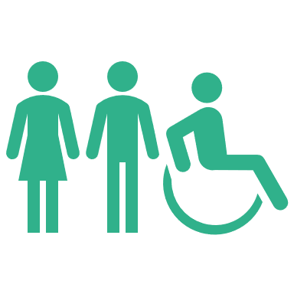
Provider Types and Credentialing Bodies for HCBS for Clients with IDD and BH
Division of Provider Services and Quality Assurance
Outpatient Behavioral Health Agency
Community Support System Provider
Division of Developmental Disabilities Services
CES Waiver Provider
HCBS service providers are licensed by different Divisions at DHS.
The CSSP provider type is licensed by the Division of Provider Services and Quality Assurance (DPSQA).

Slide 47
Community Support System Provider Certification Levels
Community Support System Providers are certified at three increasing levels of service options: 1) Base (Provider Type 96, Specialty 04), 2) Intensive (Provider Type 96, Specialty Cl), and 3) Enhanced (Provider Type 96, Specialty C9).
Enhanced
PT 96/C9
New Level !
Intensive PT 96/CI
Base PT 96/04

Slide 48
Community Support System Provider Certification Levels
CSSP Provider levels are certified to provide different services.
Base PT 96/04
Adaptive Equipment
Adult Life Skills Development
Community Transition Services
Consultation
Environmental Modifications
Pharmacological Counseling by RN
Respite
Specialized Medical Supplies
Supplemental Support
Supported/ Supportive Employment
Supportive Living
Supportive Housing
Supportive Life Skills Development
Therapeutic Host Home
Intensive PT 96/CI
Aftercare Recovery Support (Substance Abuse)
Assertive Community Treatment
Behavioral Assistance
Child and Youth Support Services
Crisis Stabilization Intervention
Family Support Partners
Intensive In Home for Children
Peer Support
Professional Counseling Services
Enhanced PT 96/C9
Adult Rehabilitation Day Treatment
Complex Care Homes
Partial Hospitalization
Residential Community Reintegration
Substance Abuse Detox (Observational)
Therapeutic Communities
Only Enhanced locations listed above are subject to the physical plant requirements found in Section 502 and 503 of the certification manual.
New Level !

Slide 49
Community Support System Provider Certification Levels
Community Support System Providers are certified at three increasing levels of service complexity:
1) Base, 2) Intensive, and 3) Enhanced.
Certification levels build upon the previous level:
  An Intensive certified CSSP must meet the requirements for both the Base and Intensive certifications.
  An Enhanced certified CSSP must meet the requirements for the Base, Intensive, and Enhanced certifications.
Base PT 96/04
Intensive PT 96/CI
Enhanced
PT 96/C9
Certified services build upon the previous level’s services:
  An Intensive certified CSSP is eligible to provide services listed under both the Base and Intensive certifications.
  An Enhanced certified CSSP is eligible to provide services listed under the Base, Intensive, and Enhanced certifications.

Slide 50


Community Support System Provider Certification Levels- Location Specific Certification
Certification levels based on physical location:
  Base and Intensive CSSP certifications apply to the agency enterprise and are not physical location specific. The certification is issued to the provider’s business address.
  Enhanced CSSP providers must meet specific physical facility standards. Therefore, the Enhanced certification is specific to each physical location and is issued to the specific facility’s address. A provider will need a separate Enhanced certification for each unique facility providing Enhanced level services.
  A provider with a certified Enhanced CSSP facility may provide base and intensive level services to clients at an indefinite number of living situations. They can only provide Enhanced level services at that specific facility.
CSSP Base and Intensive
CSSP Enhanced
Enterprise-wide Certification; Applies to Indefinite Number of Living Situations
Facility-Based Certification Level; Provider Can Provide Enhanced Level Services at the Specific Facility Only, but can Provide Base and Intensive Services at an Indefinite Number of Living Situations

Slide 51
Community Support System Provider Certification Levels- Location Specific Certification Continued
CSSP Provider Example Scenario:
People Services Inc. is a provider agency based in Bentonville that runs group homes and provides Supportive Living throughout the state. People Services Inc. is currently certified as a CES Waiver provider and is considering applying to become a CSSP certified agency. The agency currently serves clients with complex needs, meaning they have an intellectual or developmental disability (IDD) and behavioral health needs and has received requests from families to serve clients with more extensive support needs, especially at its Jonesboro location. People Services, Inc. has found some property and is considering opening a new Complex Care Home for IDD or a Therapeutic Community.
What CSSP certification could People Service, Inc. receive?
Issued Certifications:
Enhanced CSSP PT 96/C9 Certification: People Service, Inc. demonstrates that the agency meets staffing, training, client service record and other standards required to provide IDD and BH services at the Intensive CSSP level AND the facility-specific standards required to provide Enhanced CSSP level services at its Jonesboro location. DPSQA approves a CSSP Enhanced certification for the Jonesboro facility address (location of Complex Care Home or Therapeutic Community). People Services, Inc. may now provide Enhanced level services at its Jonesboro location and base and intensive level services agency-wide. If the agency wishes to provide Enhanced CSSP services at a separate location, they will need to apply for a second Enhanced CSSP license.

Slide 52
Community Support System Provider Certification Levels- Location-Specific Certification DPSQA Certification Process
People Services, Inc. Enhanced Certification Application
DPSQA Review of Base & Intensive Standards
DPSQA Review of Facility-Specific Enhanced Standards
CSSP Enhanced Certification Approved
CSSP Base/ Intensive Services
CSSP Enhanced Services
Group Home A
Group Home B
Client Living at Home
Jonesboro Complex Care Home or TC

Slide 53
Community Support System Provider Certification Levels- Location-Specific Certification DPSQA Certification Process
The provider agency submits an application packet indicating the CSSP certification level for which they are applying (Enhanced).
1
2
3
People Services, Inc. Enhanced Certification Application
DPSQA Review of Base & Intensive Standards
DPSQA Review of Facility-Specific Enhanced Standards
DPSQA reviews the application to ensure the agency meets CSSP Base and Intensive level standards.
DPSQA certifies that the specific location associated with the Enhanced level application meets the facility-specific standards.
4
CSSP Enhanced Certification Approved
5
5
CSSP Base/ Intensive Services
CSSP Enhanced Services
DPSQA approves the CSSP Enhanced certification. Provider Onboarding issues a CSSP Enhanced certification to the specific facility address.
The agency is certified to provide Base and Intensive level services agencywide. The agency may also provide Enhanced level services at the specifically-certified facility.
Group Home A
Group Home B
Client Living at Home
Jonesboro Complex Care Home or TC

Slide 54
Community Support System Provider Certification: Next Steps
Once your agency receives a CSSP certification, you will need to take a few additional steps to begin providing services and billing with the PASSEs.
1
Enroll as a Medicaid Provider
Enroll your agency as a CSSP with Group Enrollment Type with Provider Type 96
Contact PASSEs
Contact the PASSE(s) to become an in-network provider or to update your provider information as a new provider type:
Enroll individual staff under Atypical Enrollment Type with Provider Type 95
Start a new application in the Medicaid Portal
Arkansas Total Care
CareSource
Empower
Summit
2

Slide 55
Provisional Certifications for Existing CSSPs and OBHAs
CSSP Base attesting to CSSP Intensive
CSSP Base attesting to CSSP Enhanced
OBHA attesting to CSSP Enhanced
OBHA attesting to CSSP Intensive
Existing certified and enrolled CSSPs and Outpatient Behavioral Health Agencies that meet the certification requirements of Intensive CSSP Agency certification or Enhanced CSSP Agency certification can receive provisional Intensive CSSP Agency certification or Enhanced CSSP Agency certification.
Submit an attestation letter with the application to DPSQA by July 1, 2023 to receive a provisional certification.
Attestation letters can be found on the DHS CSSP webpage: https://humanservices.arkansas.gov/divisions-shared-services/medical-services/healthcare-programs/passe/community-support-system-provider/

Slide 56

Community Support System Provider Certification Levels- Service Level Updates
As of January 1, 2023, the following changes have been made to CSSP Agency Certification Levels:
Base Level Services Moved Up to Intensive
Peer Support
Aftercare Recovery Support
Behavioral Assistance
Child and Youth Support
Family Support Partners
Crisis Stabilization Intervention

Slide 57

Community Support System Provider Certification Levels- Service Level Updates Continued
Assertive Community Treatment & Intensive In Home for Children
Agencies providing Assertive Community Treatment and Intensive In Home for Children services will require the completion of an evidence-based training program and DHS approval prior to performing services.
Additional details on the evidence-based training and approval process will be forthcoming.

Slide 58
Resources for Providers

Slide 59
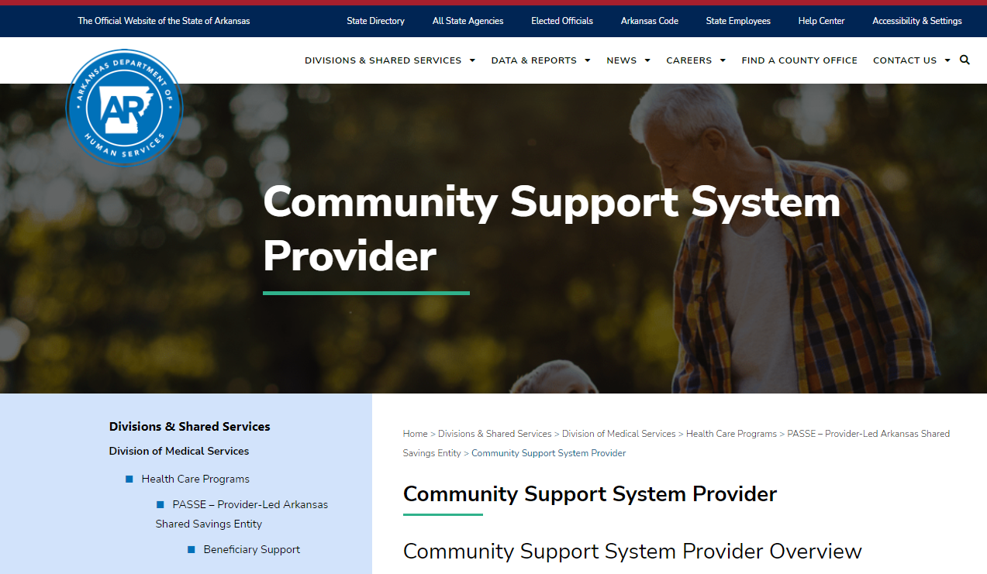
Community Support System Provider Web Page
DHS has created a CSSP dedicated web page with provider resources and FAQs. DHS will continue to update the web page with resources for providers. A recording of this training will be archived on this page.

Slide 60
Questions?
For overall programmatic questions, please contact DHS at CSSPQuestions@dhs.arkansas.gov.
For specific questions about the CSSP certification process, please contact DPSQA at DPSQA.ProviderApplications@dhs.arkansas.gov.

