Slide 1
Arkansas General Supervision using the
Comprehensive Data System

Slide 2
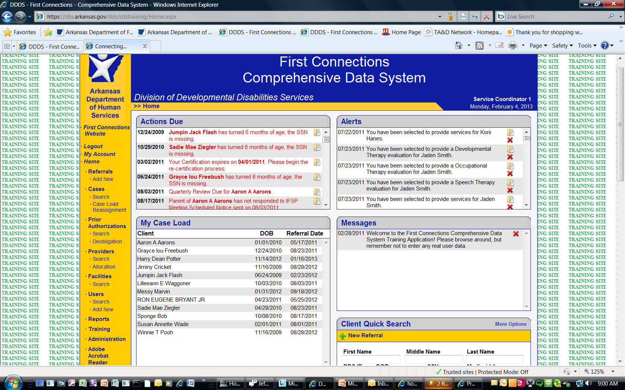
CDS System Home Page

Slide 3
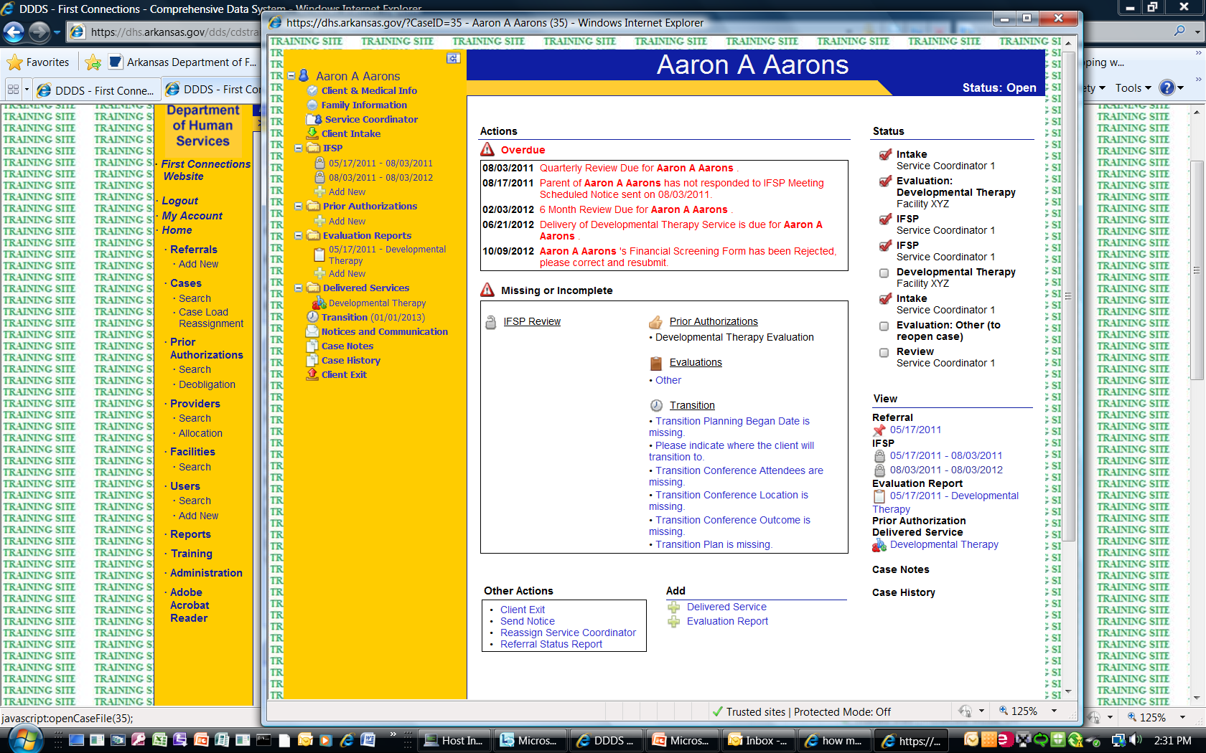
The Client’s Case File

Slide 4
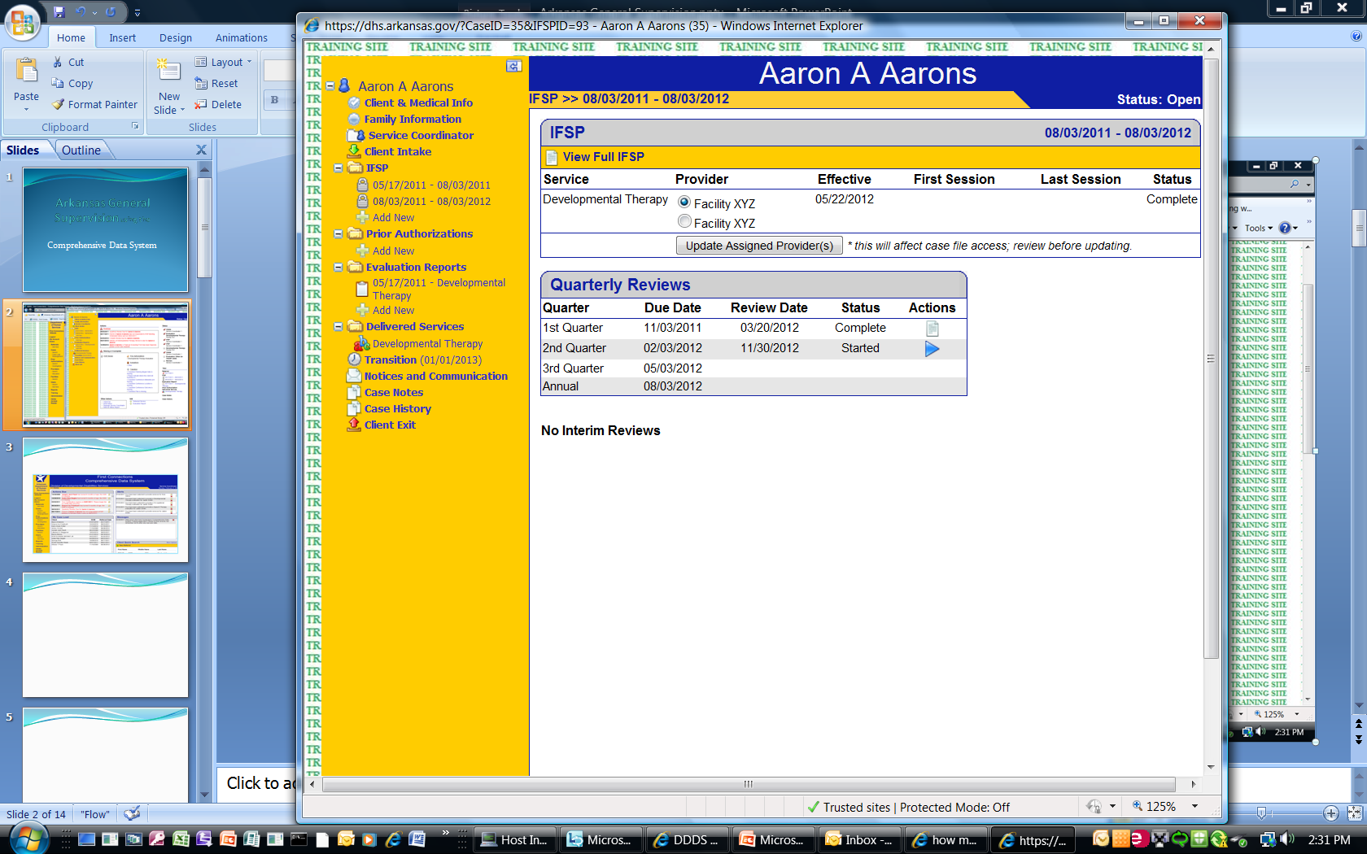
The IFSP

Slide 5
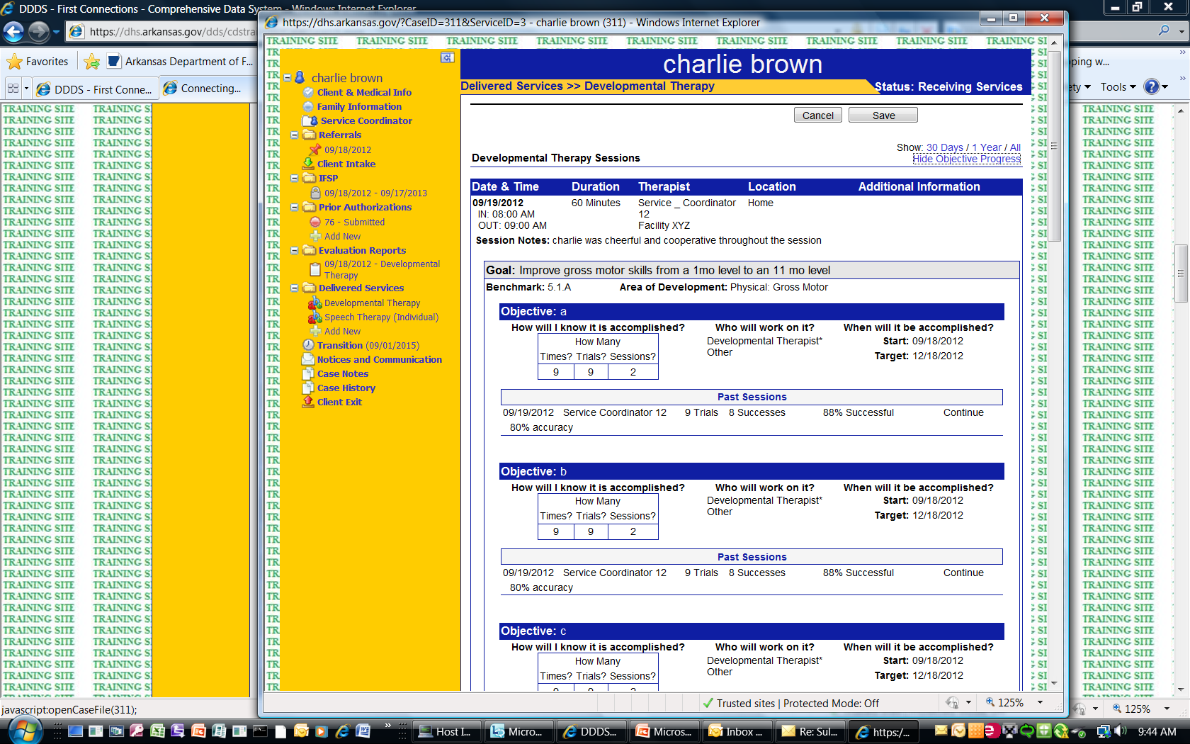
Delivered Therapy Service Session

Slide 6
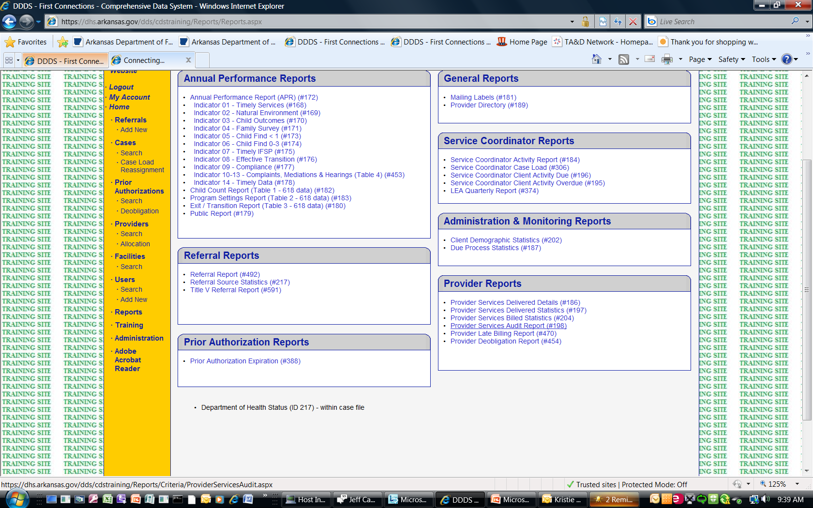
Comprehensive Data System Reports

Slide 7
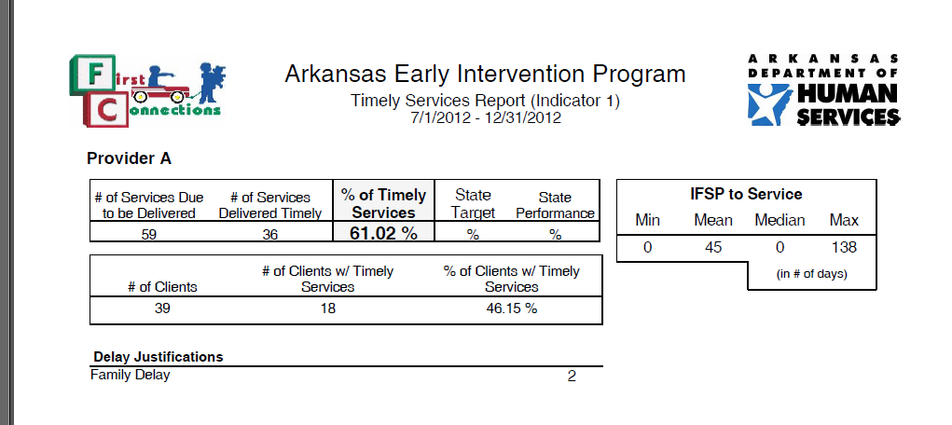
Indicator 1
Timely of Services Report

Slide 8
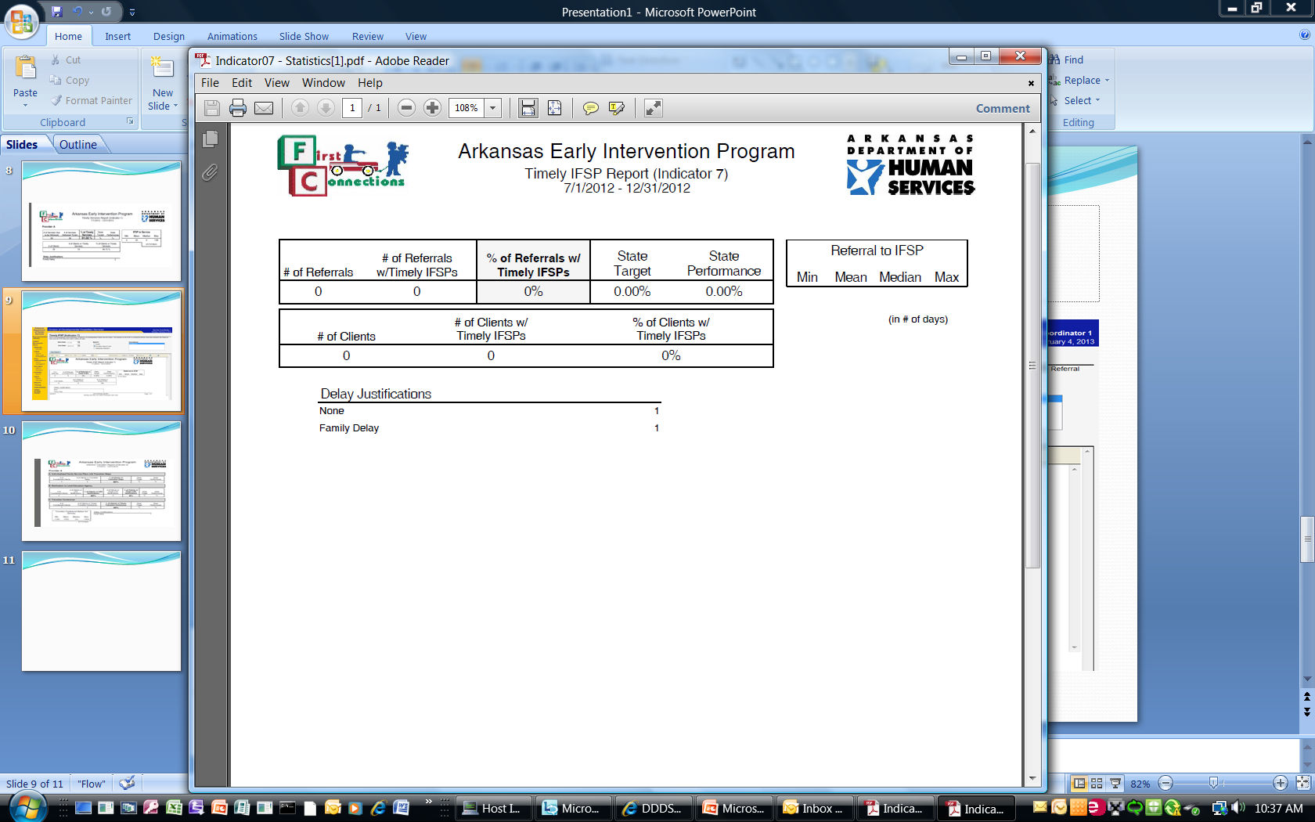
Indicator 7
Timely IFSP Report

Slide 9
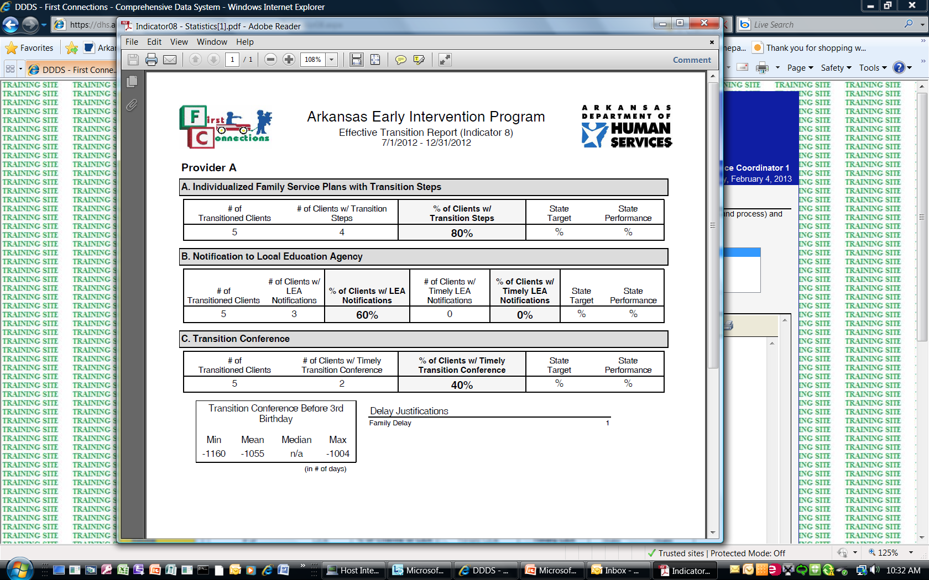
Indicator 8
Effective Transition Report

Slide 10
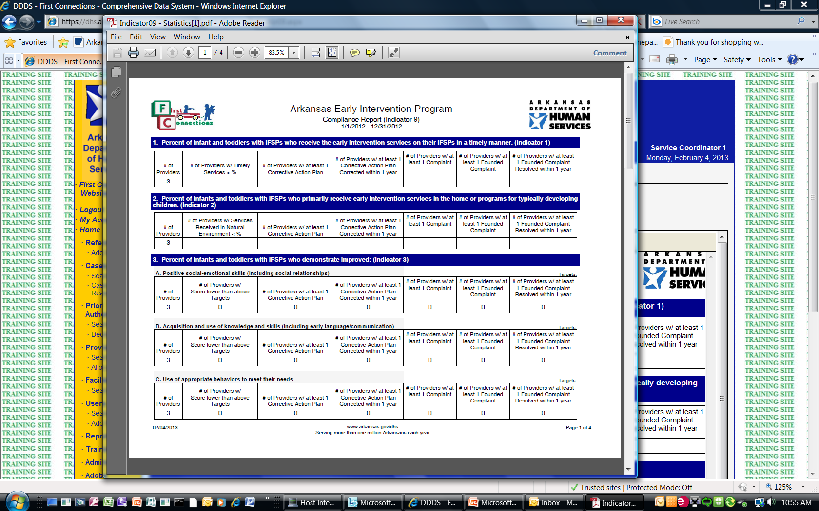
Indicator 9 APR Compliance Report

Slide 11
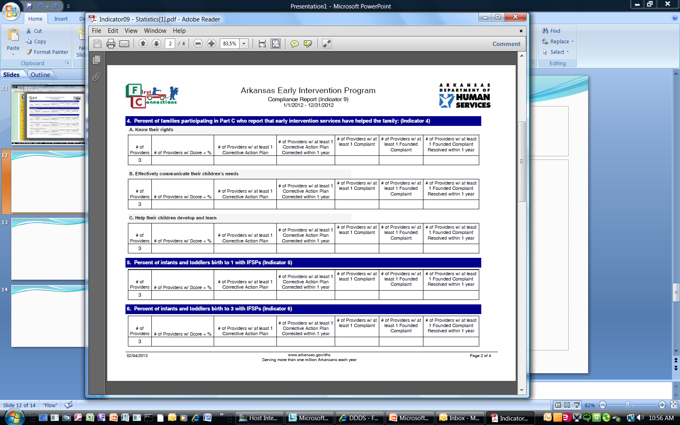
Indicator 9 APR Compliance Report

Slide 12
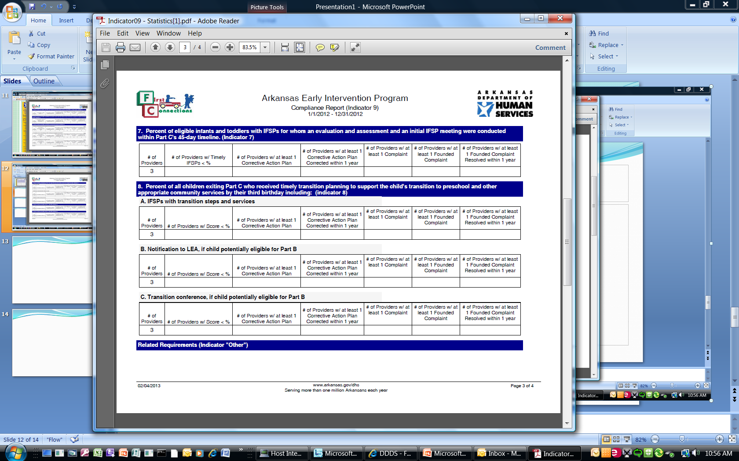
Indicator 9 APR Compliance Report

Slide 13
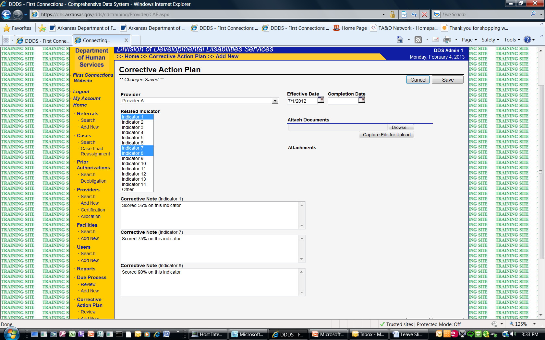
First Connection
Corrective Action Plan

