Slide 1
2024 ARHOME Strategic Plan
Laurin Dixon, Lead Executive-Medicare & Medicaid Products
Matthew Vannatta, Vice-President-Government Programs and Enterprise Analytics
December 15, 2023

Slide 2
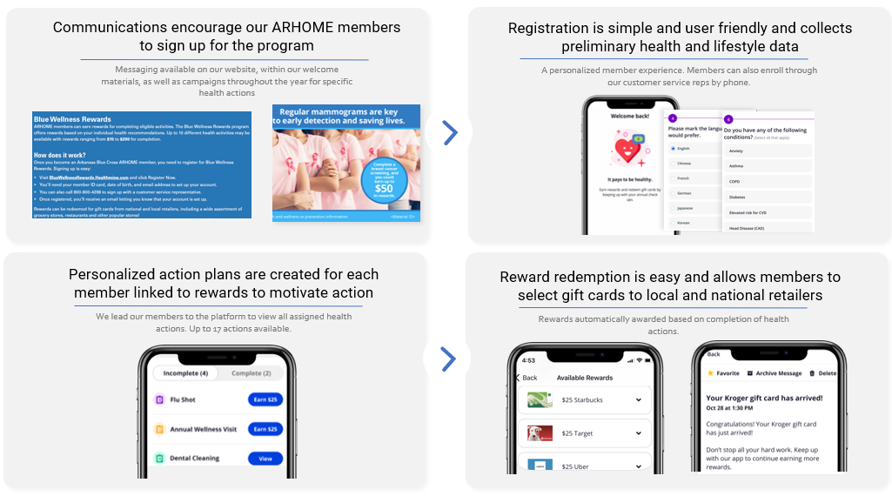
Blue Wellness Rewards
With a goal to increase engagement and involvement in healthcare and economic outcomes, ABCBS offers an interactive, personalized rewards program for all ARHOME members focused on the key goals and quality outcomes for membership.
Our members use the Blue Wellness Rewards portal to view individualized recommendations, total incentive amount possible and progress, as well as their total “reward" balance which they can use to redeem gift cards and health-related merchandise.

Slide 3
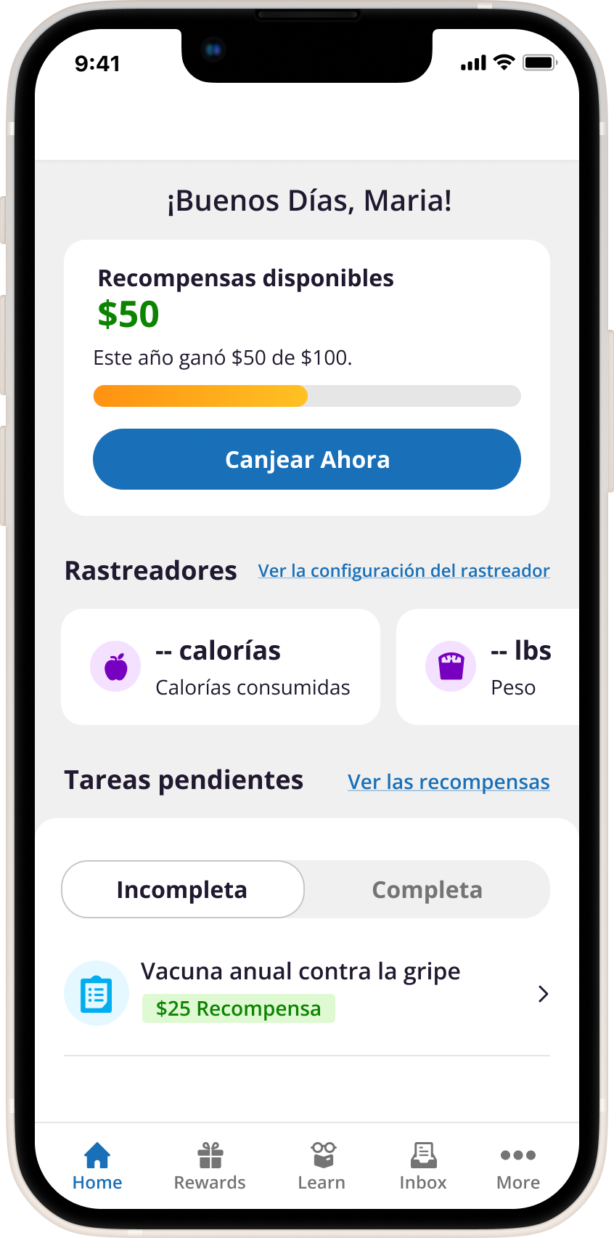
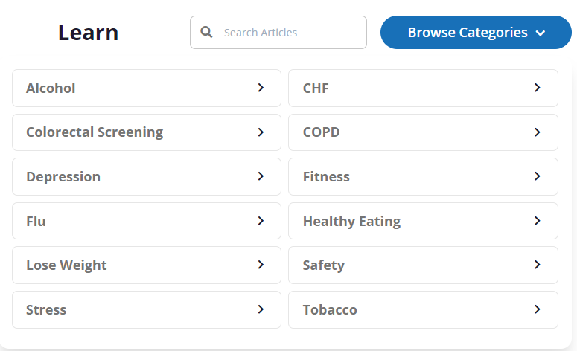
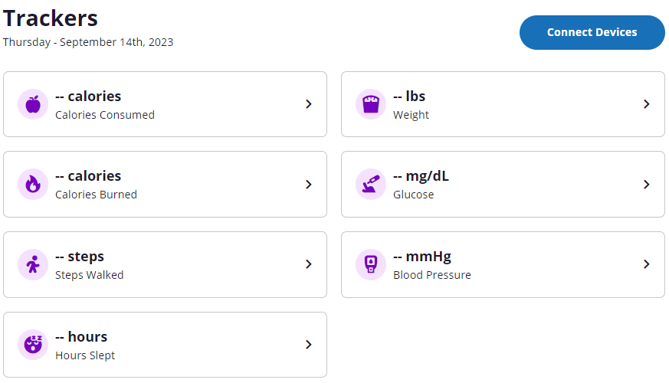
Blue Wellness Rewards
Our mobile app and web portal allows members to take the right steps to improve their health and redeem their rewards. Traditional communication methods are still available.
Personalized action plans
NCQA-certified
health education
English and Spanish
language options
Easy to read menu with total earned amount available to redeem gift cards
Biometrics and
wellness tracking
Customized incentives and rewards

Slide 4
2024 Health Improvement Incentives
Legend
Increased Incentive Amt.
New Incentive
2024 Incentive | Target ARHOME population | Goal | Amount
Chlamydia Screening | Women eligible for a chlamydia screening | To identify early cases of chlamydia to encourage early treatment and decrease spread of chlamydia | $50
Engagement in Substance Abuse Treatment | Individuals with substance use disorder | To encourage control of substance use disorder through adherence to substance use treatment | $50
Follow-up after Hospitalization for Substance Abuse | Individuals with substance use disorder | To encourage control of substance use disorder and prevent rehospitalization for substance use disorder | $100
Adherence to Mental Health Medications | Individuals with mental illness | To encourage control of mental health conditions through adherence to antipsychotics | $50
Follow-up after Hospitalization for Mental Health | Individuals with mental illness | To encourage control of mental health conditions and prevent rehospitalization for mental health disorder | $100
Prenatal Care Manager Engagement | Pregnant women | To encourage frequent follow-up during pregnancy to decrease maternal and neonatal morbidity and mortality | $25
Prenatal Care (up to 4 visits) | Pregnant women | To encourage frequent follow-up during pregnancy to decrease maternal and neonatal morbidity and mortality | $50
Contraception in Post-Partum Women | Postpartum women | To decrease unplanned pregnancies and risks associated with closely-spaced pregnancies | $100

Slide 5
2024 Health Improvement Incentives
Legend
Increased Incentive Amt.
New Incentive
2024 Incentive | Target ARHOME population | Goal | Amount
Adult Preventative Visit | All individuals | To encourage the use of preventive care | $15
Health Risk Assessment | All individuals | To collect information on health risk factors and help address SDoH | $25
Continuing Education | All individuals | To encourage advances in beneficiaries' economic status | $50
Career Readiness Certificate | All individuals | To encourage marketability in the workforce by increasing employment prospects | $100-$200
Establish a PCP | Individuals living in rural areas | To improve access to care for rural members | $25
Participate in a health fair or healthcare community event | Individuals living in rural areas | To improve access to care for rural members | $25
Diabetes HbA1c Control | Individuals with two or more chronic conditions with a diabetes diagnosis | To improve chronic condition control (diabetes) | $40
Asthma Medication Management | Individuals with two or more chronic conditions with an asthma diagnosis | To improve chronic condition control (asthma) | $50
Breast Cancer Screening | Women eligible for a breast cancer screening | To identify early cases of breast cancer and improve breast cancer screening rates | $50
Cervical Cancer Screening | Women eligible for a cervical cancer screening | To prevent and identify early cases of cervical cancer and improve cervical cancer screening rates | $50

Slide 6






Preventive Care Resources
Addressing and improving preventive care reduces the risk for diseases, disabilities, and death, yet we continue to still see low utilization and engagement. With a focus on improving the health of Arkansans, we plan to:
Continuously improve and implement gap identification and resolution through closer to “real-time” identification and intervention
Prioritize members for care management, behavioral health, social worker, and clinical quality specialist intervention and education
Digital “Blueprint” education identifies claims, medical history, and gaps-in care
Incentives for providers and members to close screenings, Health Risk Assessment, and annual preventive visits
Continuously communicate email, print, and texting campaigns to members around eligible screenings and gaps
Telehealth engagements and improvements for 24/7 access

Slide 7
Patient-Centered Medical Home &
Primary Care First
  Advanced payment models that reward preventive and comprehensive care
  Providers receive financial support through monthly care management fees and performance-based adjustments on specific quality and utilization metrics
Performance Measures
Diabetes A1c poor control Medication management Controlling blood pressure Cancer Screenings Breast cancer Cervical cancer Colorectal cancer Asthma medication ratio Antidepressant medication management | Wellness visits for children BMI for pediatrics, including physical activity and nutritional counseling Antibiotic use ED utilization IP admissions Generic Rx

Slide 8
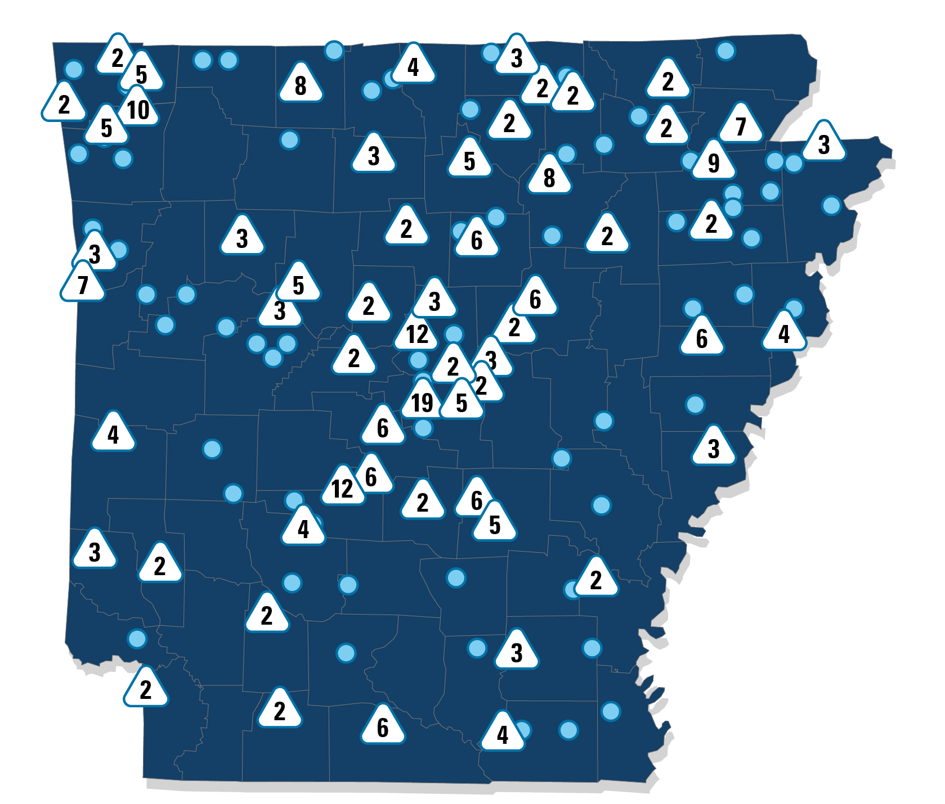


Where Value-Based Care Happens
Primary Care First
Patient-Centered
Medical Home
71
CLINICS
42
CITIES
255
CLINICS
116
CITIES
in
in
459
PROVIDERS
22,632’MEMBERS
1,085
PROVIDERS
54,723
‘
MEMBERS
In 2022, there were 77,355 ARHOME members attributed to 1,544 providers in a value-based program.
Primary Care program
primary presence
Cities that have one or more clinics in PCF or PCMH with Arkansas Blue Cross and Blue Shield
*Starting in 2024, PCF will be the only program offered.

Slide 9
2022 Patient-Centered Medical Home & Primary Care First
$6.3 million
IN PROVIDER INCENTIVES PAID FOR 2022 ARHOME PRIMARY CARE VALUE-BASED PROGRAM PERFORMANCE

Slide 10

Case Management and Social Work
Case management is a cooperative process between members, their families, their doctors and nurses, and their health insurance company.
Case managers assess, plan, facilitate, and advocate for options and services designed to meet the member's health-care needs through communication and available resources to promote cost effective outcomes.
Our case management program focuses on members with multiple chronic conditions such as diabetes, asthma, congestive heart failure, chronic obstructive pulmonary disease, coronary artery disease, and renal disease
Social work is integrated into our case management services when the member has social determinants of health along with physical and/or behavioral health needs.
Social workers connect members with local resources when needs exist such as food, transportation, housing, and more.
Helps the member to maximize the benefits available under the ARHOME plan.
Provides health education to empower the member and family to self-manage aspects of condition care in accordance with the PCP.
Helps members to better understand and deal with the complexities of the health-care system and health-plan benefits.
Identifies cost-effective alternatives to high-cost treatment settings such as hospitalization.
Value-added benefits of ABCBS Case Management:

Slide 11


Nurse24
The Nurse24SM nurse line is free and gives members access to a registered nurse 24 hours a day, 7 days a week, 365 days a year.
How to make wise decisions about tests, medications, and procedures
How to make lifestyle choices to improve health
Registered nurses provide reliable information to achieve a better level of health by providing information on:
Home treatment of minor illness and injury
How to prepare for doctor visits
How to effectively take prescription medications and understand the purpose of taking medications
When to call a health professional and how to effectively communicate with the doctor

Slide 12
Maternity Program
Assessment: self-enrollment, data identification (claims, SHARE, etc.) with prioritization on high risk for nurse outreach
Education: Materials encouraging good health practices (mental health, chronic conditions, smoking, nutrition) and enrollment in Text4baby (prenatal and infant care, developmental milestones, nutrition, safety)
Intervention: Engagement through mail and mobile app with OB nurse partnership
Special Delivery Program
Low risk: trimester and post-partum outreach
High risk: minimum of monthly
Digital Health Engagement: Maven provides 24/7 assistance to a Care Advocate and provider visits (OB/GYN, mental health, midwives, etc.)
Post-Partum Intervention: Nurse outreach for depression screening and customized baby and healthy behavior assistance
Improving disparities and key risks in maternal health—including lack of access to health care; pre-existing chronic conditions; increases in drug addiction; and the use of tobacco products and alcohol during pregnancy—are critical to reducing pre-term births and improving outcomes
While we recognize the access to care issues that may exist for rural members, ARHOME rural low birth weight rates were better than urban rates over the last four years. This underscores the challenges throughout the state regarding maternal care and why we will continue to expand our communication efforts to members through in-person and virtual care options with the goal of improved pre- and post-birth outcomes.

Slide 13
Maven Health
Meet Maven, a 24/7 pregnancy support team, hosting resources for personalized pregnancy, loss, postpartum, and baby care support. Members can easily reference relevant educational resources, review provider qualifications, & schedule appointments.
Learn
Review
Schedule
Members have access to:
Unlimited video appointments
Messaging with providers
Pregnancy tracking
Expert-led classes
*Maven is an independent company contracted by Blue Cross and Blue Shield to provide benefits including care advocacy, virtual consultations, coaching, and education.

Slide 14
Behavioral Health Program
Arkansas Blue Cross Behavioral Health Care Management Program
Member outreach
Both telephonic and targeted face-to-face outreach are used to engage members through proactive identification in daily at-risk reports
Our CM team works closely with providers to schedule follow-ups, within 7 days of a hospitalization
Care management, coordination, and tracking
Connecting members with community providers and resources to move toward recovery and self-management
Care transitions assist members transitioning from impatient and residential care to lower levels of care in the home
Member education, discharge and medication assistance to determine if a member is taking medications as prescribed
Specialized Behavioral Health Interventions
Substance use prevention program helps members and physicians prepare for the risks that come with acute and chronic pain management
Social determinates of Health Support (SDOH) coordinates with community resources, our social work, and care management team to assess and recommend services in a member’s community
ABCBS implements a variety of specialized interventions:
Alternative care options (Licensed Associate Counselors, Licensed Master Social Workers) and telehealth interventions for acute follow-up or ongoing care
Targeted facility meetings and education
Medication Adherence outreaches and pharmacist engagement/incentives
Substance Use Prevention/Substance Abuse Prevention Coordinator
Peer Support Specialists

Slide 15
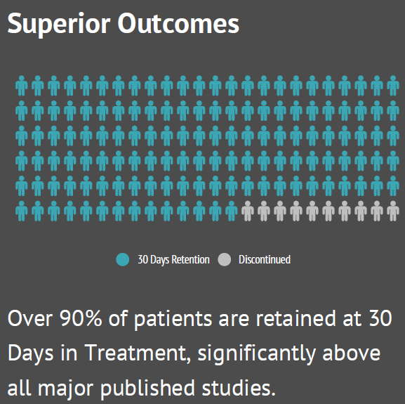
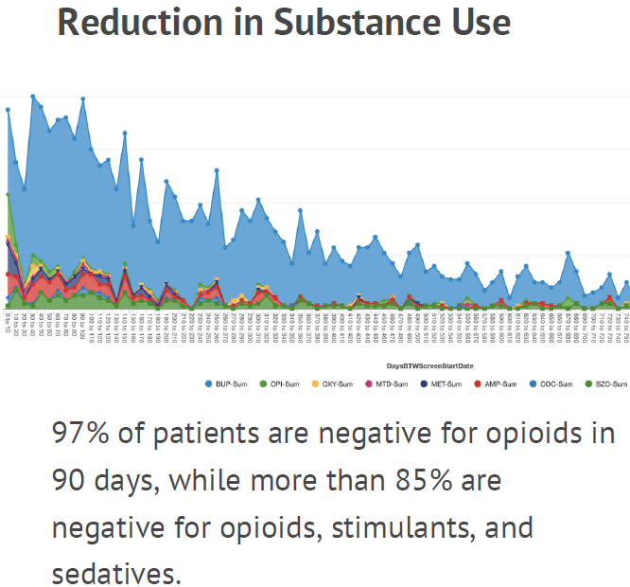





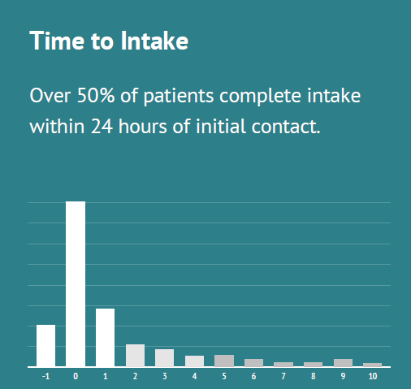

Bright Heart
A comprehensive on-demand telemedicine service addressing an individual's behavioral health needs and beyond
Simple Intake Process
Patients are easily connected to care with streamlined intake process
On-Demand Availability
Intake, admissions, screening, assessments are available 24/7
Care Coordination
Offering a team centric approach, coordinating care on key aspects of recovery, substance use, co-occurring issues, social determinants, and activities of daily living
Performance & Tracking
Quantitative longitudinal measures provide additional insight into patient care, areas of struggle, areas of strength and areas of progress

Slide 16






Promoting Health Equity & Resolving Access Barriers
Improving education and training options for ARHOME members through:
Continuously improving access and available treatments, while reducing health disparities by:
Promoting career advancement
In 2023, we added a 2nd incentive for completing continuing education (CE) to encourage advancement in economic status and marketability in the workforce.
To recognize diverse CE opportunities, we reward for college courses, training programs, online courses, and more.
In 2024, we doubled the incentive amount to further incentive members to engage in these trainings.
Assisting job seekers
Encouraging members to leverage the Arkansas Department of Workforce Services
Specifically, direct members to the free Career Readiness Certificate program
In 2024 as we triple the eligible reward for members earning a Career Readiness Certificate
Improving access & health equity
  Improved telemedicine options in behavioral health, substance abuse, maternal health, chronic condition management for rural members
  Promotion of resources to improve health literacy of health insurance & digital tools
Increased community collaboration
Actively engaged in Arkansas Rural Health Partnership
  Collaborative Health Initiative partnerships with health systems, medical centers, and clinically integrated networks
  FindHelp triage and engagement for members needing assistance

Slide 17





Community Investment
Investment in our youth in Arkansas by supporting schools, providing relief to Arkansans in emergency situations, and actively participating in community events to engage with others and support various initiatives.
Welcome centers available all throughout the state that allow us to engage with our members by hosting events, providing giveaways, and more.
Arkansas Blue Cross is committed to the health and well-being of the people and communities of Arkansas.
The following are a small sample of our engagement activities:
Mental health first-aid training for employees, members, and the public
Partnership and collaboration with Arkansas Rural Health Partnership
Expanded mental health focus in 2024 through funding for UAMS Pathways to Wellness and create a virtual AR ConnectNow welcome center with mental health resources and expanding the Trauma Resource initiative in Arkansas schools, Wolfe Street Foundation’s expanded substance use treatment resources for schools, American Foundation for Suicide Prevention—Arkansas chapter for 3 years to expand suicide prevention programs around the state.

