Slide 1

ARHOME
Performance Measures
August 2021

Slide 2
CMS National Core Set:
Medicaid Measures
Existing FFS Measurement
  Adult and Child Measures
    Standardized Specifications for Collection
      Enrollment Requirements
      Numerator and Denominator Definitions
  Administrative and Clinical Data
Mandatory Submission 2024
  Most States Submit 50-75% of Listed Measures

Slide 3
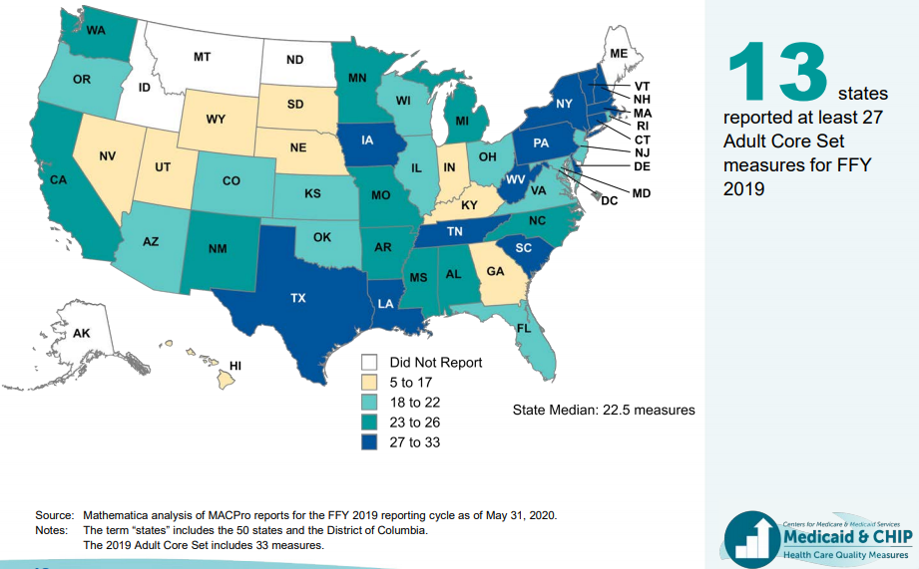
States Report Different Numbers of
Adult Core Set Measures

Slide 4
Commercial Payers
HEDIS Measures for Managed Care
  Specifications Set By NCQA

Slide 5
ARHOME Data Group
Convened to produce baseline performance on target measures
Weekly meetings since December 2020
Members:
  DHS
  Blue Cross
  Centene/QualChoice
  General Dynamics Information Technology(GDIT)
  AR Medical, Dental, & Pharmaceutical Association (AMDPA)
  UAMS College of Public Health
  AR Center for Health Improvement (ACHI)
  AR Dept. of Health, Office of Health Information Technology (OHIT)/ State Health Alliance for Records Exchange (SHARE)

Slide 6
Data Preparation
Paid Claims Database
  DHS, QHPs
  Shared Data Required Homogenization of Codes
Clinical Data
  Avoidance of Chart Audits
    Provider Hassles
    Administrative Hours of Work
  Alternative Sources
    Commercial Lab Data
    SHARE/OHIT

Slide 7
Local Environments
FFS vs MCOs
Formularies vs PBMs
Local Coding Requirements
Global Billing
Analytic Capacities
Identified vs Deidentified Data
Health Information Exchanges

Slide 8
Baseline Data
Initial Work Used CY 2019 Data
  Intact Dataset to Test Shared Codes and Data Transmission
CY 2020 Data Analysis Available Later This Year
CY 2019 Data Provides Framework for Discussion and Future Targets
  Statewide Performance
  QHP Comparisons
  Urban vs Rural Issues
  Other Demographic Subsets

Slide 9
Using Measurement
Goals
  Trusted Analytics, Clinical Transformation, Effective Care Delivery
Setting Targets for Achievement
Setting Targets for Improvement
Information to Guide New Policy
Data Targets Tied to Financial Incentives
  Core Activity Metrics (Tied to PMPM) – Minimal Performance
  Quality Metrics (Tollbooth for Incentive Dollars) – Average Performance
  Incentive Metrics (Performance Bonuses) – Excellent Performance

Slide 10
Performance Variability
National Comparisons
Plan Comparisons
Regional Comparisons
Demographic Comparisons

Slide 11
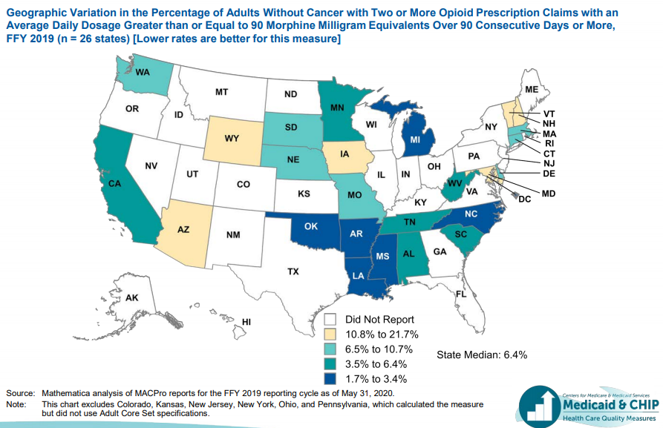
Use of Opioids at High Dosage in Persons
Without Cancer

Slide 12
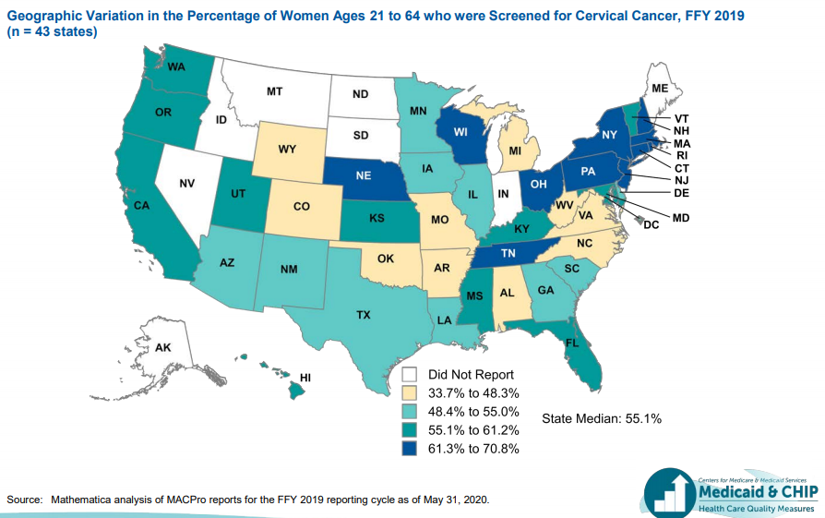
Cervical Cancer Screening

Slide 13
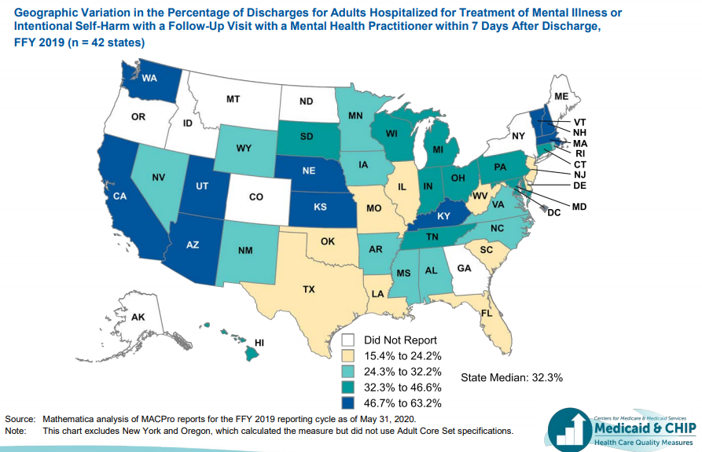
Follow-Up After Hospitalization for Mental Illness Within 7 Days After Discharge

Slide 14
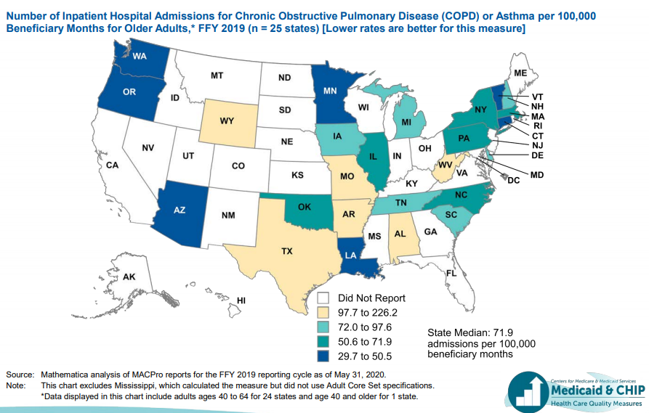
PQI 05: Chronic Obstructive Pulmonary Disease (COPD) or Asthma in Older Adults Admission Rate

Slide 15
CY 2019 Measurement Highlights
Cervical Cancer Screening
Substance Abuse Treatment
Follow Up After Acute Behavioral Health Event

Slide 16
Variability
Urban/Rural
  Urban rates worse for Heart Failure Admissions, Substance Abuse Treatment, Follow Up After Acute Behavioral Health Events
Demographic
  Black Patients Lag in Treatment of Depression, Substance Abuse Treatment, Follow Up of Acute BH Events
  White Patients Lag in Breast and Cervical Cancer Screening, Concomitant Use Of Opioids and Benzodiazepines, Admission Rates for Adult COPD/Asthma

Slide 17
Defining Improvement
Gap Reduction
  AR vs Nation, Disparities, Plan Performance
Aspirational Goals
Implementation Opportunities
  Opioid Prescription
Measurement of Change
  Targets
  % improvement in Baseline
  Reduction in Failure Rates

Slide 18
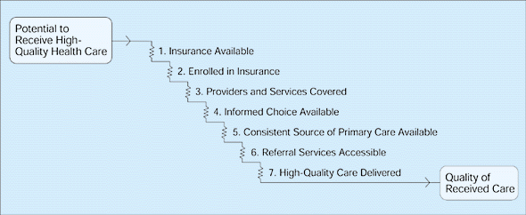
Barriers to Improvement
Data Limitations
Care Gap Not Prioritized
Care Gap Characteristics
Patient Refusal/Engagement
Disorganized Systems Issues

Slide 19
Promoting Improvement
Compelling Data/Clinical Science
Prioritized Topics
Comparative Performance
Better Systems Solutions
Financial Incentives
  Plans, Professionals, Patients

Slide 20
Opportunities
More Comprehensive, Coordinated Data Collection
Identification of Priority Topics
Satisfying Waiver Requirements As Set By CMS
Reduction of Variability of Care Within Arkansas
Improvement of AR Rates With National Measures
Better Health of our Communities

Slide 21


We Care. We Act. We Change Lives.

