Slide 1
ABCBS ARHOME 2022 Health Improvement Incentive Program
Kaitlin Bates, PharmD, Manager ARHOME Quality
September 27, 2023

Slide 2

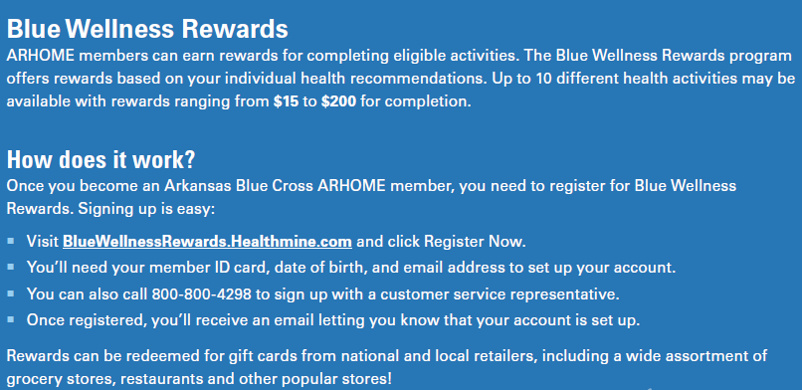

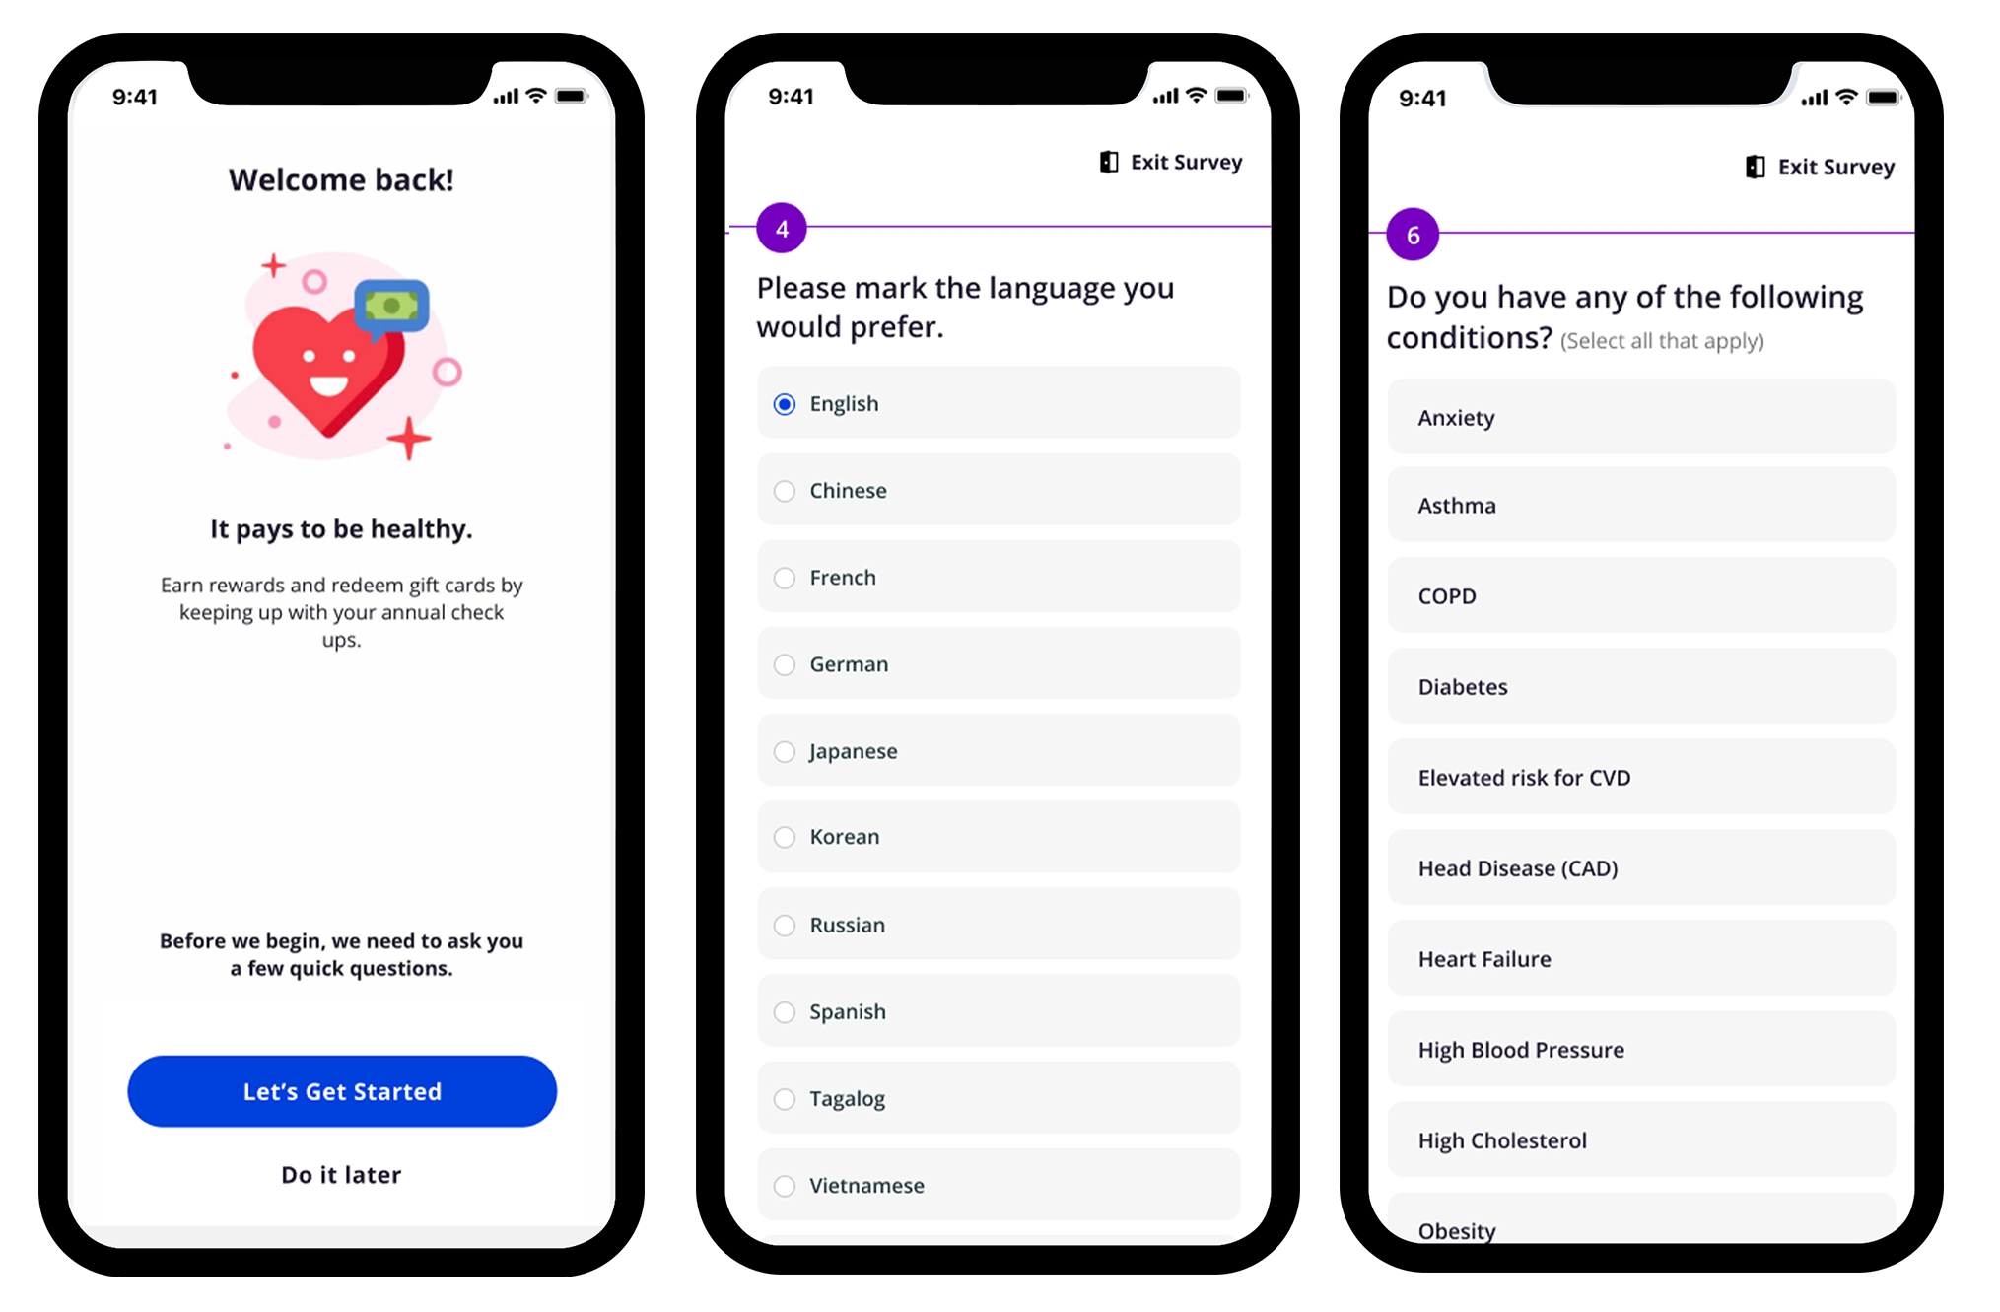

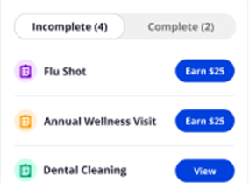
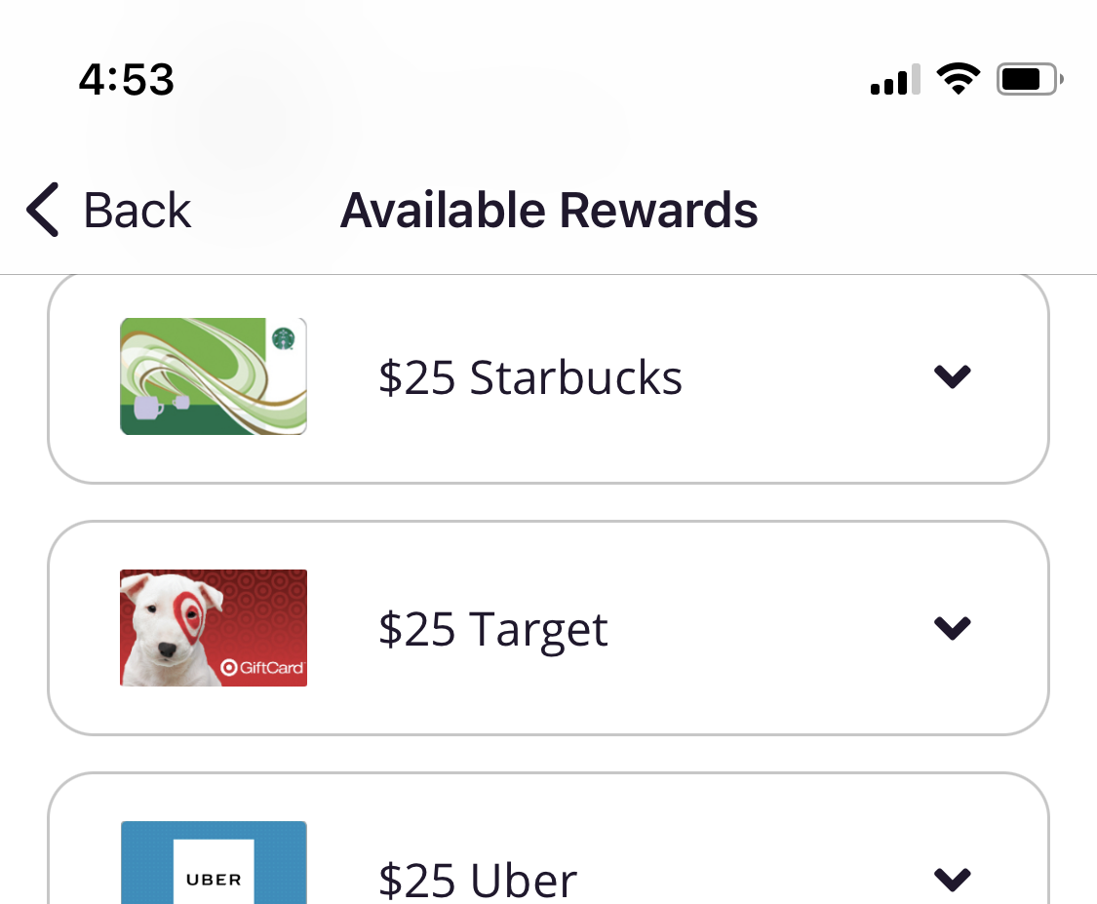

Blue Wellness Rewards
Communications encourage our ARHOME members to sign up for the program
Registration is simple and user friendly and collects preliminary health and lifestyle data
Messaging available on our website, within our welcome materials, as well as campaigns throughout the year for specific health actions
A personalized member experience. Members can also enroll through our customer service reps by phone.
Personalized action plans are created for each member linked to rewards to motivate action
Reward redemption is easy and allows members to select gift cards to local and national retailers
We lead our members to the platform to view all assigned health actions. Up to 17 actions available.
Rewards automatically awarded based on completion of health actions.

Slide 3
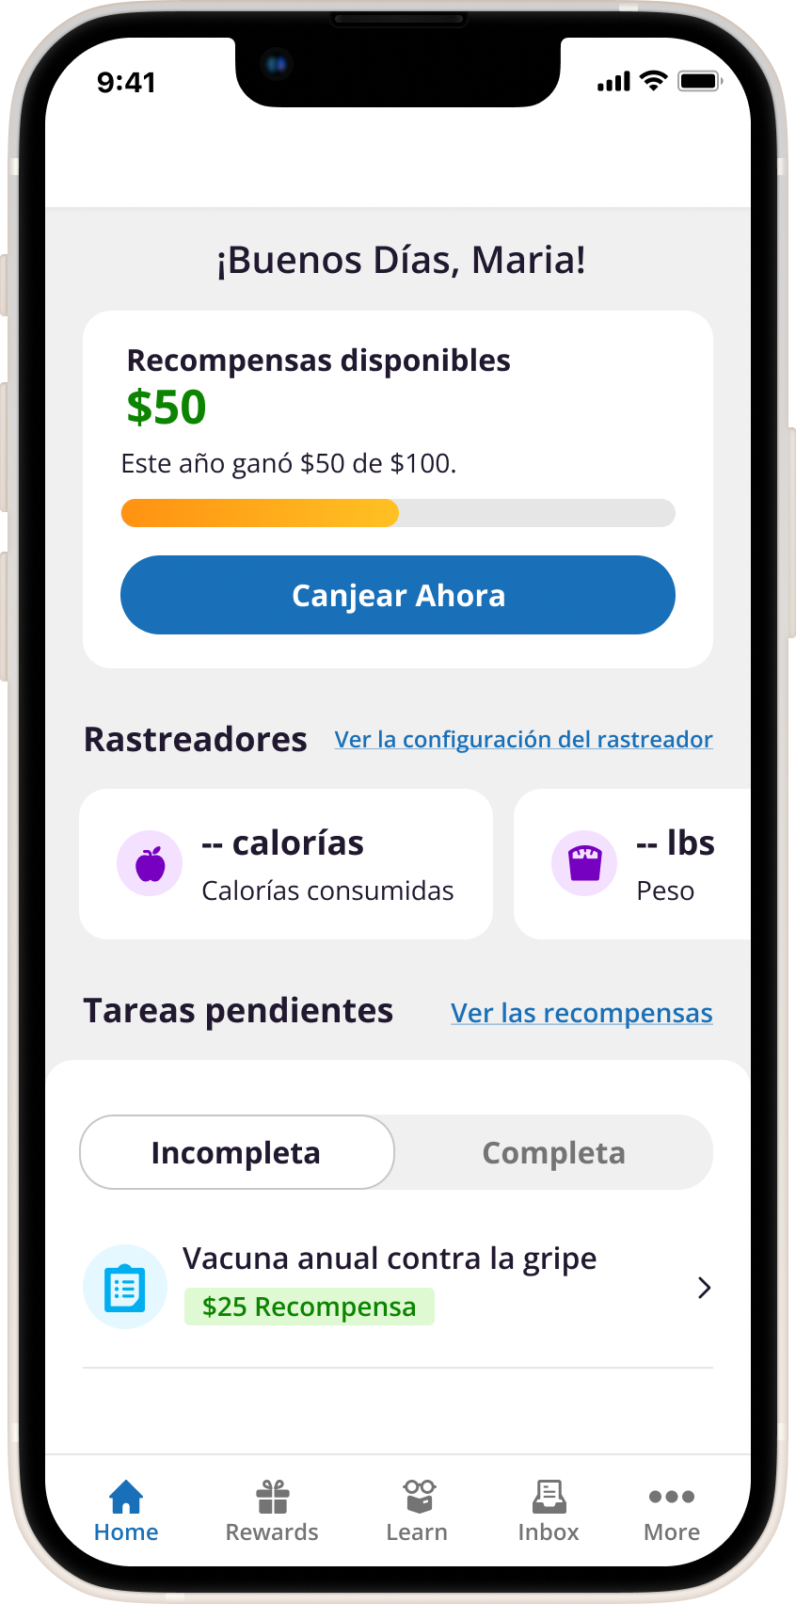
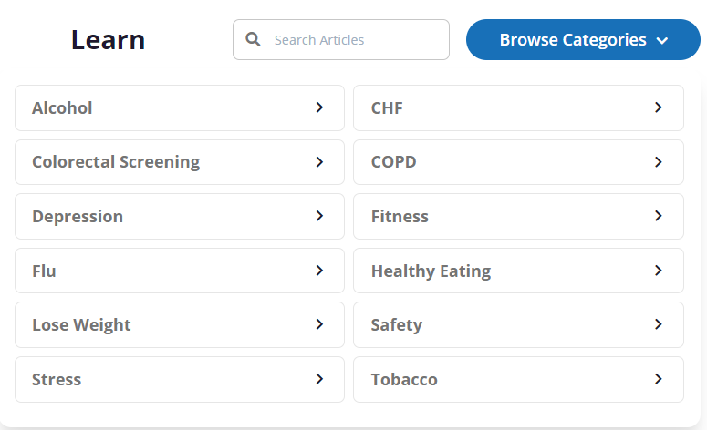
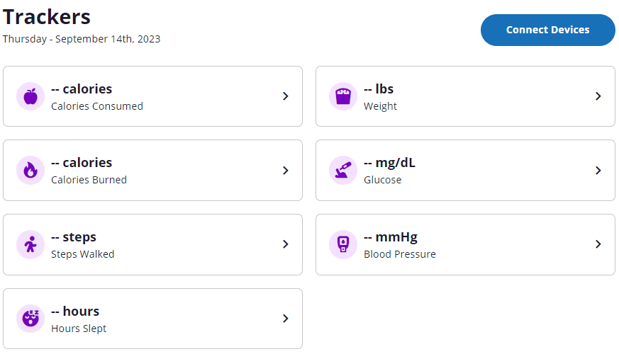
Blue Wellness Rewards
Our mobile app and web portal allows members to take the right steps to improve their health and redeem their rewards.
NCQA-certified
health education
Personalized action plans
English and Spanish
language options
Biometrics and
wellness tracking
Easy to read menu with total earned amount available to redeem gift cards
Customized incentives and rewards

Slide 4
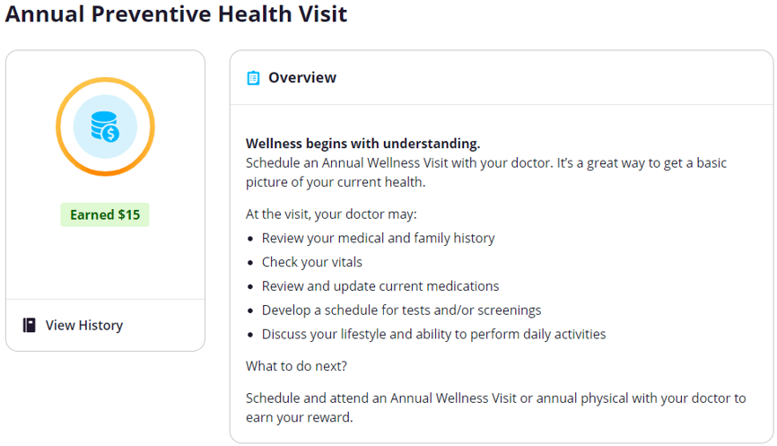
Incentive for Preventive Care
  Goal: To increase annual preventive health visits
  Activity: Completion of annual wellness visit
  Amount: $15
Plan | Members who received the reward in 2022 | Total amount awarded in 2022
BCBS | 27,702 | $415,530.00
HA | 4,719 | $70,785.00
Total | 32,421 | $486,315.00

Slide 5
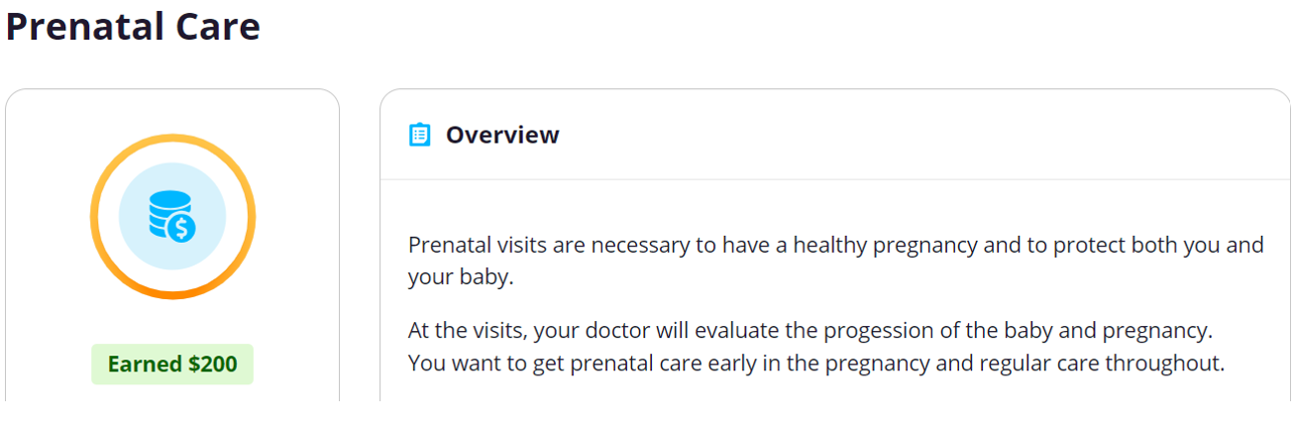
Incentive for Pregnant Women
  Goal: To encourage the use of prenatal care to promote healthy pregnancies and decrease maternal and neonatal morbidity and mortality
  Activity: Report due date and complete one prenatal visit
  Amount: $200
Plan | Members who received the reward in 2022 | Total amount awarded in 2022
BCBS | 1,822 | $364,400.00
HA | 713 | $142,600.00
Total | 2,535 | $507,000.00
Changes made for 2023:
Focus on longitudinal care by incentivizing 4 visits
Added a separate pregnancy care manager engagement incentive

Slide 6
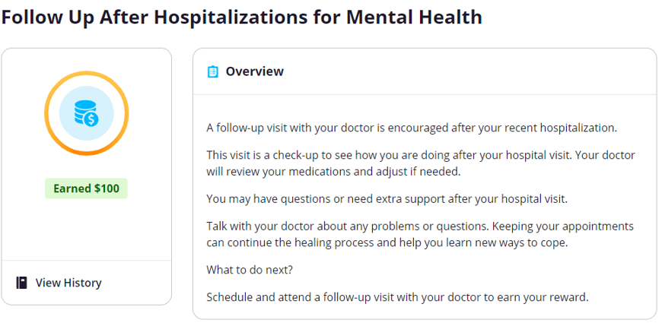
Incentive for Individuals with Mental Illness
  Goal: To encourage follow-up with a mental health provider after hospitalization for mental illness to prevent rehospitalization and promote continued support for mental health conditions
  Activity: Completion of a follow-up visit 30 days after hospitalization for a mental health disorder
  Amount: $100
Plan | Members who received the reward in 2022 | Total amount awarded for 2022
BCBS | 440 | $26,300.00
HA | 97 | $5,700.00
Total | 537 | $32,000.00
*Technical glitch caused a delay in administration of the reward.

Slide 7
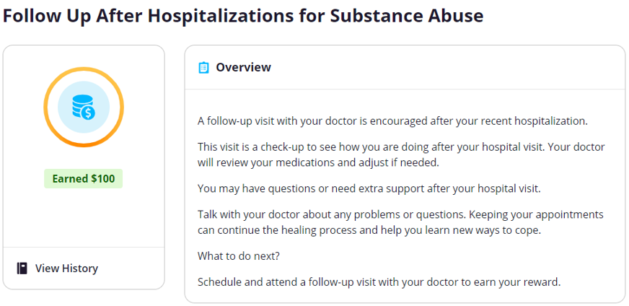
Incentive for Individuals with Substance Use Disorder
  Goal: To encourage follow-up after hospitalization for substance use disorder to prevent rehospitalization and encourage treatment and continued support for substance use disorder
  Activity: Completion of a follow-up visit 30 days after hospitalization for substance use disorder
  Amount: $100
Plan | Members who received the reward in 2022 | Total amount awarded for 2022
BCBS | 78 | $5,000.00
HA | 10 | $700.00
Total | 88 | $5,700.00
*Technical glitch caused a delay in administration of the reward.

Slide 8
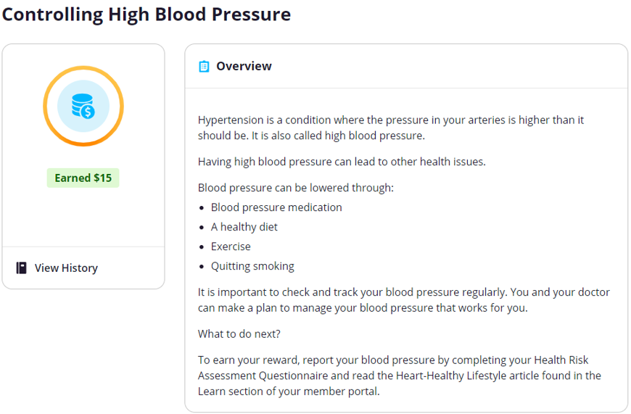
Incentive for Individuals with 2+ Chronic Conditions
  Hypertension
  Goal: To encourage monitoring of blood pressure and educate on the importance of maintaining a controlled blood pressure
  Activity: Report blood pressure and read an educational article related to hypertension
  Amount: $15
Plan | Members who received the reward in 2022 | Total amount awarded for 2022
BCBS | 516 | $7,740.00
HA | 33 | $495.00
Total | 549 | $8,235.00

Slide 9
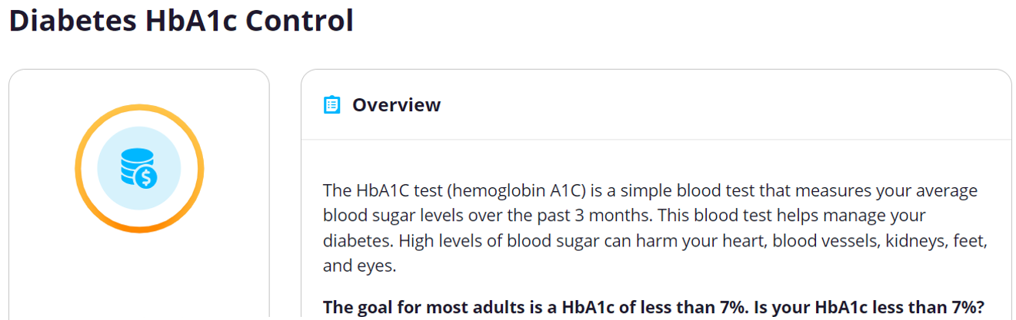
Incentive for Individuals with 2+ Chronic Conditions
  Diabetes
  Goal: To encourage individuals with diabetes to complete hemoglobin A1c tests to address the continued need for ongoing and comprehensive diabetes care
  Activity: Complete 2 hemoglobin A1c tests within the calendar year
  Amount: $25
Plan | Members who received the reward in 2022 | Total amount awarded for 2022
BCBS | 9,548 | $238,700.00
HA | 1,256 | $31,400.00
Total | 10,804 | $270,100.00
Changes made for 2023:
Focus on the importance of a controlled HbA1c of less than 7%
Increased reward amount
Only requires 1 HbA1c test

Slide 10
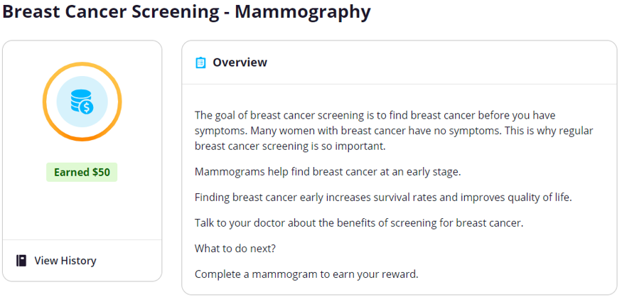
Incentive for Women’s Health Preventive Screenings
  Breast Cancer Screening
  Goal: To identify early cases of breast cancer by encouraging breast cancer screenings for women that are eligible at recommended time intervals
  Activity: Complete 1 mammogram during the recommended time frame
  Amount: $50
Plan | Members who received the reward in 2022 | Total amount awarded for 2022
BCBS | 6,584 | $329,200.00
HA | 18 | $900.00
Total | 6,602 | $330,100.00

Slide 11
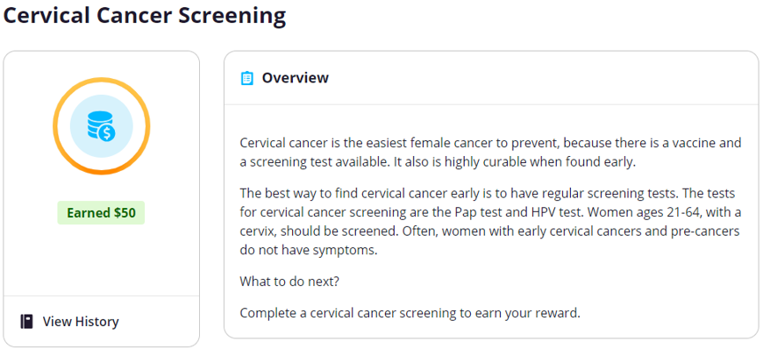
Incentive for Women’s Health Preventive Screenings
  Cervical Cancer Screening
  Goal: To prevent and identify early cases of cervical cancer by encouraging cervical cancer screenings for women at risk for cervical cancer at recommended time intervals
  Activity: Complete 1 cervical cancer screening during the recommended time frame
  Amount: $50
Plan | Members who received the reward in 2022 | Total amount awarded for 2022
BCBS | 23,755 | $1,187,750.00
HA | 1,273 | $63,650.00
Total | 25,028 | $1,251,400.00

Slide 12
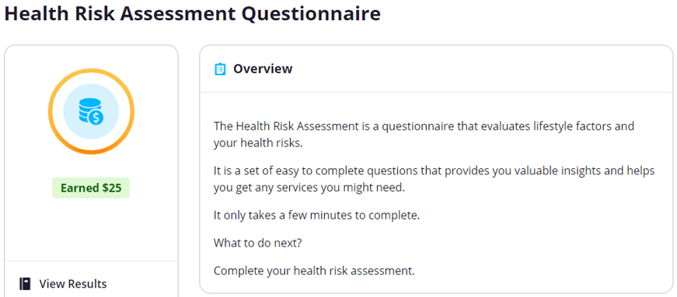
Incentive to Collect Data on Health Disparities
  Goal: To evaluate member risk factors to provide customized recommendations and gain insight on health inequities
  Activity: Complete health risk assessment questionnaire
  Amount: $25
Plan | Members who received the reward in 2022 | Total amount awarded for 2022
BCBS | 1,962 | $49,050.00
HA | 124 | $3,100.00
Total | 2,086 | $52,150.00
Based upon responses from the HRA, members in need of assistance are triaged to appropriate areas for access to food, transportation, housing, case management, etc.

Slide 13
Incentive Plan for 2024
ABCBS continues to learn from the level of member engagement with our incentive program and the impact our incentive program has on our overall quality metric results. As we uncover more about our member preferences and what motivates action, we adapt our rewards program each year to better fit our population. Our goal is to continue to drive and increase engagement by offering incentives that members care about so Arkansans can live healthier lives.
2024 Incentive Program Changes
Addition of New Incentives | Chlamydia Screening Contraception Post Partum
Increase in Incentive Amounts | Career Readiness Certificate Continuing Education Health Fair attendance for rural members
Removal of Incentive | Blood Pressure

