Slide 1

ARHOME: Arkansas Health & Opportunity for Me
Demonstration Project of National Significance for Improving Health Outcomes & Economic Independence
8/25/21 PRESENTATION

Slide 2
Arkansas Works to ARHOME
Arkansas Works: Arkansas’s Medicaid expansion program under the federal Affordable Care Act.
Serves adults:
Between 19 and 64 years old
With household income below 138% FPL
Federal government pays 90%; Arkansas pays 10%
Currently established as a Medicaid waiver program; uses Medicaid dollars to buy private insurance for clients
The Arkansas Works state law and waiver expire December 31, 2021.
Act 530 of 2021 authorizes the Department of Human Services to apply for a new five-year waiver.
8/25/21 PRESENTATION

Slide 3
Current Arkansas Works Population
Nearly 325,000 people are currently enrolled in ARWorks.
About 19% of Arkansas’s non-elderly adults receive health coverage through ARWorks.
SFY 2021 expenditures totaled $2.46 billion.
8/25/21 PRESENTATION

Slide 4
ARHOME: What Stays the Same
No changes to member eligibility; existing clients who remain eligible will seamlessly transition to ARHOME.
DHS will continue using Medicaid dollars to purchase private health insurance.
ARHOME will continue drawing 90% federal match.
8/25/21 PRESENTATION

Slide 5
Three Measurable Goals for ARHOME
Improve health outcomes among Arkansans in:
  Maternal and infant health
  Rural health
  Behavioral health
  Chronic disease
Provide opportunities to reduce poverty through employment, education, and training.
Slow the growth in spending for ARHOME while maintaining the economic and fiscal benefits of coverage through Qualified Health Plans.
8/25/21 PRESENTATION

Slide 6
ARHOME: Primary Focus is Health Improvement
Require Health Plans to meet annual health improvement targets based on the Medicaid Adult Core Set used to monitor trends in performance on standardized indicators of quality of care related to primary and preventive care, maternal and perinatal care, care of acute and chronic conditions, and behavioral health care.
  The next presentation will present the baseline on 21 measures. The purpose of these measures is to drive quality improvement over the next 5 years.
Health Plans will provide incentives to their members or providers to encourage health improvement activities.
Health Plans are required to submit annual Quality Assessment and Performance Improvement Strategic Plans.
  Each of the health plans will present their strategic plans.
DHS may assess penalties if targets are not met.
8/25/21 PRESENTATION

Slide 7
Requirements for Strategic Plans
Strategic Plans must include:
Activities to support health improvement and economic independence
Activities to meet quality and performance metrics
Activities to improve health outcomes for:
Pregnant women
Individuals with mental illness
Individuals with substance use disorders
Individuals with chronic diseases
Initiatives for improving health outcomes in rural areas
8/25/21 PRESENTATION

Slide 8
Health and Economic Outcomes Accountability Oversight Advisory Panel
New joint Executive-Legislative Oversight Panel
Panel ensures essential program transparency and stakeholder involvement.
Primary purposes:
Review health plans’ annual strategic plans
Make recommendations on performance improvement targets
8/25/21 PRESENTATION

Slide 9
Arkansas Works Demographics, July 2019

Slide 10
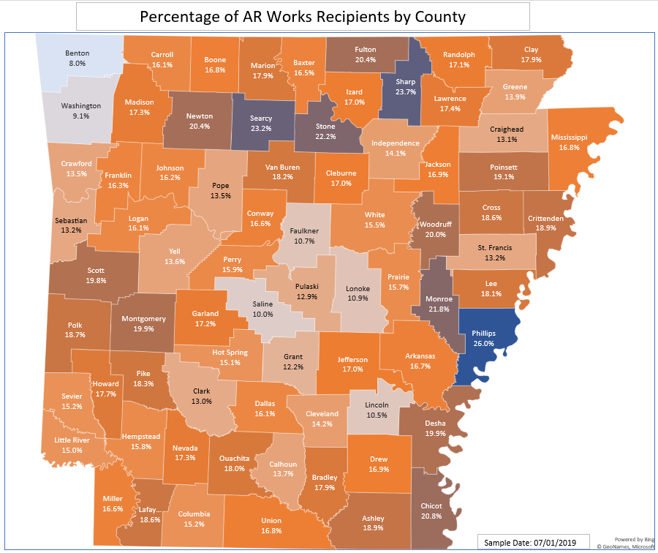
Highest Percentage Enrollment in Poorest and Most Rural Counties
AR Works Enrollees as % of County Residents 20 to 64 Years Old, July 2019
8/25/21 PRESENTATION

Slide 11
AR Works Enrollees by Gender
8/25/21 PRESENTATION

Slide 12
AR Works Enrollees by Race/Ethnicity
8/25/21 PRESENTATION

Slide 13
AR Works Enrollees by Age

Slide 14
AR Works Enrollees by FPL %
8/25/21 PRESENTATION

Slide 15
Contact Us
Dennis Smith
Dennis.G.Smith@dhs.arkansas.gov
Elizabeth Pitman
Elizabeth.Pitman@dhs.arkansas.gov
Nell Smith
Nell.M.Smith@dhs.arkansas.gov
8/25/21 PRESENTATION

Slide 16


We Care. We Act. We Change Lives.
8/25/21 PRESENTATION

