Slide 1
2025 ARHOME Strategic Plan
Arkansas Blue Cross and Blue Shield
Matthew Vannatta, Vice President Government Programs
Kaitlin Bates, PharmD, Manager ARHOME Quality
September 30, 2024

Slide 2
ABCBS 2025 ARHOME Strategic Plan
Overall Goal & Strategic Vision: slide 3
Incentives: slide 4
Blue Wellness Rewards: overview, slide 5
Blue Wellness Rewards communications, slide 6
Incentive analysis to guide changes, slide 7-8
2025 incentives, slide 9-13
Member Communications: slide 14
How we communicate with our members and examples, slide 15
Driving engagement through 2-way SMS messaging, slide 16
Member-specific journeys, slide 17-18
Communication strategic goals, slide 19-21
Whole Person Approach, preventive care and chronic condition management: slide 22
Collaboratives value-based program, slide 23-25
Primary Care First/Blueprint Primary Care value-based program, slide 26-30
Diabetes management collaboration with pharmacies, slide 31-33
Virtual care alternatives, slide 34
Maternal Health: slide 35
Maternity program overview, slide 36
Special Delivery high-risk case management program, slide 37
Maven digital maternity program, slide 38-42
Maternal health and behavioral health coordination, slide 43
Behavioral Health: slide 44
Behavioral health incentive optimization, slide 45
Behavioral health case management, slide 46
Lucet, slide 47
Teladoc Mental Health Complete, slide 48-49
Peer Support Specialists and substance use disorder program, slide 50
Beyond Opioids, slide 51
Mental health medication adherence, slide 52-53
Improving Access to Care: slide 54
Meeting members where they are, slide 55
Take Good Care of Her events, slide 56
Test kits delivered, slide 57
Dispatch Health, slide 58
Pharmacists as providers, slide 59-60
Economic independence incentives, slide 61

Slide 3






2025 Strategic Vision
Health Incentives
Whole Person Approach
Behavioral Health
Our overall strategic vision offers both breadth and depth.
ABCBS will support, advocate, and advise for all ARHOME members. By breaking down barriers for members to access quality, timely, and appropriate care; supporting members in both urban and rural areas of various economic standing; bringing care to the community, while educating members around the importance of preventative services; lastly, offering tailored programs to address the most vulnerable, which include expecting mothers, those with mental health and substance use conditions, chronic conditions, and beyond.
Strategic Communication
Maternal Health
Improving Access to Care

Slide 4
Blue Wellness Rewards
Incentives
Blue Wellness Rewards overview, slide 5
Blue Wellness Rewards communications, slide 6
Incentive analysis to guide changes, slide 7-8
2025 incentives, slide 9-13
The Why | The Who | The How
To encourage healthy behaviors and improve health outcomes by providing rewards to our members. | Blue Wellness Rewards focuses on the promotion of preventive care and offers suggestions for improvement of economic independence for all. Specific incentives are available that offer education and services for the following priority populations: Pregnant women Members with mental illness Substance use disorder 2 or more chronic conditions Members living in rural areas | Incentives Communication Complete health actions, get rewarded in a timely manner, redeem gift cards that help you eat and live healthier

Slide 5
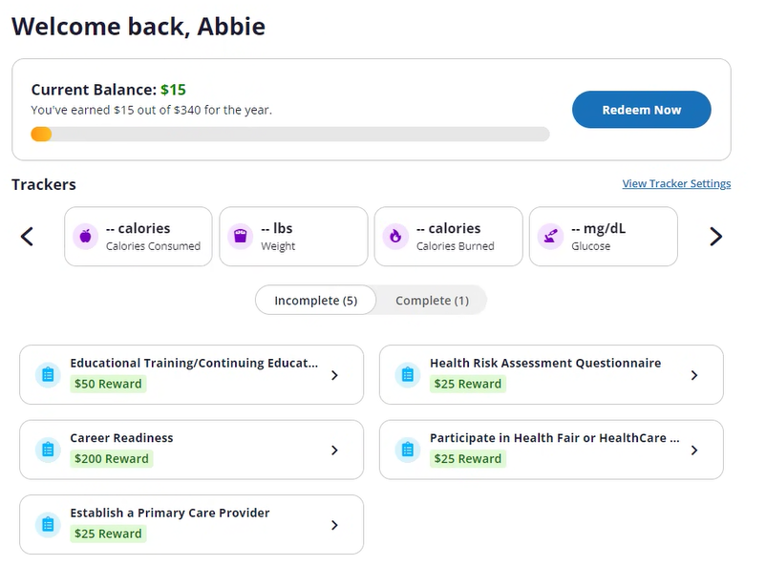
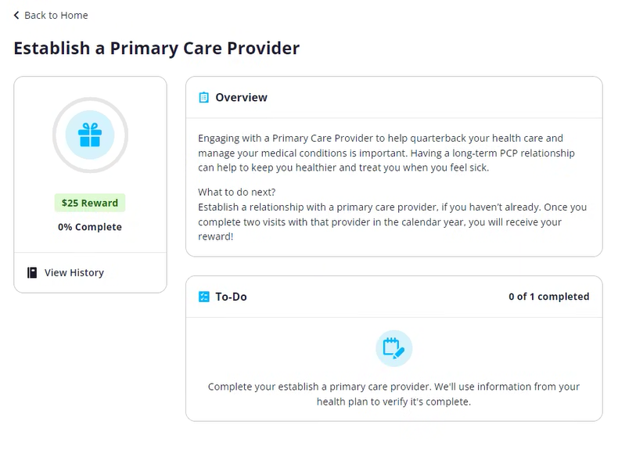
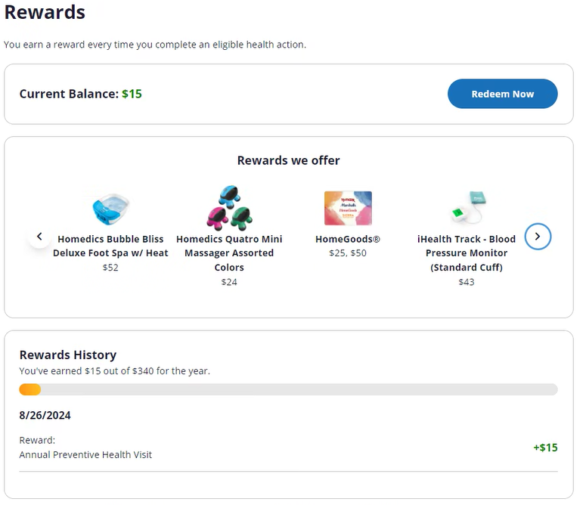
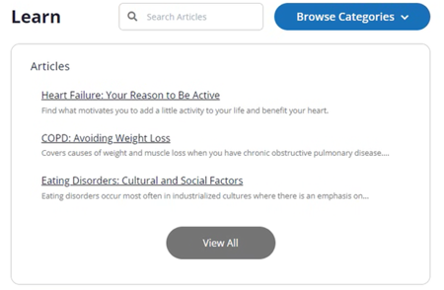
Blue Wellness Rewards
Advising members on appropriate care paths through education opportunities and incentivizing members to act on their health needs
Advise
Learn
Act
Earn
Members can learn about their suggested care paths
Members earn rewards when care is completed
1
2
3
4
Members are advised through custom health actions in their portal
Members can act based on their suggestions

Slide 6
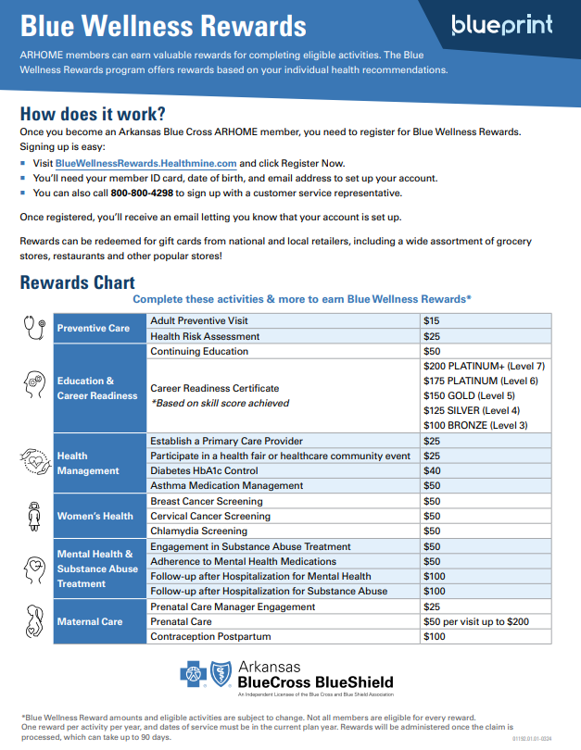
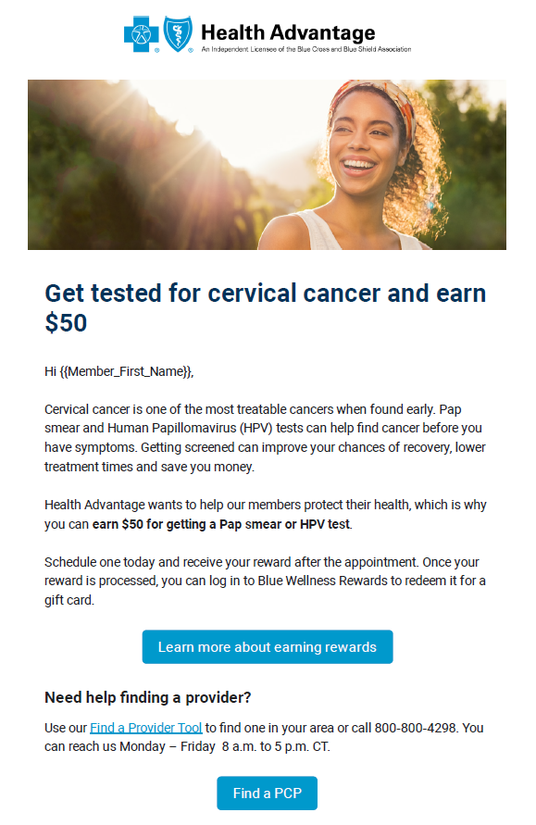
Blue Wellness Rewards Awareness
Creating awareness through multiple channels:
Targeted communications based on a members current health status via email, text, and mail
Enhanced Blue Wellness Reward website landing page
Incorporated into member quick start guides when onboarding

Slide 7



Determination of 2025 Proposed Incentive Program Changes
Considered 2023 quality performance to determine which quality metrics are priority and if an incentive needs optimization
Analyzed the efficacy of Blue Wellness Rewards on improving the performance in these quality measures: were active Blue Wellness Rewards members more likely to complete health actions?
Analyzed the success of communication campaigns which drove members to complete health actions: was frequency and mode of communication appropriate? Did members “click” on the communications? How did this impact health action performance?
Added new rewards and enhanced some existing rewards to drive quality performance, improve upon timeliness of the reward, and plan future communication campaigns
1) Investigate
2) Analyze
3) Interpret
4) Improve

Slide 8
Blue Wellness Rewards: Optimizing Incentive Performance
Increase in communications drove breast cancer and cervical screening engagement for registered members
*
*
The analysis of engaged (registered) Blue Wellness Rewards users compared to unregistered members shows that engaged members have a higher rate of completion for most health actions. These health actions can impact quality performance.
* AMR and mental health adherence is not rewarded until the end of the year.

Slide 9
2025 Proposed Incentive Program Changes
Legend
Enhanced Incentive
New Incentive
Preventive Care
2024 Incentive | 2025 Incentive | 2025 Changes | Amount
Adult Preventative Visit | Adult Preventative Visit | None | $15
Chlamydia Screening | Chlamydia Screening | Updating the description with education on how to contact ABCBS to obtain a chlamydia test kit, especially for rural members or those with transportation barriers. Hoping to have an attestation for a test kit in 2026. | $50
Breast Cancer Screening | Breast Cancer Screening | None | $50
Cervical Cancer Screening | Cervical Cancer Screening | None | $50
Economic Independence
2024 Incentive | 2025 Incentive | 2025 Changes | Amount
Continuing Education | Continuing Education | None | $50
Career Readiness Certificate | Career Readiness Certificate | None | $100-$200
 | Community Health Worker Certification | Encourages CHW to offer Launch (job seeker platform) and Civiform (apply for public assistance programs in one place) to Arkansans. | $200

Slide 10
2025 Proposed Incentive Program Changes
Legend
Enhanced Incentive
New Incentive
Pregnant Women
2024 Incentive | 2025 Incentive | 2025 Changes | Amount
 | Report Your Pregnancy | Attestation to gather pregnancies not confirmed by claims to offer prenatal care services, triggers other prenatal rewards ($225 value) | $0
Pregnancy Care Manager Engagement | Pregnancy Care Manager Engagement | Remains the same but recommended from the new Report Your Pregnancy Health Action. | $25
Prenatal Care (up to 4 visits) | Prenatal Care (up to 4 visits) | Changing the current prenatal care incentive to a compound health action where it remains recommended until all 4 visits are completed. Will be recommended from the new Report Your Pregnancy Health Action. | $50
 |  |  | ($200 total)

Slide 11
2025 Proposed Incentive Program Changes
Legend
Enhanced Incentive
New Incentive
Mental Health
2024 Incentive | 2025 Incentive | 2025 Changes | Amount
Adherence to Mental Health Medications | Adherence to Mental Health Medications using Pharmacy Services | Including antidepressants next year (not limited to antipsychotics). Rewards for using adherence solutions at the pharmacy: $25 for a 90-day conversion, $25 to switch to mail order for those with transportation barriers, OR $50 at the end of the year if remained adherent. | $50
Follow-up after Hospitalization for Mental Health | Engagement in Mental Health Treatment and Visit Options | Expanding eligibility so that it is not only displayed after a hospitalization. It will be displayed to members with mental health conditions throughout the year and educates on mental health treatment options available: mental health providers, Teladoc Mental Health Complete, Lucet, Arisa, Behavioral Health Case Management, etc. Attending 2 visits or services satisfies the reward. | $50

Slide 12
2025 Proposed Incentive Program Changes
Legend
Enhanced Incentive
New Incentive
Substance Use Disorder
2024 Incentive | 2025 Incentive | 2025 Changes | Amount
Engagement in Substance Abuse Treatment | Engagement in Alcohol or Substance Use Disorder Treatment Options | Rewards members for engagement (2 visits) with a peer support specialist, SUD provider, or virtual SUD provider to display options available throughout the year. | $50
Follow-up after Hospitalization for Substance Abuse | Follow-up after Hospitalization or ED Visit for Substance Use Disorder | Expanding eligibility for reward to include ED visits in addition to hospitalizations. | $100
Multiple Chronic Conditions
2024 Incentive | 2025 Incentive | 2025 Changes | Amount
Diabetes HbA1c Control | Diabetes HbA1c Control | None | $40
 | Heart Failure Visit and Follow-up | New incentive to address the lowest performing chronic condition admissions measure, encourages 2 PCP visits for HF or 1 PCP visit with a follow-up with CM for heart failure. Replaces asthma adherence. | $50

Slide 13
2025 Proposed Incentive Program Changes
Legend
Enhanced Incentive
New Incentive
Individuals Living in Rural Areas
2024 Incentive | 2025 Incentive | 2025 Changes | Amount
Establish a PCP | Establish a PCP | None | $25
Participate in a health fair or healthcare community event | Participate in a health fair or healthcare community event | None | $25
Other Incentives
2024 Incentive | 2025 Incentive | 2025 Changes | Amount
Post-Partum Contraception | Post-Partum Contraception | None | $100
 | Contraception for All Women | Likely no targeted outreaches to encourage but will remain as recommended on the portal and educates about the ability to obtain contraception in a pharmacy. | $25
Health Risk Assessment | Health Risk Assessment | None | $25

Slide 14
Member Communications
Member Communications
  How we communicate with our members and examples, slide 15
  Driving engagement through 2-way SMS messaging, slide 16
  Member-specific journeys, slide 17-18
  Communication strategic goals, slide 19-21
The Why | The Who | The How
To establish trust with members through effective, timely, and strategic communication, creating a relationship to help address a person’s unique heath needs | All members, with an enhanced focus on the most vulnerable populations. Pregnant women Members with mental illness Substance use disorder 2 or more chronic conditions Members living in rural areas | Targeted incentives communications Various Communication Methods and mediums such as email, text, mailer, flyer, etc. Member-specific journeys that are tailored and dynamic, addressing current healthcare needs and gaps
Notes:
Methods

Slide 15
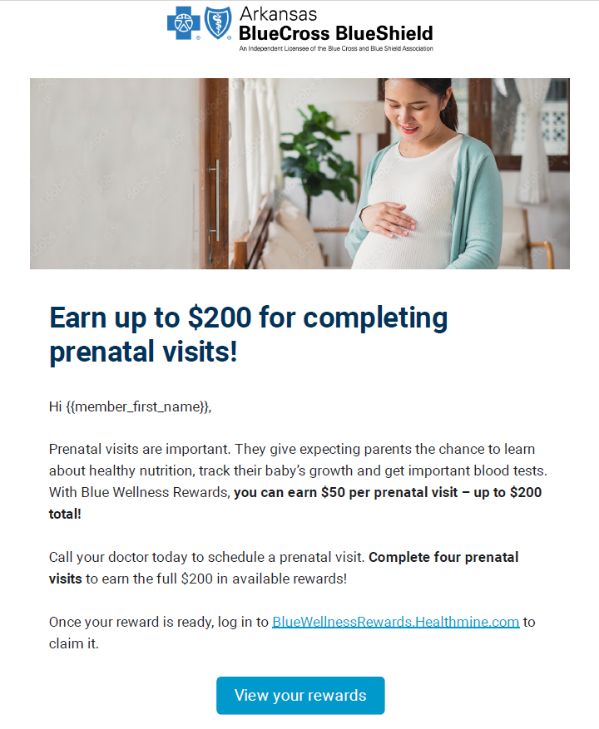






Strategic Communication
Engaging members through multiple communication channels and modalities for a personalized experience that enhances the member’s care journey
Blue Wellness Rewards Email Example
Maven Welcome Email Example
Personalized Communications
Adaptive member journeys based on a member’s engagement
Electable communication channel preferences
Directed claims-based communications for outreach
Various Communication Channels
Emails
Texts
Mail
Flyers
QSG
Blue Wellness Rewards Text Example
With Blue Wellness Rewards, you can earn $50 for up to 4 prenatal visits and $100 for starting a birth control method within 90 days of delivery—up to $300 total! Click here to register or login to bluewellnessrewards.healthmine.comor call 1-800-800-4298. Text STOP to End. Msg and Data Rates May Apply

Slide 16
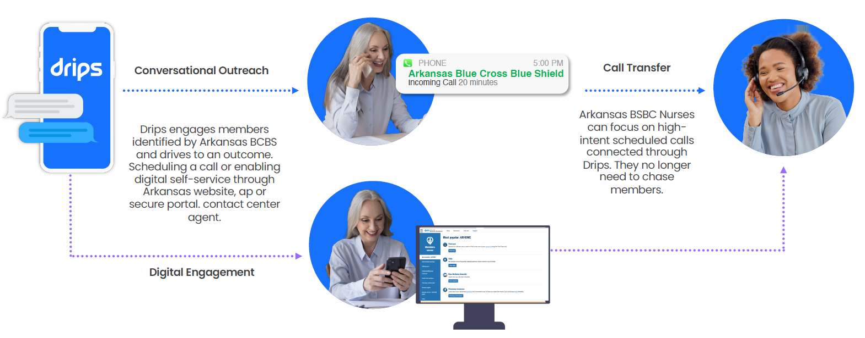
Two Way Texting
Objective: Have more members screened for breast cancer, chlamydia, and cervical cancer.
The How
Informative tone that leverages text, phone, voicemail in campaigns. Stimulating member actions via inbound calls to nurse navigators to assist with scheduling
Insert Date | Records | Engagement | Engagement Rate
9/6/2024 | 399 | 38 | 9.52%
8/30/2024 | 441 | 56 | 12.70%
8/23/2024 | 389 | 75 | 19.28%
8/16/2024 | 369 | 74 | 20.05%
8/9/2024 | 440 | 133 | 30.23%
8/2/2024 | 414 | 112 | 27.05%
7/26/2024 | 354 | 102 | 28.81%
Total | 2,806 | 590 | 21.03%
21% average
engagement

Slide 17
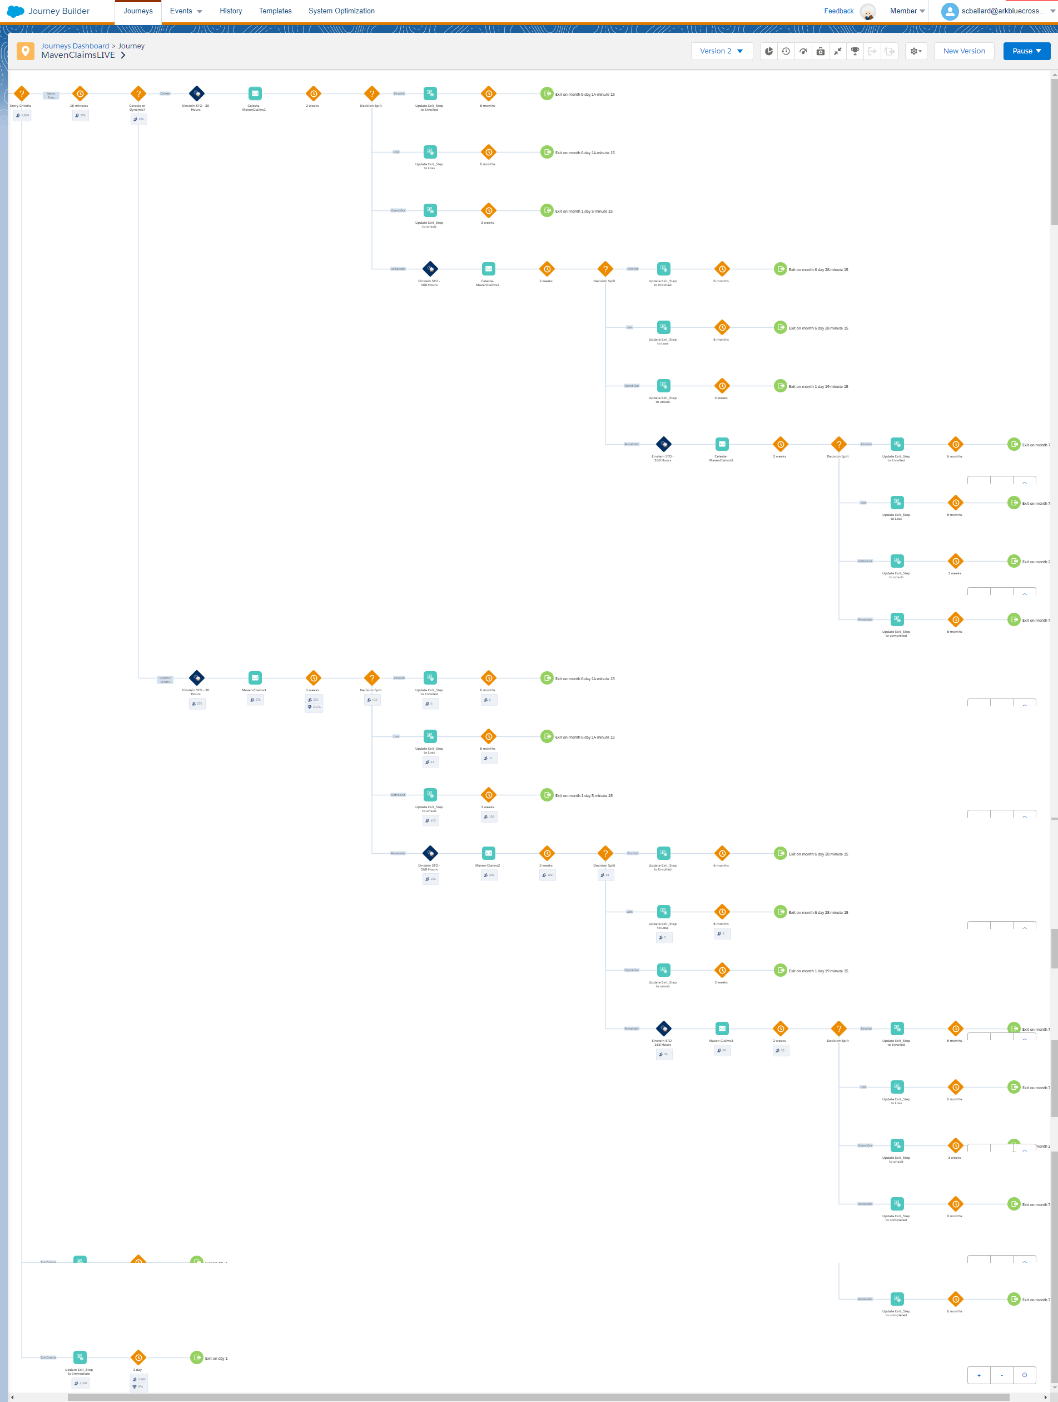
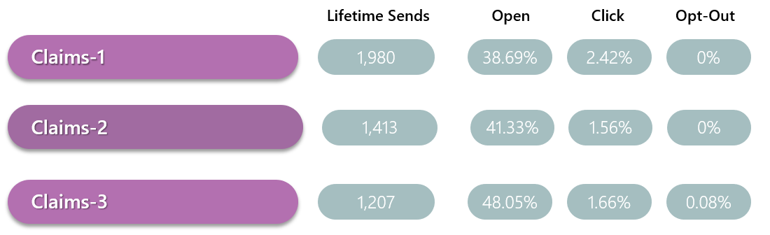
Claims Based Journeys
Leveraging data insights to provide custom and timely care communications
Delivering timely and relevant communications through claims data, while also using engagement data insights to adjust communication journey to fit member needs.
Adaptive journeys will stimulate member engagement and action on their personal care needs.
Adaptive Communication Journeys
Claims data drives pulls eligible members into custom communications.
Open rates continue to grow as the journey evolves.

Slide 18
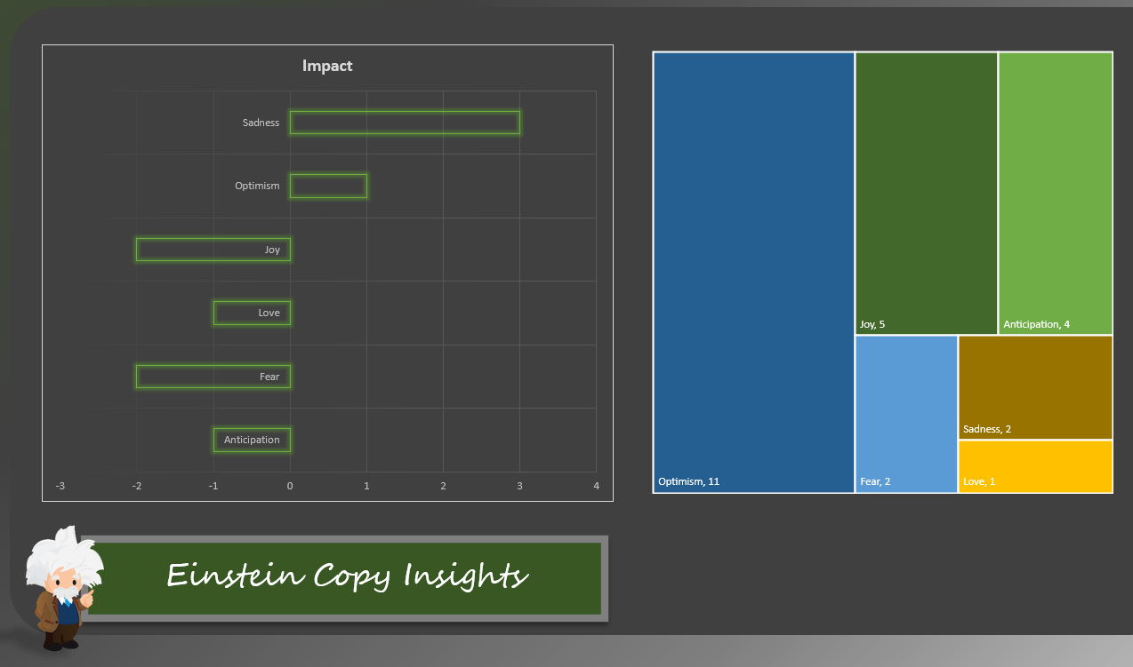
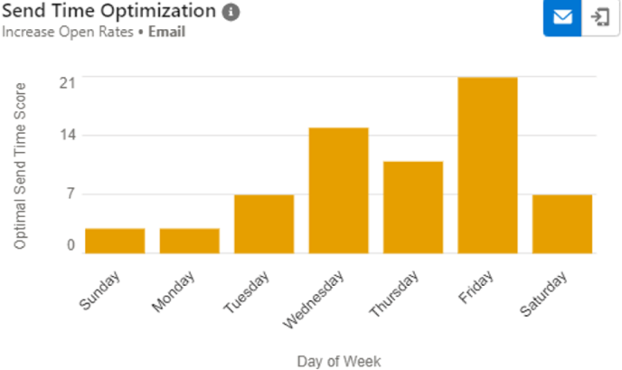
Data driven and adaptive campaigns
Using data driven in sights to create tailored member communication journeys through custom verbiage, sending communications during the days, and times with the highest open rates. Stimulating greater member engagement and trust.
Tone maters!

Slide 19

2025 Communication Strategic Vision
Strategy focused on target populations with largest opportunity for quality improvement, considering amount of time to standup communication efforts in short vs. long-term
Short Term
Long Term
North Star
Encouraging members to confirm contact information regularly for accuracy
Enhance women’s health campaign
Develop ARHOME website content to include more behavioral health education and resources
Create additional women’s health fair communications “Take Good Care of Her”
Reboot test kit campaign for chlamydia test kit, create additional test kit campaigns for added test kits
Create custom member journeys:
  Maternal health journey for women of child-bearing age
  Behavioral health journey (ED hospitalization)
  Breast cancer and cervical cancer screening
  Chronic condition management (focus on heart failure)
  Antipsychotic and antidepressant adherence
Opioid communication targeting and optimization
Maintain purposeful, impactful, & aligned communication strategy
Ensuring all ongoing efforts support larger mission to improve member health outcomes
Increase member engagement through data driven, adaptive, and custom marketing communications, highlighting relevant events, and informational resources in multiple channels

Slide 20
2025 Communication Strategic Vision (Short Term)
Prioritizing standing up enhanced communications that can be delivery in a timely fashion
Short Term
Short Term Goals
Gathering accurate contact information is top priority as consistent inaccurate contact information creates obstacles for reaching members.
Continue to enhance women’s health campaign through data driven custom insights(SFMC/Einstein Insights), develop expanded maternal/family planning journey
Launch behavioral health journey, highlighting resources available and education materials reducing stigma around individuals engaging in BH care
Launch “Take good care of her” campaign for first community fair
Breaking down barriers for access to care by bring HPV &
Chlamydia test kits to the members through targeted communication.
Encouraging members to confirm contact information regularly for accuracy
Develop an enhanced women’s health campaigns
Develop ARHOME website content to include more behavioral health education and resources
Create additional women’s health fair communications “Take Good Care of Her”
Reboot test kit campaign for chlamydia test kit, create additional test kit campaigns for added test kits

Slide 21
Opportunities to be explored, long term focus
Secondary communications that offer longer time to market based on complexity involved in delivery and build out of custom adaptive journeys
The Who
Focused outreach efforts listed in prioritized order
  Women of child-bearing age, educating about prenatal and postpartum care
1
  Members who visit the emergency room or hospital for mental health and substance abuse disorders
2
The Why
Focused outreach efforts on vulnerable audiences to help close care gaps and improve quality measures
  Members who are not adherent to behavioral health medications, including those on antipsychotics and antidepressants
3
  Members with multiple chronic conditions, focusing on those with heart failure, diabetes, and asthma
4
  Women that need a breast cancer screening and/or cervical cancer screening, new or overdue
5
6
  Members who misuse opioid medications

Slide 22
Whole Person Approach to Healthcare
Pointing members to providers for preventive care and chronic condition management
Collaboratives value-based program, slide 23-25
Primary Care First/Blueprint Primary Care value-based program, slide 26-30
Diabetes management collaboration with pharmacies, slide 31-33
Virtual care alternatives, slide 34
The Why | The Who | The How
To improve the overall wellbeing of our members, emphasizing preventive care and treatment of physical and behavioral health conditions along with offering support for social determinants of health for better quality and longevity of life. | All members, focusing on encouraging members to be proactive based on their care needs, either through preventative or consistent chronic condition management | Innovative programs that meet members where they are Alternative visit options Case management for chronic conditions, behavioral health, and social work Provider value-based programs Encouraging proactive preventative care practices

Slide 23
Collaborative Health Initiatives
Collaboration between:
Providers
  Use data for care integration and management
  Population health oversight
  Improve quality of care through improved patient access and experience
  Manage cost through effective, evidence-based clinical care
Plan
  Provide transparent data to providers
  Collaborate to remove administrative barriers
  Support with Case Management on complex, multi-geographic cases
  Establish and administer value-based payments
Notes:
2024
Baptist
Aledade
2025
Attribution logic
FEP
Metric alignment

Slide 24

Provider Value-Based Programs: Collaborative Model
Partnering with providers and health systems alike to close targeted quality care gaps
Member attribution
  PCP roster from participating provider systems
  Members attributed to PCP based on 24-month claims lookback
Total cost target
  Prior year medical and Rx claims expense for attributed members in participating used to establish baseline target
  Target adjusted for agreed upon methodology for change in of observed trend and risk
Measured performance
  Cost for current year compared to trend and risk-adjusted target.
  Quality performance focus
    Cervical Cancer Screening
    Breast Cancer Screening
    Use of opioid medications
    Antidepressant medication management
    Hemoglobin A1c control
    Concurrent use of opioid and benzodiazepines
    Behavioral health screening
Program benefits
  Improved quality
  Reduces cost
  Improved member experience

Slide 25
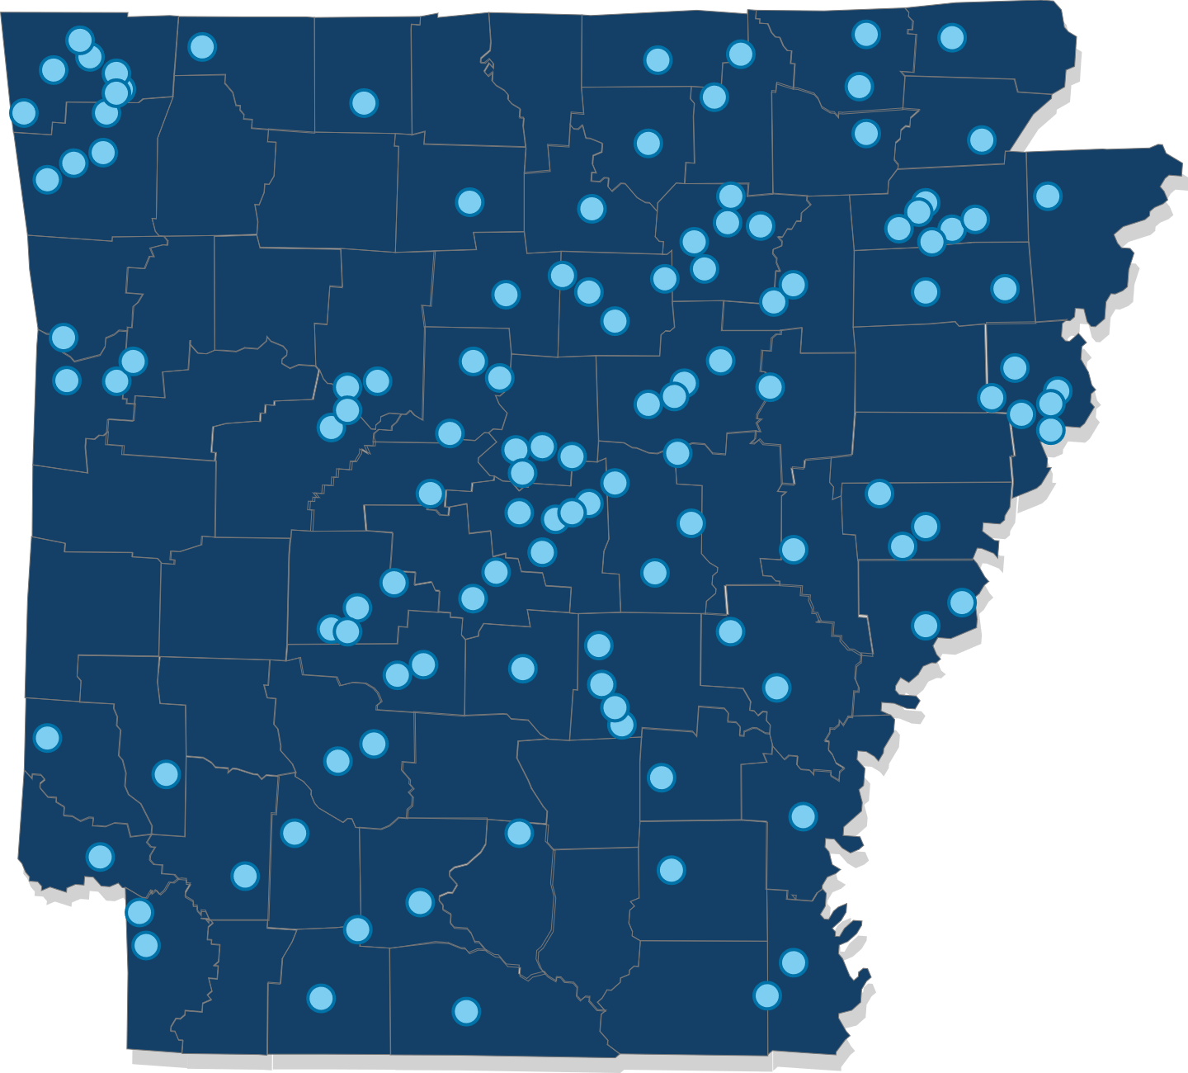

2024 Collaborative Health Initiatives
14 Collaboratives
St. Bernards
NEA Baptist
Washington Regional / MANA
Baptist Health Physician Partners
Collom & Carney
White River
Unity / ARcare
Arkansas Health Network (St. Vincent)
Community Quality Alliance (NW Health)
Aledade
Arkansas Rural Health Partnership
Baxter Physician Partners
AdvantagePoint (LifePoint)
UAMS
ACH
2015
2016
> 140,000 lives in Collaboratives
2017
2018
2021
Cities that have one or more clinics participating in a Collaborative Health Initiative with Arkansas Blue Cross and Blue Shield.
2023
Notes:
2024
Baptist
Aledade
2025
Attribution logic
FEP
Metric alignment

Slide 26
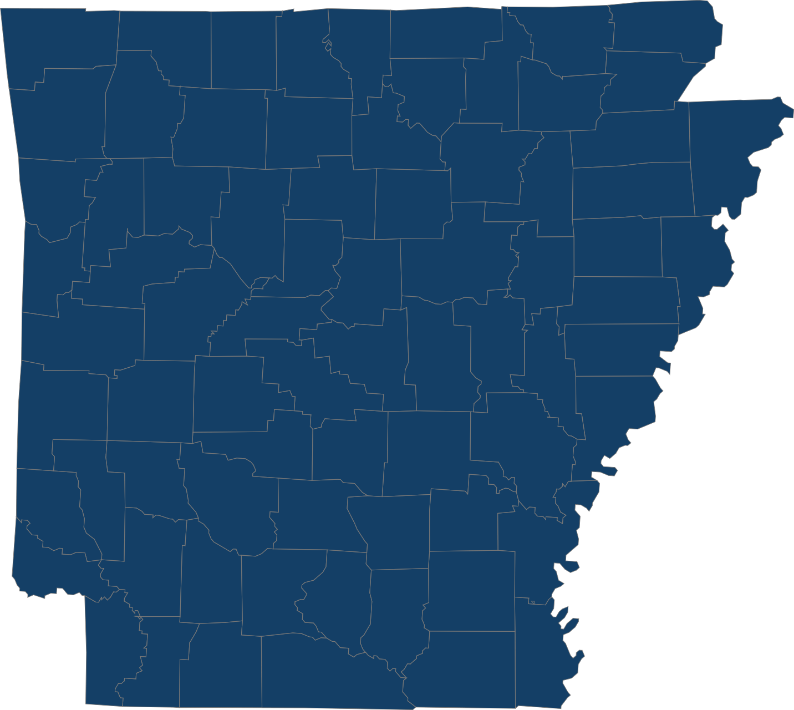
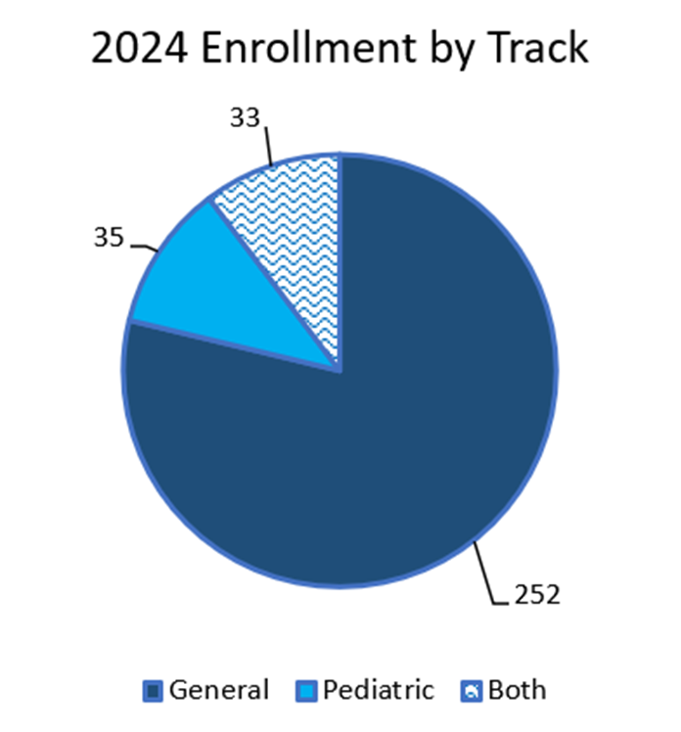

2024 Primary Care First Program (PCF) Participation
We have a total of 322 clinics leading the way in value-based care this year!
322
in
138
CLINICS
CITIES
1,872
PROVIDERS
150,461
Members
Notes:
We have a total of 322 clinics leading the way in value-based care this year! PCF participation has grown every year since it began in 2021. With PCMH sunsetting at the end of 2023, 209 PCMH practices joined PCF. We also have 29 practices that are new to value-based programs.
You can find a PCF clinic in 138 cities across the state, and in almost every county.
Thank you all for your commitment to providing high-quality, value-based care!

Slide 27
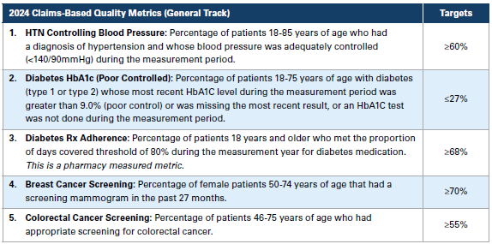
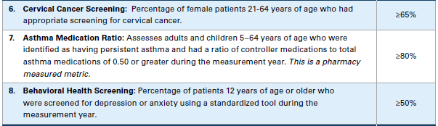
2024 Quality Metrics
Metrics that align with ARHOME strategy:
Diabetes A1c Control
Breast Cancer Screening
Cervical Cancer Screening
Asthma Medication Ratio

Slide 28
Primary Care First
Our members receive
better quality care in Primary Care First.
Higher rates of preventive screenings and controlled chronic conditions
Performance 2023 Utilization Compliance
*Lower is better=Diabetes A1c
Notes:
Lower is better=Diabetes A1c
2023 PCMH still existed, transitioned to PCF in 2024.

Slide 29

Primary Care Value Based Programs
Program
Improved Access
Improved Quality
Reduced ED / IP / Rx Utilization
Reduced Total Cost of Care
Improved Risk Adjustment
Achieves
Population-Based Payments
Care Coordination & Aligned Incentives
Boots on
the Ground
Support
Meaningful
Reporting
Through

Slide 30
Primary Care First Behavioral Health Pilot
Strengths
  Most practices are already screening for depression or anxiety
  Most practices are very involved and ready to make changes
Barriers
  Financial sustainability – practices need guidance on billing and coding
  Lack of staffing – hard to find LCWSs to hire
  Two practices dropped out of pilot due to staffing
Star Practices
  1st Choice Healthcare – 6 practices, 4 LCSWs
  Mid Delta – implementing group visits focused on behavioral health for patients with chronic illnesses
  Mainline – focus on postpartum depression screening and treatment
Performance 2023 Utilization Compliance
Emergency Department
Inpatient Admissions
14
PCF Practices
Self-Management Support
Screening & Follow-Up
Sustainability
Generic Prescribing
Depression
Anxiety
Patient Resources
Billing guidelines
Notes:
Change the graph on the bottom right.
Top right is that per 1,000 members?
Get footnote from Adam.

Slide 31
Diabetes A1c Program Background and Objectives
A1c Pilot Background
ABCBS was selected by PQA to participate in a national pilot program to evaluate improvement in hemoglobin A1c (HbA1c) results
Involved collaboration and value-based payment arrangement between health plans and community pharmacies
A1c Pilot Program Objectives
Improve A1c control
Improve comprehensive diabetes care
Reduce total cost of care
Improve medication adherence
Encourage medication use
Prevent long-term complications (eye exams, kidney testing, foot exams, and more)
Highlight collaboration between health plans and pharmacies
Pharmacies can be a point of care for members

Slide 32
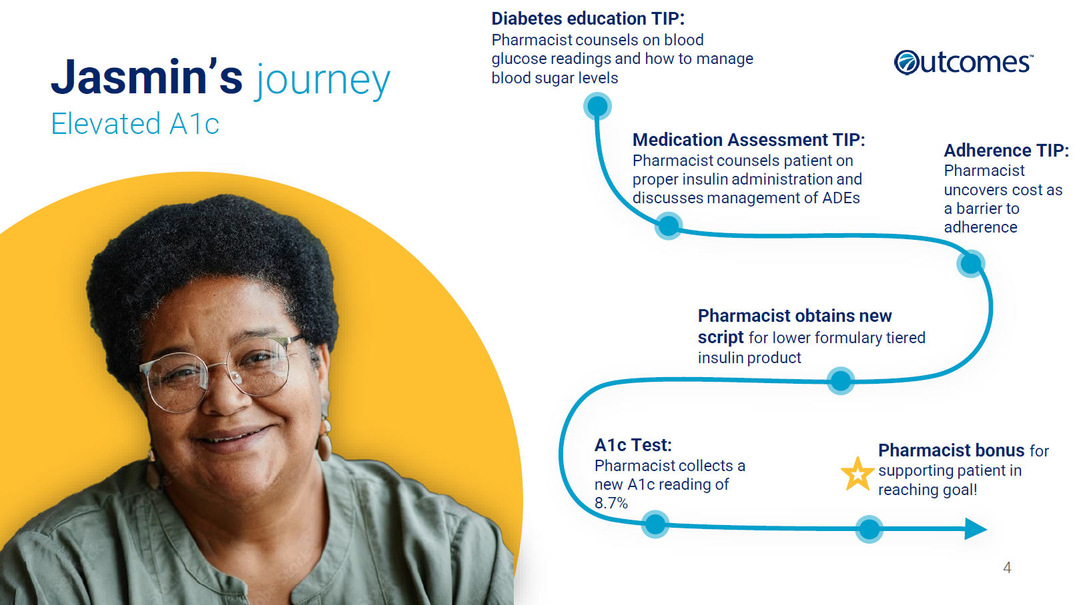
2023 Diabetes A1c Program Design
Target population: 9,500 ABCBS members
Outdated HgbA1c test result
Uncontrolled HgbA1c test result
Timeframe: 7 months (May 2023-Dec. 2023)
Diabetes medication adherence improved by 20-25% with pharmacist intervention with cost of care savings.
ABCBS coordinated with Outcomes and pharmacy systems vendors and connected with over 700 pharmacies across the state to recommend interventions to pharmacies.

Slide 33
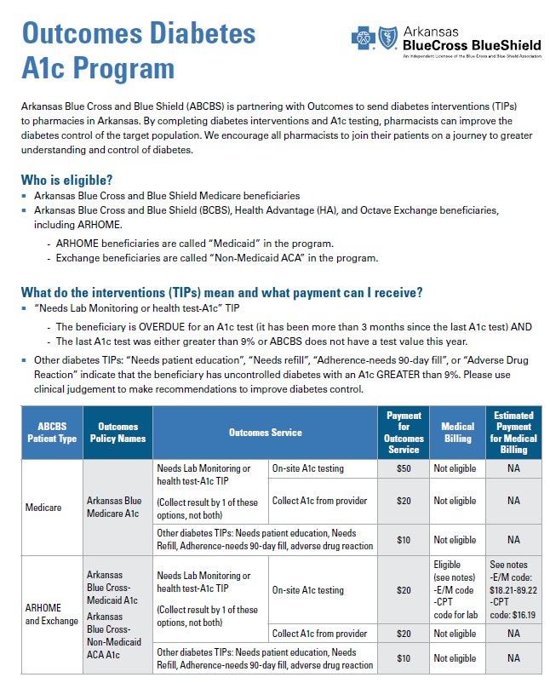

2024 Diabetes A1c Program
Program resumed in May 2024 with modifications:
Prioritization of key membership targets
Approved medical billing of HbA1c by pharmacists
Pharmacist engagement efforts to increase awareness
  Article and interview in the APA newsletter
  Webinar by CPESN
  Presented at APA annual meeting
  Attended APA regional meetings
  Created flyers and emails for pharmacists
Outcomes measured quarterly:
Improvement in medication adherence
Cost of care savings
Improvement in A1c control

Slide 34


Primary 360 Telehealth Collaboration
Delivering whole-person care through a unified, virtual first experience
Offering care when members need it through telehealth services available
24/7
Expanding telemedicine alternatives for behavioral health and maternal health
Specialty Care
Developing treatment plans by high quality specialists
Preventative Care
Providing primary care along with treatment plans to avoid future heath risks
Continuous Care Coordination
Chronic Care
Empowering members to address and manage ongoing health challenges. Focusing on diabetes, hypertension, and more.
Urgent Care
Treating everyday health needs virtually
Mental Health
Managing stress, anxiety, substance abuse disorder, and other conditions through therapy and counseling

Slide 35
Maternal Health
Maternal Health
Maternity program overview, slide 36
Special Delivery high-risk case management program, slide 37
Maven digital maternity program, slide 38-42
Maternal health and behavioral health coordination, slide 43
The Why | The Who | The How
To improve maternal and infant morbidity and mortality in Arkansas by improving access to care and promoting prenatal care throughout the entire pregnancy. | Women of child-bearing age, with an enhanced focus on those that are currently pregnant or post partum | Special Delivery program for high-risk pregnant members Maven virtual care around the clock Enhanced incentive and notification of pregnancy survey Communication Collaboration with Maternal Life360 HOMEs for home visits Encouraging the use of contraception
Notes:
Enhancements for 2025: enhancing incentives and NOP survey, new journey for maternal health, Maternal Life360

Slide 36




ABCBS Maternity Program Overview
ABCBS continuously strives to enhance maternal and infant outcomes through offering innovative and collaborative solutions
ABCBS drives better clinical maternal and infant outcomes by:
Operating our Special Delivery Program
Offering a Digital Maternity Telehealth Platform/Maven
Rewarding members for prenatal visits, using our maternity programs, and contraception
Promoting enrollment in Maternal Life360 HOME, as applicable
We continue to work internally to improve upon our maternity program by:
Improving
high-risk maternity program workflows, assessments, and high-risk prediction in our care management platform, along with expanding enrollment postpartum with depression screening
Engaging
with members, community partners, and providers through various programs using different modes of outreach to educate and improve care
Collaborating
with Social Work and FindHelp to address SDOH needs and link members to resources.
Analyzing
data to inform our outreach efforts and programs
Educating
case managers and community pharmacists on health equity and the maternal health crisis

Slide 37




Special Delivery Program
ABCBS uses Special Delivery to offer support during pregnancy and postpartum, with a focus on high-risk pregnancies
Assessment
Members have the option to self-enroll, but most members are identified for potential engagement through claims and other data sources
Members are assessed for chronic conditions and mental health conditions, such as substance use disorder and behavioral health disorders, as well as for SDoH, including access to food, transportation and other resources
Education
Individualized educational materials provided
Contact information provided regarding organizations that support women who are pregnant, as well as their families
Referred to our digital maternity platform for in-between OBGYN visit care and questions
Information on Blue Wellness Rewards provided
Intervention
  Low-risk pregnancies are contacted each trimester and postpartum
  High-risk pregnancies are contacted monthly at minimum
  The Special Delivery mobile app, telehealth, and 24/7 care advocate are available to assist members when they need it the most
  Members may be referred to network obstetricians as needed

Slide 38
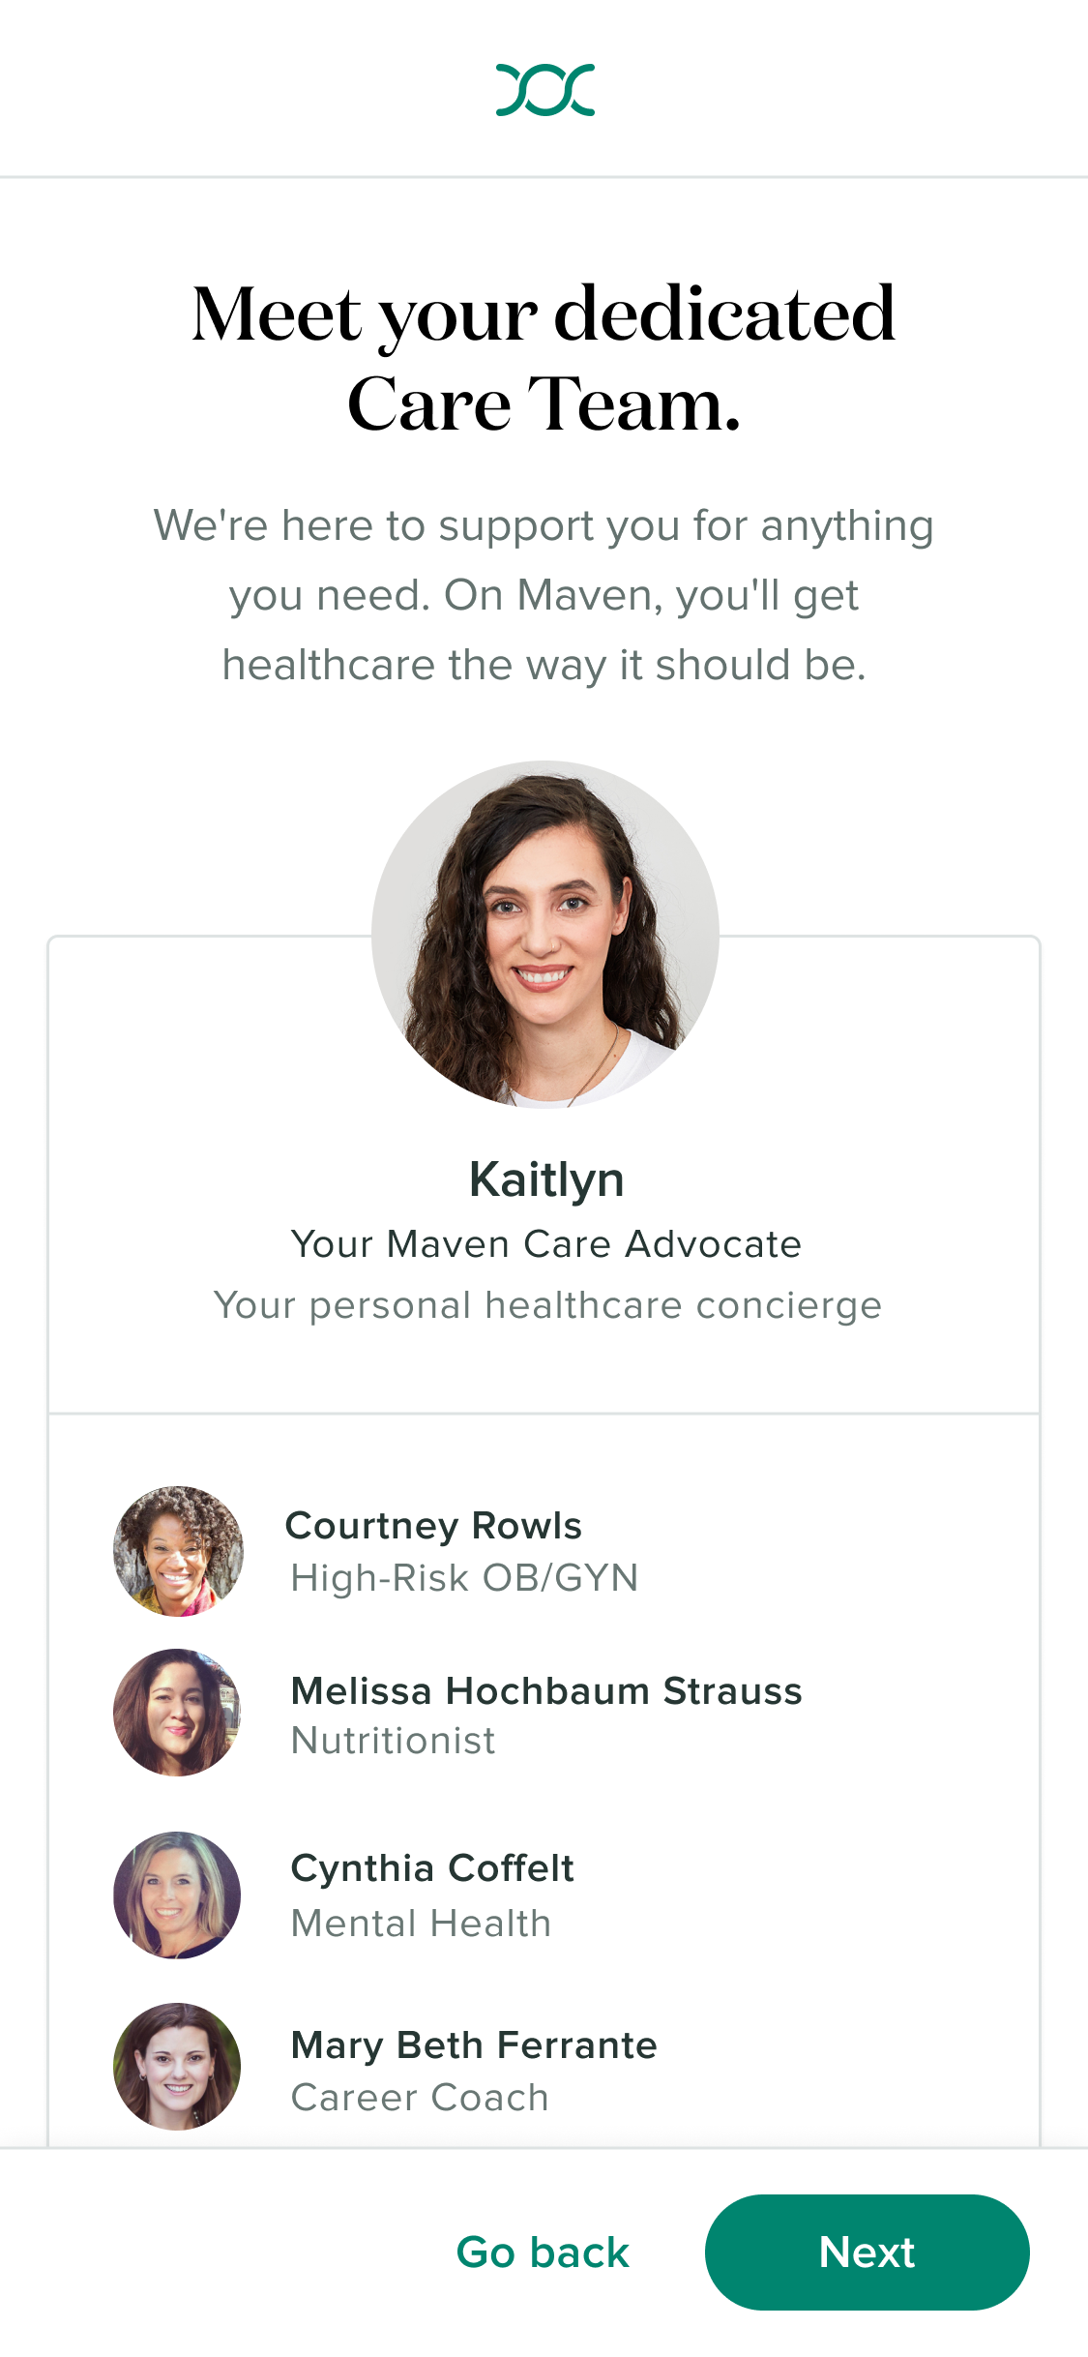
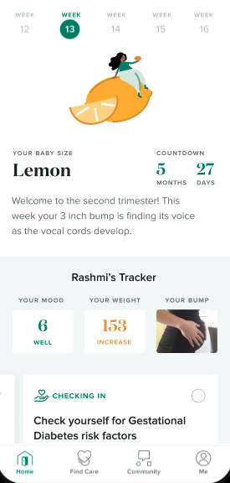

Digital Maternity Program: Maven
ABCBS partners with Maven to provide engaging digital maternity care around the clock
Build trust
Engage members
Provide access
through 24/7 access to
dedicated Care Advocate
in personalized care programs - 60+ minutes / trimester
to 30+ specialists, with 32% identifying as BIPOC
Identify pregnant members
Address disparities in care
Assess clinical & social risk
Improve clinical outcomes
*Maven is intended to supplement OBGYN prenatal and postpartum care.
It is not intended to replace in-person provider visits.
Notes:
Add a disclaimer that Maven does not REPLACE OBGYN, supplemental care.
In 2022, we partnered with Maven to bring virtual maternity support to Ar Home members. Maven enables us to identify pregnant members earlier, as well as identify a number of individuals enroll in Maven prior to us receiving a maternity claim. Upon enrollment, every member is assessed for clinical and social risk, enabling Maven to personalize support. Each member receives a dedicated Care Advocate, who becomes a ‘go-to’ trusted resource throughout their pregnancy journey. Maven also provides access to a virtual network of specialists available 24/7 - including doulas, OB/GYNs, mental health coaches, lactation consultants as well as timely and relevant educational content that keeps members coming back to the platform. Ultimately, it is the early and consistent engagement that enables Maven to help us drive improved outcomes.

Slide 39


Members engage early and often, driving outcomes as well as member experience
ENROLLMENT & ASSESSMENT
72% enrollment in
1st or 2nd trimester
> 50% of members enrolled in Maven
before the plan
had notification
of pregnancy
60% are high risk and nearly 20% have an unmet social need
ENGAGEMENT
97% engage with a specialist
on Maven
99% engage with content
on Maven
20+ average touch points per month
60 minutes in app per trimester
OUTCOMES
4.9/5 member star ratings
50% say Maven helped
them breastfeed longer
31% say Maven helped
with anxiety and depression
15% say Maven helped
avoid an emergency room visit
“Thank you so much for this inspiring service. I hope one day to be able to comfort and help others the way I have been helped and comforted today.”
-ABCBS MEMBER
Notes:
To put some numbers behind those statements:
72% of enrollments occur in the 1st or 2nd trimester and when we looked at the enrollments, more than 50% were individuals that enrolled in Maven before we had the notification of pregnancy… Maven regularly shares data back with us so that we now have a deeper understanding of these individuals and their risk profiles
97% of members engage with a specialist and nearly 100% engage with content… overall we see on average, 20 touchpoints per month and 60 minutes spent in the app per trimester
Most importantly… members are having a positive experience - there is a 4.9/5 star rating for provider appointments on Maven and showing improved outcomes - 50% say Maven helped them breastfeed longer, nearly a third report Maven helped them manage anxiety or depression and 15% were able to avoid an unnecessary ED visit

Slide 40
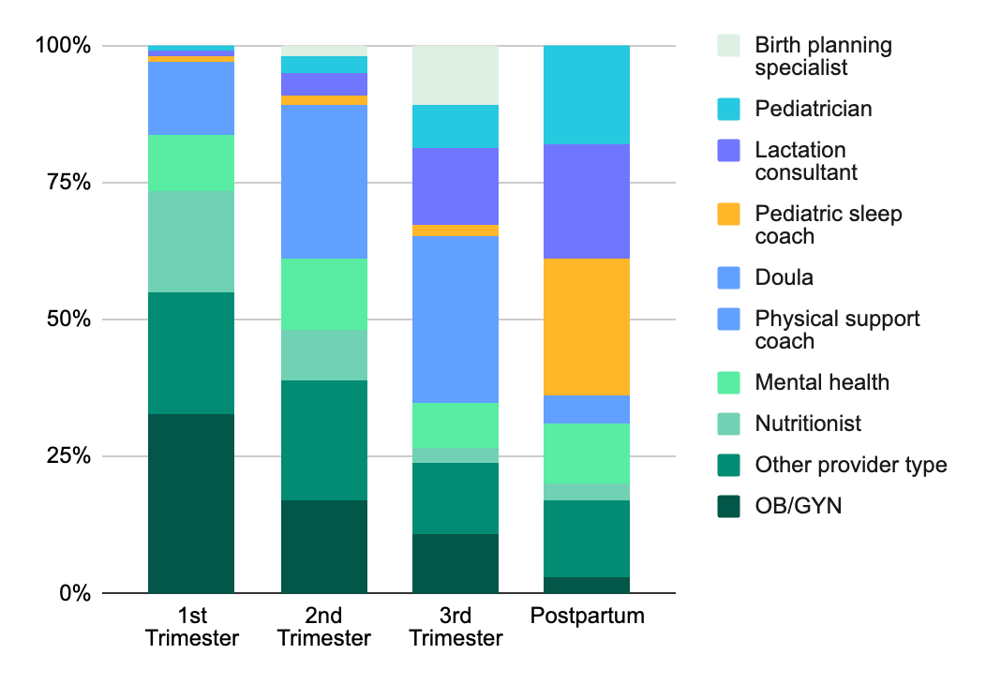
Members are engaging with a wide variety of specialists
ABCBS members are leveraging various provider types in platform to gain holistic support From recent Maven research, we know: Attending 2+ doula appointments is associated with a 20% reduction in odds of C-section among all members and 60% reduction in odds among Black members Obstetrics & Gynecology, December 2023 Attending an appointment with a Maven OB/GYN is associated with a 4x increase in likelihood of avoiding an unnecessary ED/in-person visit JMIR, March 2023
Notes:
One interesting point I wanted to highlight is value members receive from the breadth of the specialists Maven offers. Here you see the breakdown of appointment utilization by trimester… and as members advance through their maternity journey they are using different types of providers. For example, early on, we see higher use of OB/GYNs, as we know members have so many questions upfront and don’t often meet with an OB in-person until weeks 10-12. In the second and third trimesters, more members meet with doulas, as they are starting to think about deliver and create a birth plan. And then postpartum, members are seeing pediatricians, lactation consultants, and pediatric sleep coaches (which I’m sure is no surprise to the parents in the room).
Over the past couple of years Maven has published over 10 peer reviewed articles that highlight the value of different components of their product. One recent example shows the impact of virtual doulas - Maven demonstrated that members that attended 2 or more doula appointments had a 20% reduction in odds of C-section, and this was elevated to a 60% reduction in odds of C-section for black members with 2+ doula appointments.

Slide 41
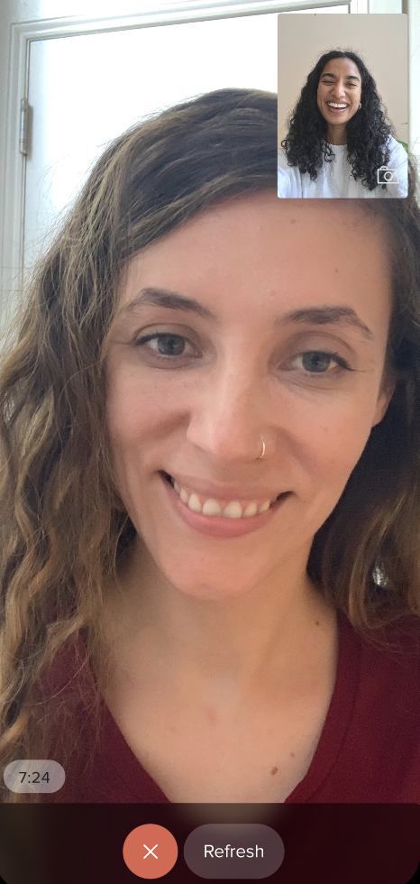
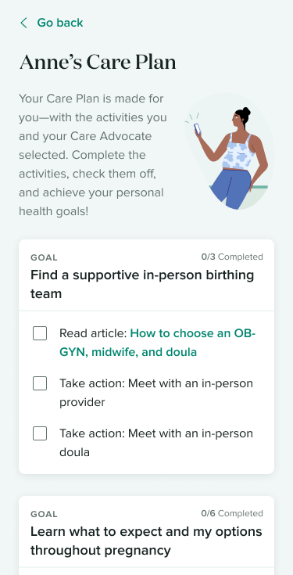
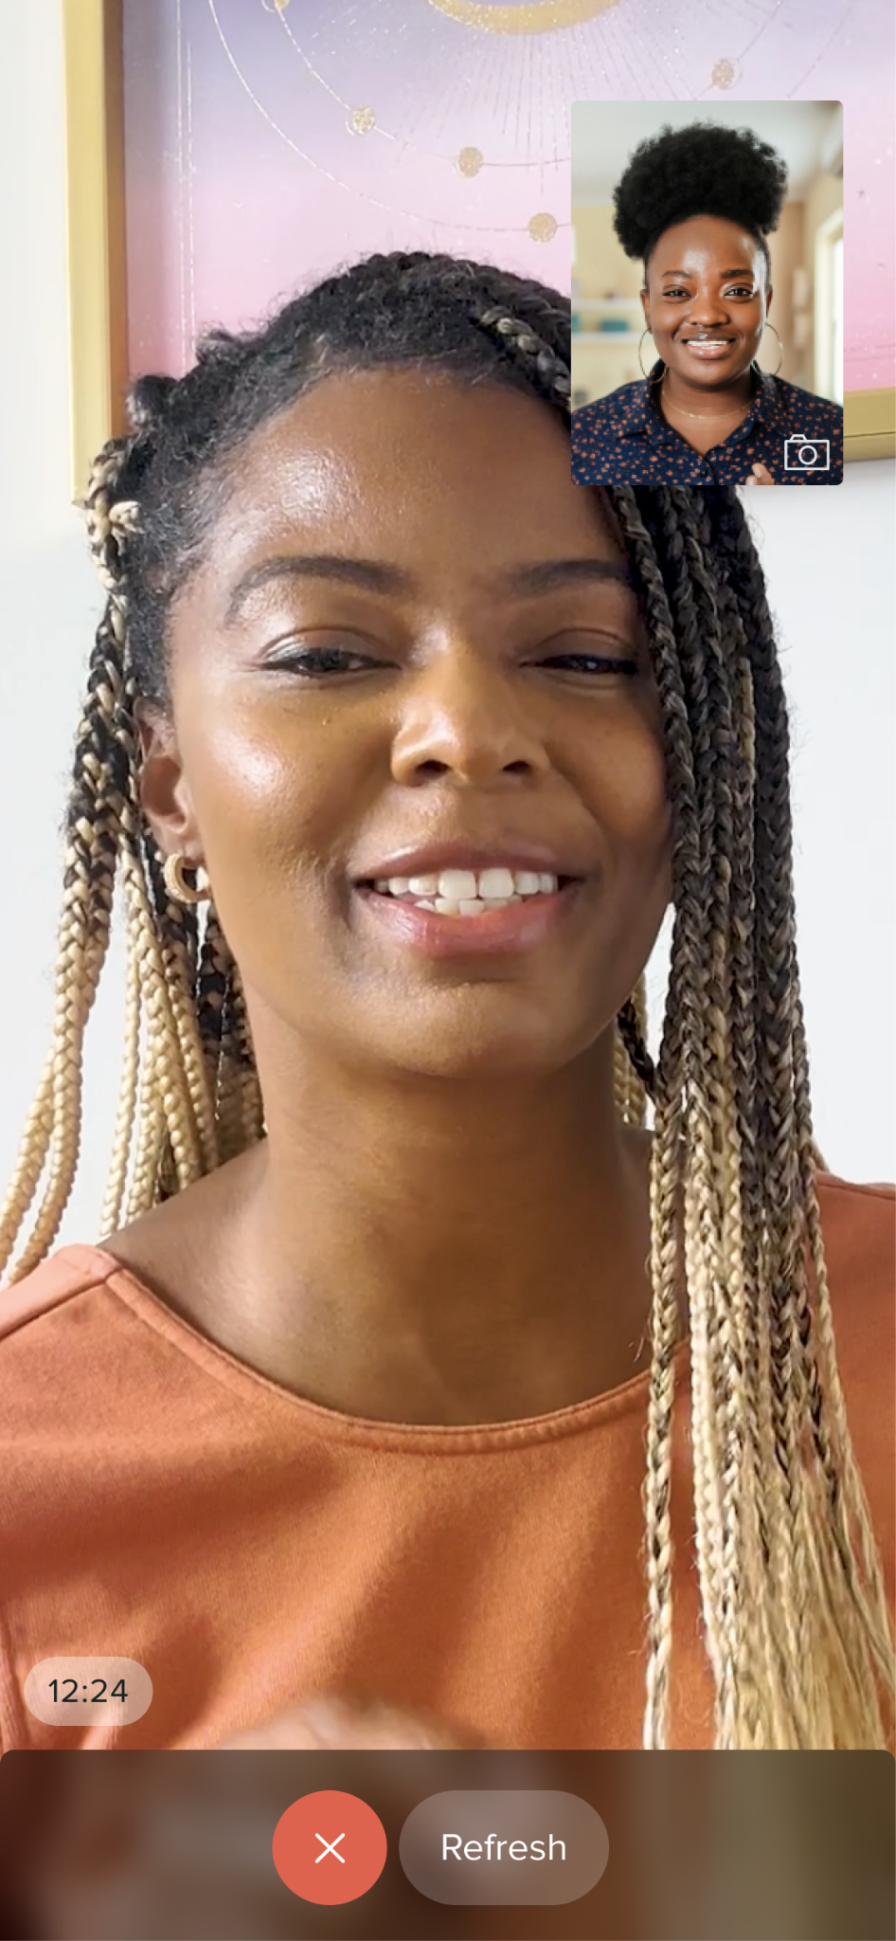
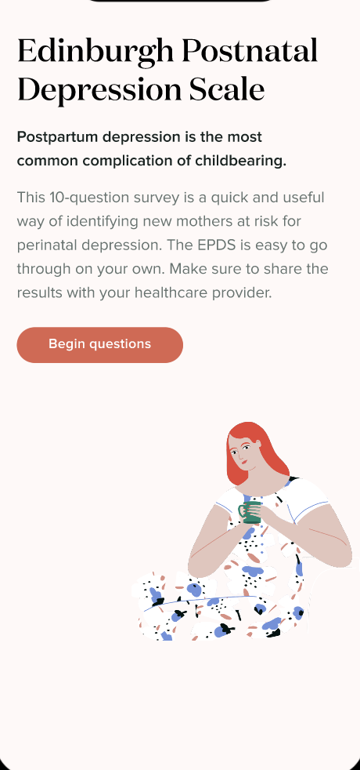


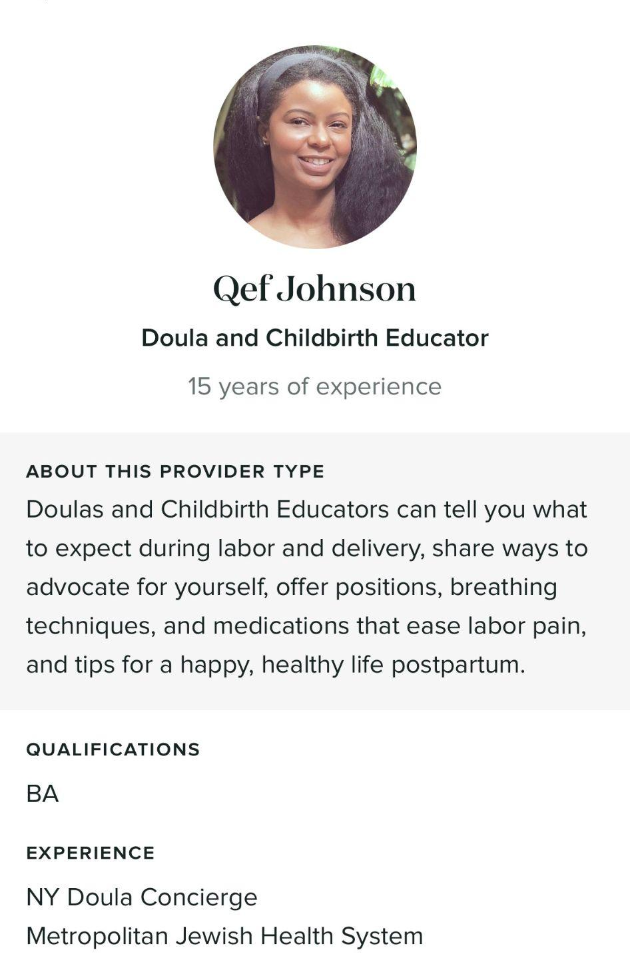
Member example using digital maternity platform
Anne receives mental health support along her maternity journey
Meet Anne. She’s pregnant with her first child and has a history of depression. She works at a daycare which has been stressful post-Covid and has added to her anxiety
Anne enrolls in her second trimester, completes a validated clinical and social assessment. She meets with her Care Advocate, and together, they established a goal to take action to support mental health and wellbeing.
Anne is matched with a team of specialists, and receives a targeted care plan that includes counseling.
She completes 3 appointments with a mental health specialist.
In addition to her mental health appointments, Anne meets with an OB/GYN and a doula. She prepares for labor with a birth plan and shares that she has learned tools for managing anxiety. Maven also provides her with a list of in-person mental health providers that are in-network.
Anne continues to receive support as she prepares for birth. Post-delivery, she receives mental health screening and support given additional risk for postpartum depression and her Care Advocate facilitates a warm hand off to ABCBS case management upon graduation from Maven.

Slide 42
Data Insights about Maven Engaged Members
Engaged members are addressing their mental health conditions and have lower NICU rates
Maven engaged members who are currently pregnant have higher rates of mental health claims.
This shows that members who are pregnant and engaged with Maven seek mental healthcare at a higher rate than those not utilizing a maternal care program.
Members who are engaged with Maven have lower rates of babies in the NICU than members who do not utilize a maternal care program. Combined Maven and Special Delivery engagement drive even lower NICU rates.

Slide 43


Maternal Health and Behavioral Health Coordination
ABCBS collaborates seamlessly across multiple teams to provide an all-encompassing care management model addressing pregnancy and behavioral health and substance use disorder needs
For intervention after an acute substance use or mental health event, behavioral health case management and Lucet work together to provide a transition plan after a crisis post-discharge
Maven assists both low & high-risk pregnant members through digital solutions. However, if a member is identified as high risk, Special Delivery will be engaged for additional high touch support
Maternal Case Management (Special Delivery)
Behavioral Health & Substance Abuse Case Management (Lucet)
Digital Maternal Health (Maven)
We work to co-manage mental health conditions throughout pregnancy and encourage members to take full advantage of all resources, include our digital maternal solution, Maven

Slide 44
Behavioral Health
Behavioral Health
Behavioral health incentive optimization, slide 45
Behavioral health case management, slide 46
Lucet, slide 47
Teladoc Mental Health Complete, slide 48-49
Peer Support Specialists and substance use disorder program, slide 50
Beyond Opioids, slide 51
Mental health medication adherence, slide 52-53
The Why | The Who | The How
To promote mental and behavioral health as an important component of whole person healthcare for our members, emphasizing a positive relationship with oneself as an important factor that can lead to the acceptance of preventive care and chronic care management | Members with behavioral health conditions, substance use disorders, and prevention for all members | Incentives Personalized communication Numerous visit and treatment options, including virtual care Eliminating barriers Improving access to care Following-up with members in a timely manner after acute events

Slide 45

Behavioral Health Incentive Optimization
Focusing on timely reward and educating about care options throughout the year to prevent crisis situations
Adherence to Mental Health Medications—up to $60
  Incentivizing for using mental health medication adherence strategies (90-day supply and mail order) for more timely reward vs. at the end of the year to better motivate members to continue medications
  Expanding incentive to include antidepressants.
Follow-up after hospitalization for substance use disorder—$100
  Expanding to include emergency room visit discharges
Mental Health Treatment options—$50
  Offering a variety of solutions: in-person visits, virtual visits, Lucet, and case management
  Displaying throughout the year vs. only for a new diagnosis or acute event
Substance use treatment options—$50
  Offering a variety of solutions: in-person visits, peer support specialists, virtual visits, and case management
  Displaying throughout the year vs. only for new diagnosis or acute event

Slide 46
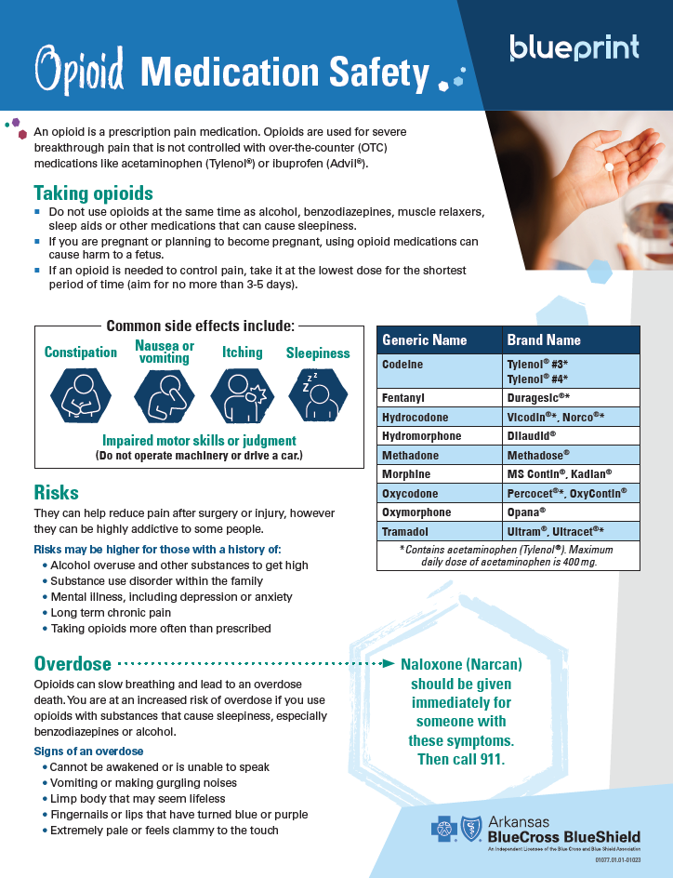

Behavioral Health Case Management
Offering whole-person care through prevention, post acute adherence, recovery, and resiliency
Behavioral health case management coordinates with ARHOME quality measures and goals
Programs and Benefits
  Free Visits: 3 Free Visits for Teladoc Mental Health Complete
  Suicide Prevention Program: Caring Contacts
  Preventive Screening
  Autism
  Eating Disorders
  Opioid Outreach
  Behavioral health digital communications/journeys
Notes:
INTERNAL

Slide 47
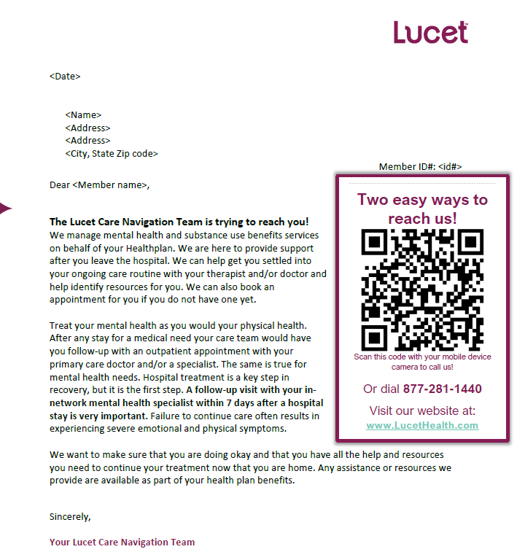
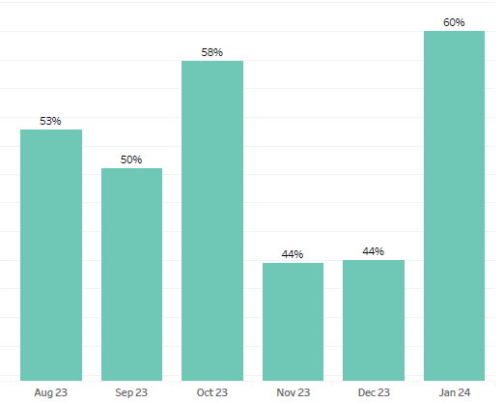
Lucet
Providing support post-hospitalization to navigate care and resources available
Helping members get the care they deserve by optimizing access to behavioral healthcare providers and connecting members to quality care
Post-hospitalization follow-up care is provided in less than 5 days, oftentimes in as little as one day
Working to build facility partnerships to optimize high quality level of care, step down, and discharge follow-up to increase sustainable recovery and reduced readmissions.
Offering care when members need it
24/7
Rate of 7-day follow-up appt scheduled→
Notes:
TELEPHONIC OUTREACH for time sensitive acute events. Post-hospitalization follow-up care is provided in less than 5 days, oftentimes in as little as one day. 24/7, 365 days a year when you need to talk to someone.

Slide 48

Teladoc Mental Health Complete
Providing alternative behavioral health services that can address member BH needs at any place or any time
Through a collaborative partnership with Teladoc, we are reducing barriers for members to receive the behavioral health support that members need 24/7.
With the launch of our mental health complete program, members will have:
Personalized care plans
Access to skill-building tools and resources based on needs and preferences
Therapy when they need it. Meet virtually with a licensed therapist by appointment 7 days a week
Notes:
Virtual care option to support areas that may not have a readily available MH provider.

Slide 49
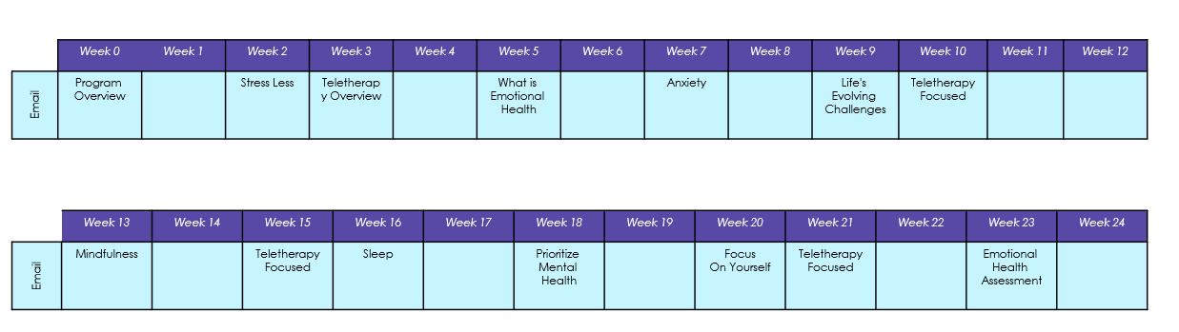

Teladoc Mental Health Complete Journey
Engaging members regularly through member-specific educational communications
Communications highlight various care resources that are available to meet a member’s unique mental health needs
Campaign Overview & Timeline
Stress less
Teletherapy overview
What’s emotional health
Anxiety
Life’s Evolving Challenges
Mindfulness
Sleep
Prioritize Mental Health
Emotional Health Assessment
Educating members around mental health helps to reduce the negative stigma placed around therapy and helps to empower members to engage in good emotional and mental health practices

Slide 50
Peer Support Specialists and Substance Use Disorder Program
Offering substance use disorder support from people with “lived experience” that are now in lifelong recovery
Program Highlights
Peer support specialists help facilitate recovery after crisis, often meeting at a facility when the member is receiving treatment.
Peer support specialists work alongside nurses and social workers, and they serve as a single point of contact to coordinate integrated, whole-person care.
The peer support specialists help members, who often have both physical and behavioral illnesses, connect to the medical care and resources they need for recovery, improved health and overall well-being.
Coverage for the entire state of Arkansas, meeting members where they are in their communities

Slide 51

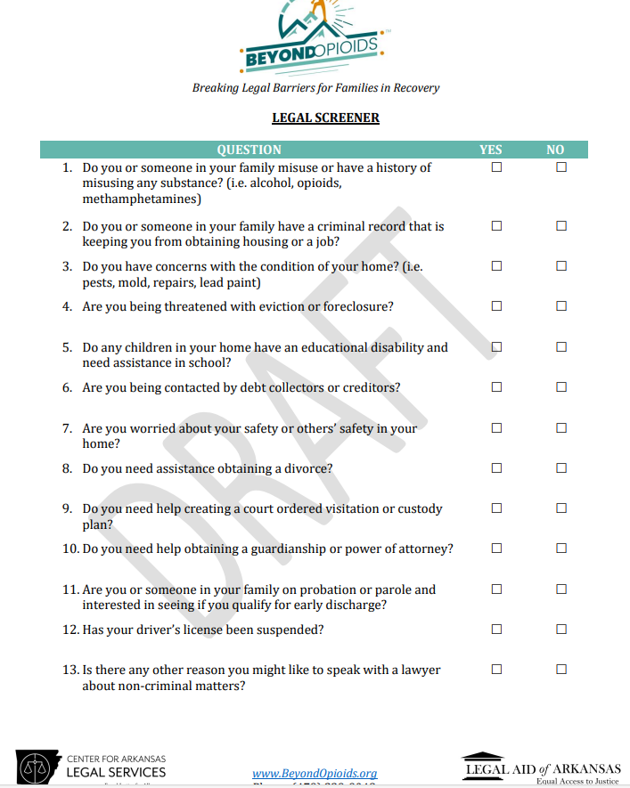
WHO? Opioids is a public interest law project in Arkansas with a statewide scope, partnering with organizations providing a continuum of prevention, treatment, and recovery services. Beyond Opioids provides legal assistance to low-income Arkansans affected by the opioid crisis.
WHY? Many with SUD don’t realize legal help can address or ease their life challenges. ABCBS is partnering with Beyond Opioids to address social determinants of health among members with substance use disorder.
WHAT? 6-month plot for 30 members. Outcomes to be measured:
  # of ABCBS referrals Received
  # of ABCBS referrals that were rejected and reasons for ineligibility (over-income, outside of priorities, controversy is out of state, criminal case, potential client’s unresponsiveness, etc.)
  # of ABCBS referrals that were eligible for service that are open and level of service decision (legal information, advice only, limited scope representation, extended services)
  # of ABCBS referred cases that were eligible for service that had been closed and the level of service rendered (legal information, advice only, limited scope representation, extended services
  # Beyond Opioid referrals to provider for substance use disorder treatment
  # Beyond Opioid referrals made to LAUNCH
  # Beyond Opioid referrals made to CiviForm

Slide 52
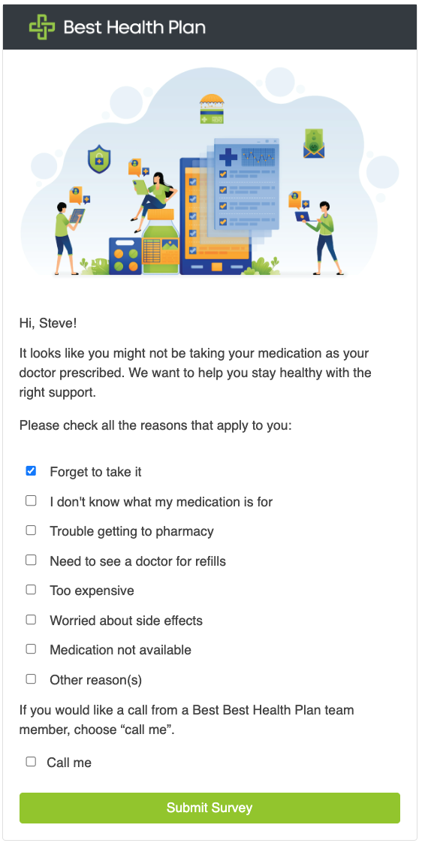
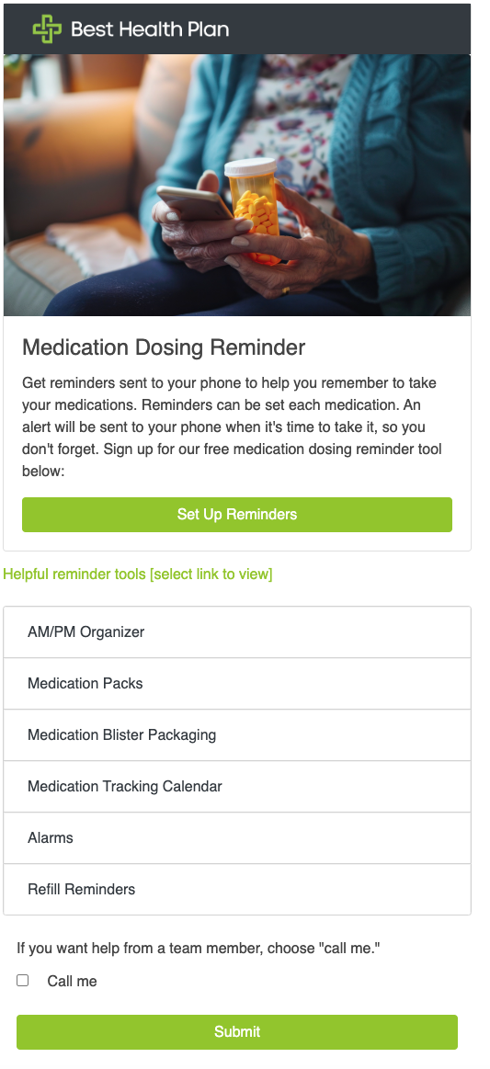
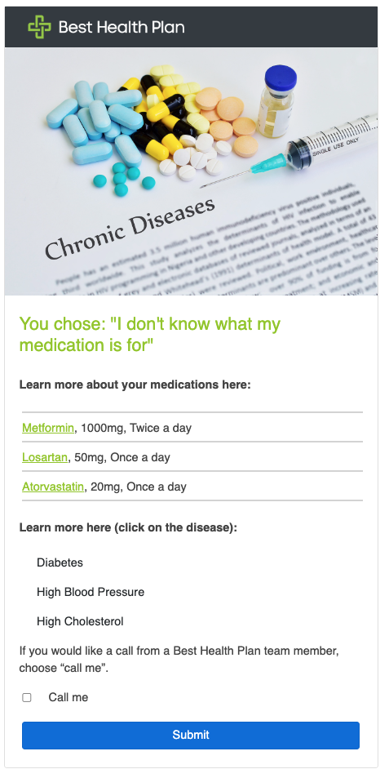
Mental Health Medication Adherence
Offering medication adherence reminders and solutions for mental health medications
Goal: To increase adherence to mental health medications, including antidepressants and antipsychotics
Activity: A variety of medication adherence strategies are offered, including enhanced pharmacy services, medication reminders, education, and more. Patients can indicate through secure messaging what barriers they have when taking medications. Members are provided with education and solutions to help take medication as prescribed, referring to providers when needed.

Slide 53
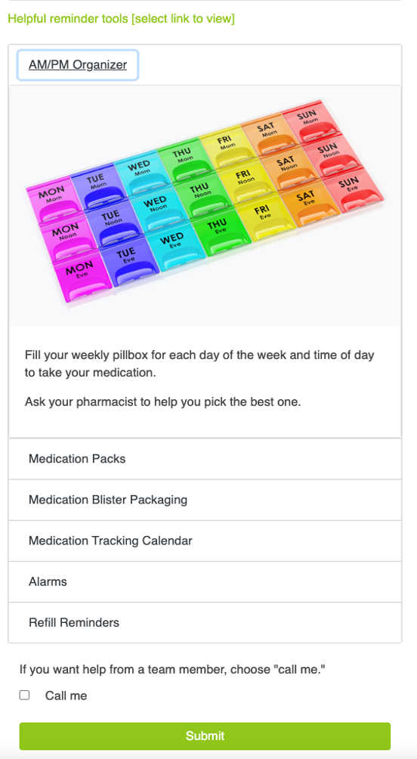
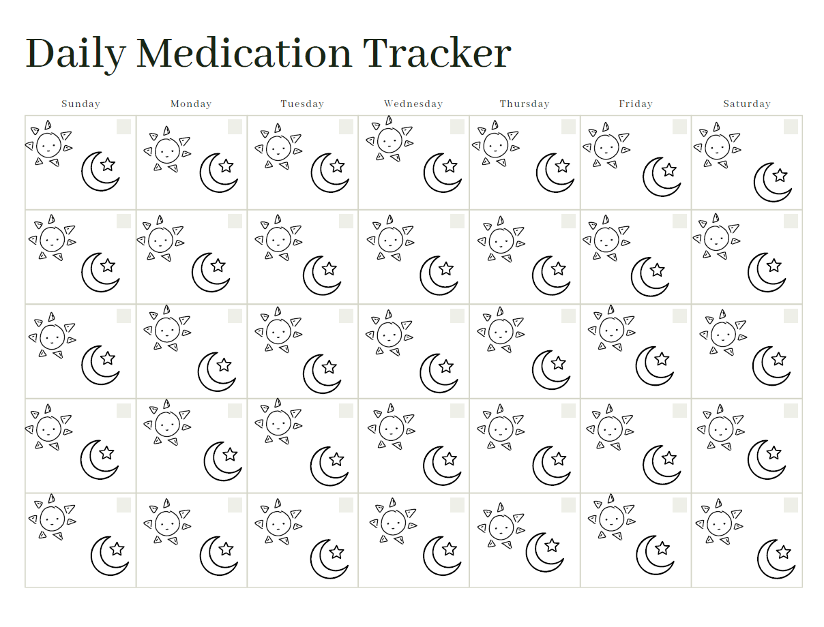
Adherence Strategies
Associating taking medication with an activity to help those that might struggle with forgetfulness, helping them to take their medication regularly
The daily medication tracker helps members remember to take their medication regularly. Members can track their medication intake day and night by coloring in the sun and moon.

Slide 54
Improving Access to Care
Improving Access to Care
Meeting members where they are, slide 55
Take Good Care of Her events, slide 56
Test kits delivered, slide 57
Dispatch Health, slide 58
Pharmacists as providers, slide 59-60
Economic independence incentives, slide 61
The Why | The Who | The How
To meet members where they are in their community and provide members with quality healthcare, regardless of barriers that may exist, working to promote health equity and to improve access to care for all | All members, especially those living in rural communities or those that have social determinants of health which impede access to care | Community outreach and investment Alternative provider visit options: at-home, virtual, pharmacy Test kits Incentives Communications

Slide 55
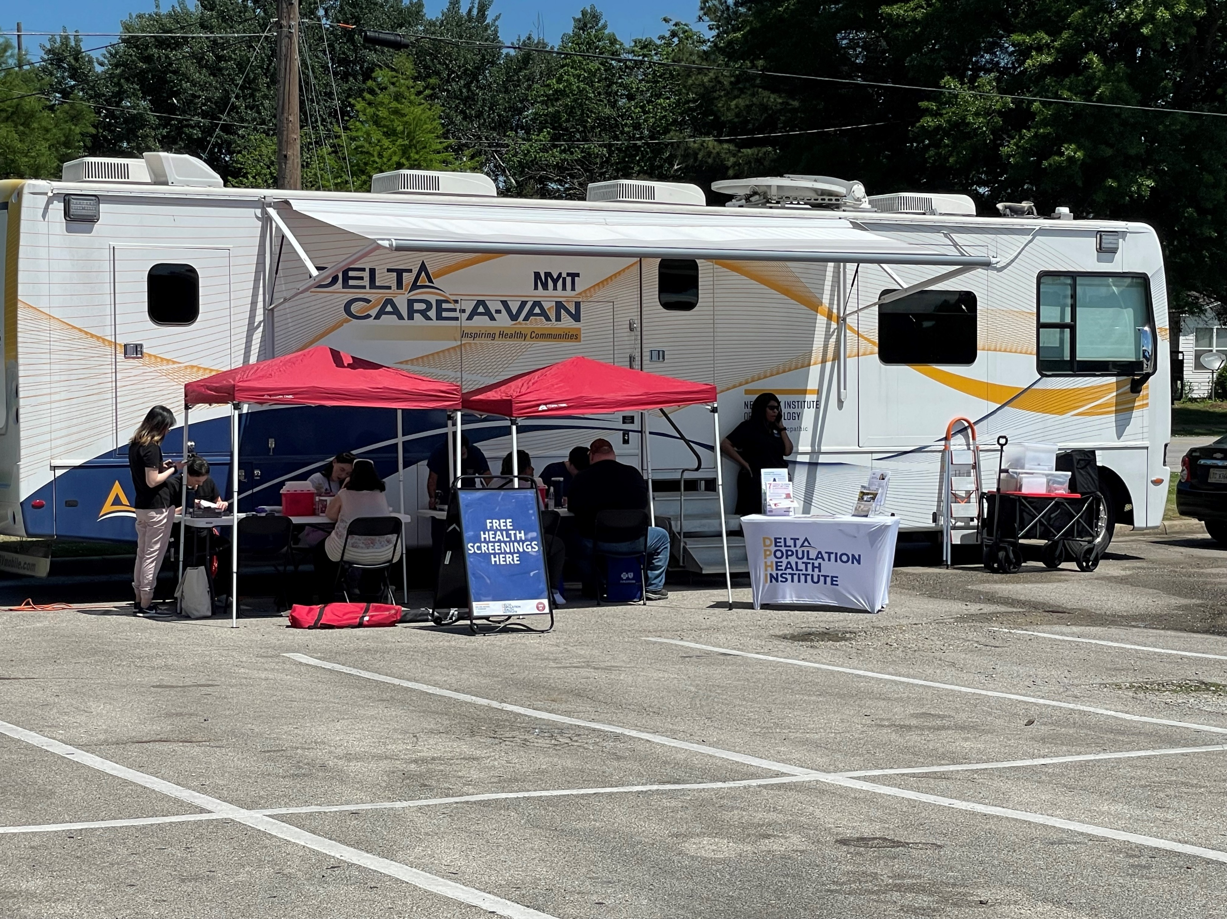

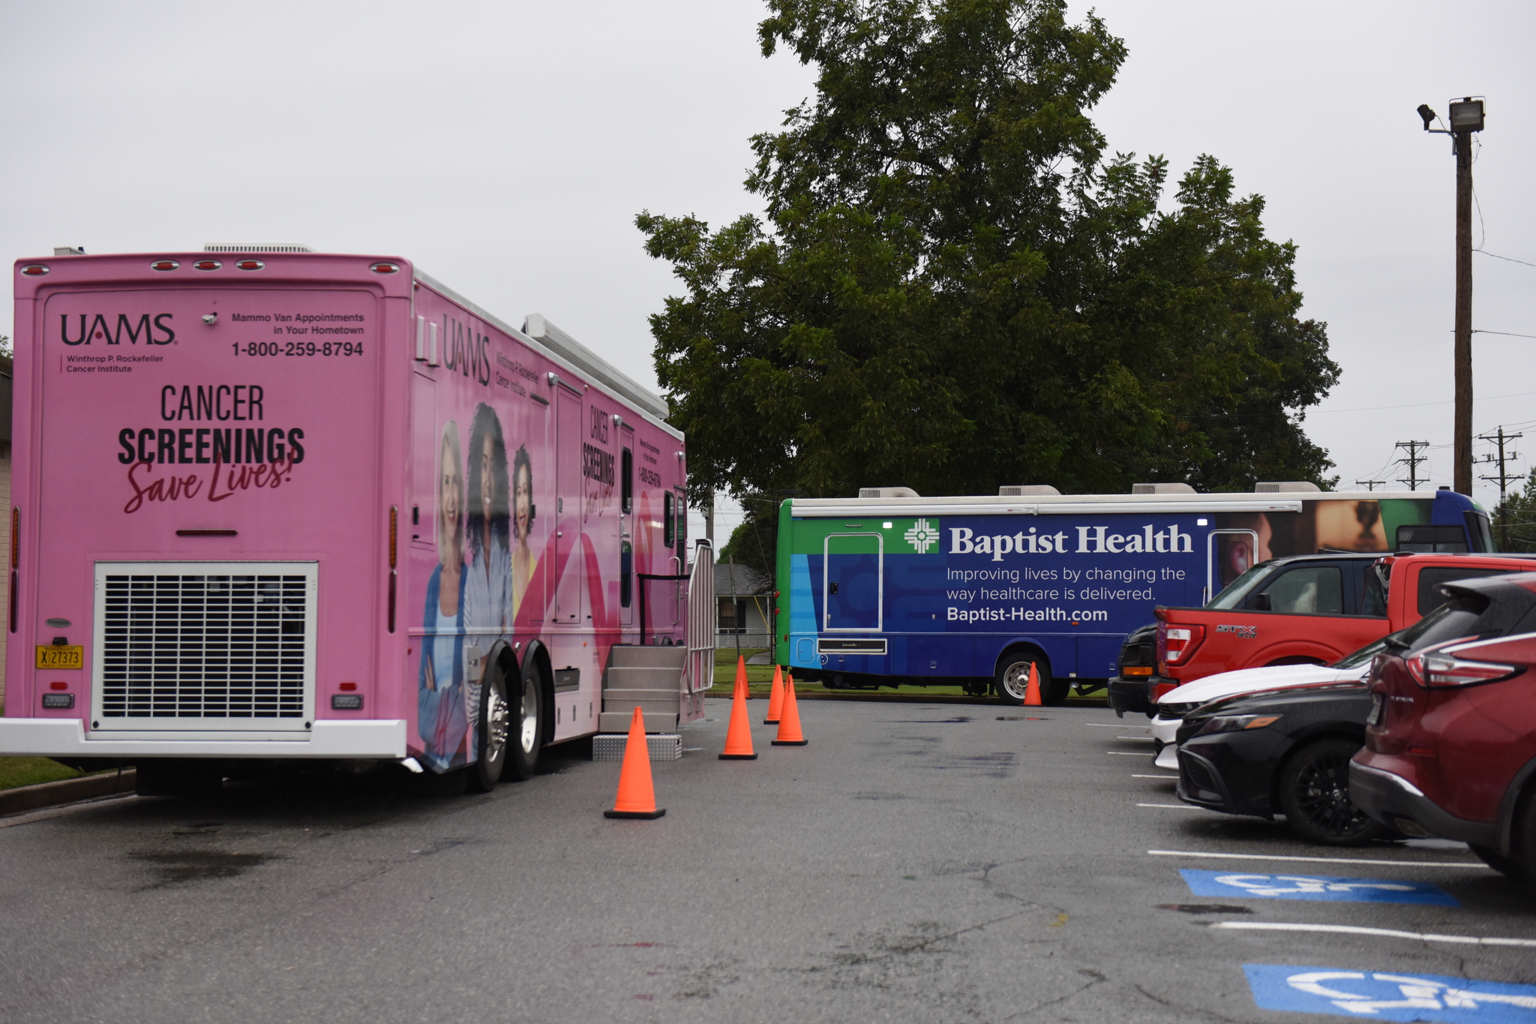


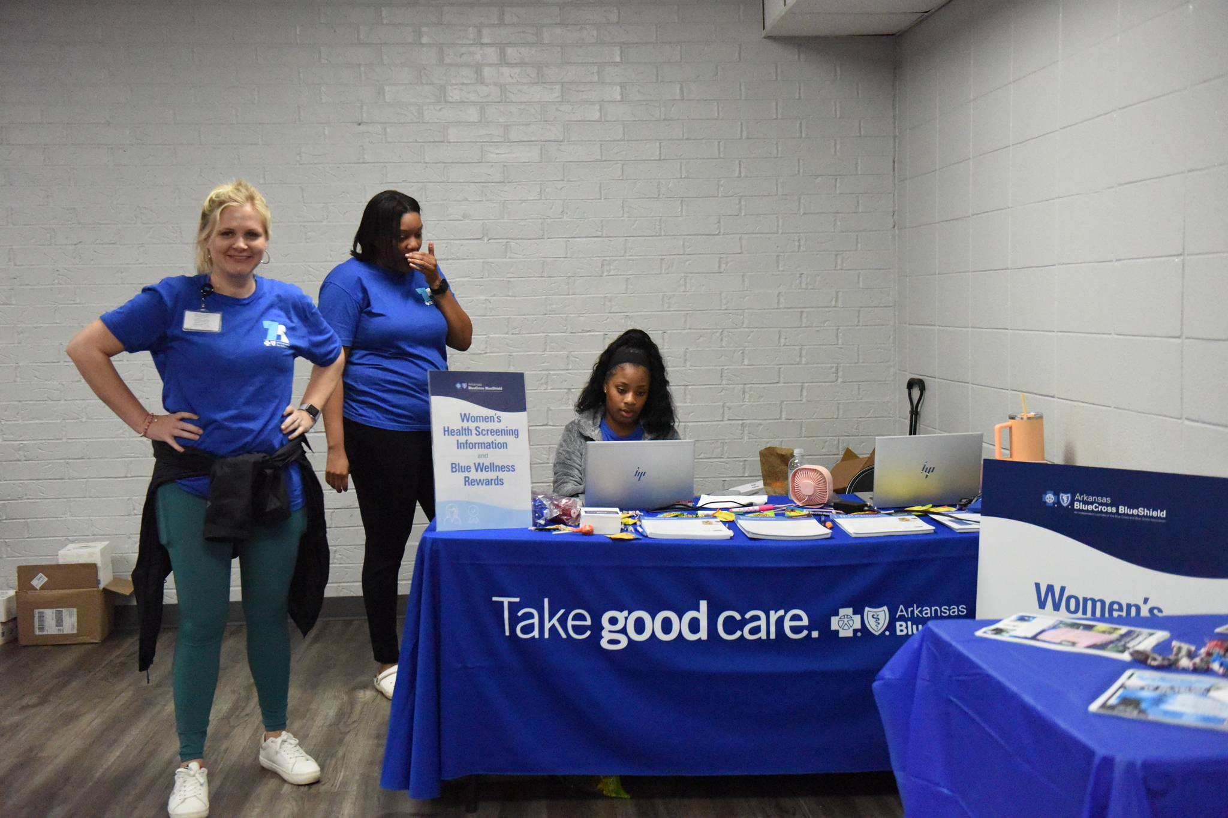
Meeting Members Where They Are
Promoting the use of mobile care and other convenient care alternatives during outreach and for community events
Aiming to eliminate barriers to receiving quality care in rural communities, we are promoting the use of:
Mobile mammography units
Health screenings (mobile health units)
Test kit options

Slide 56
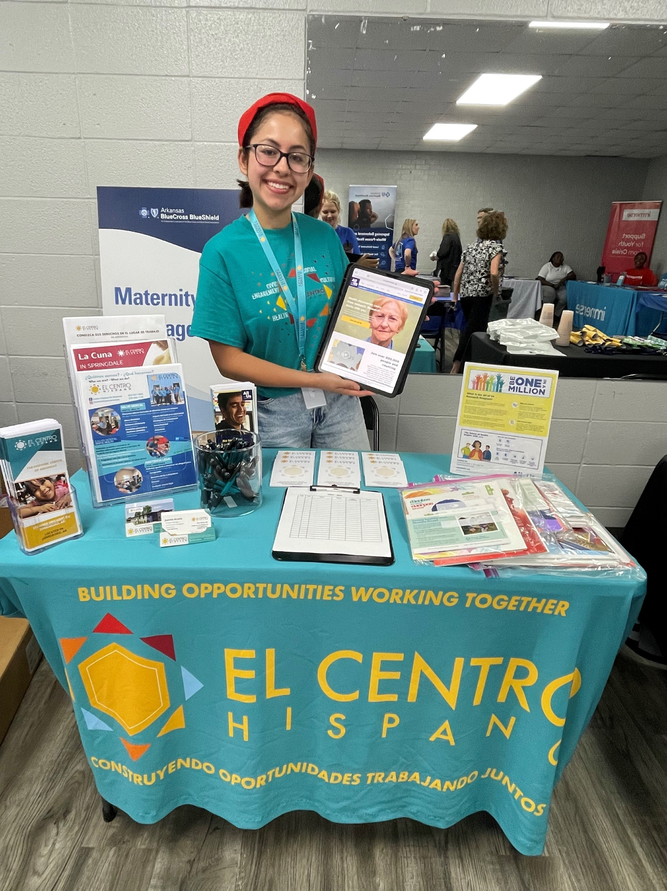


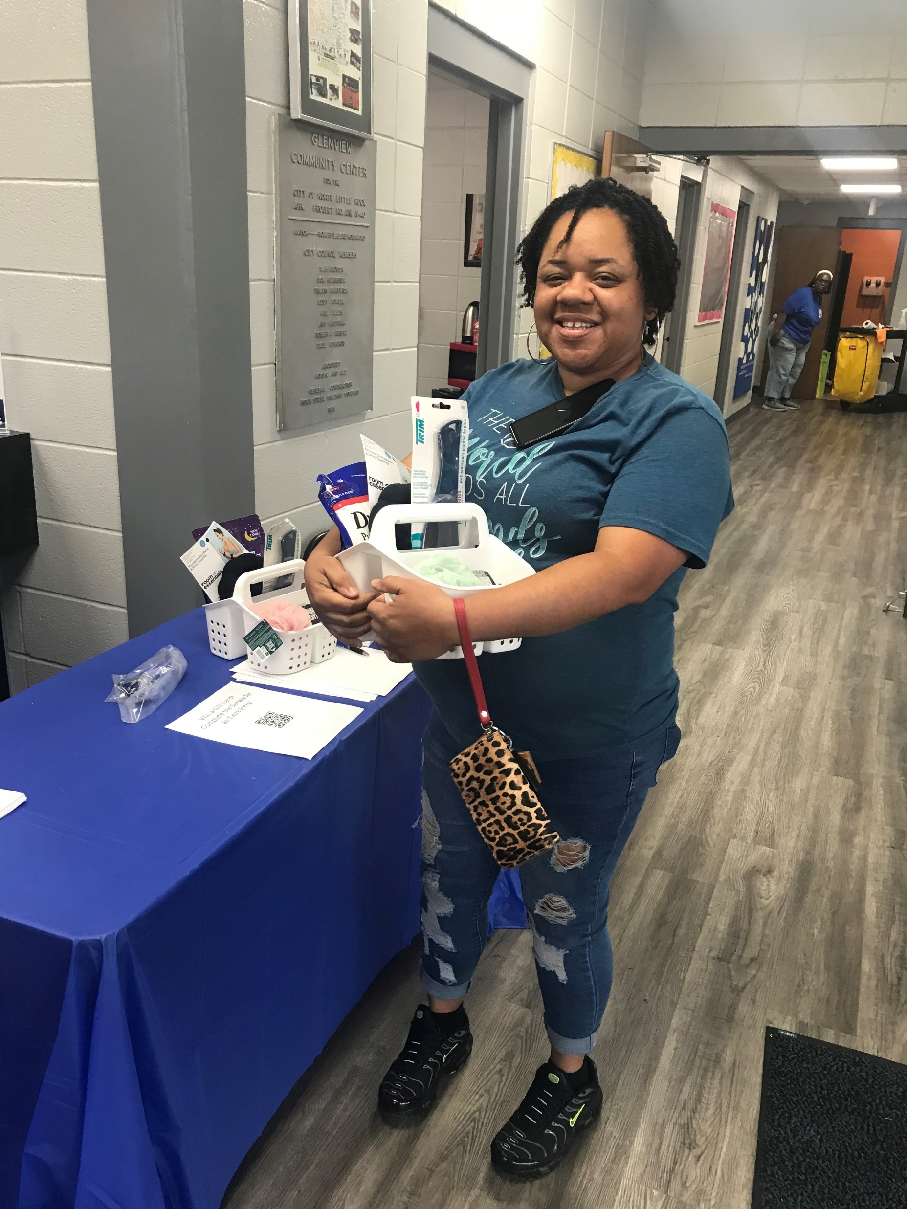

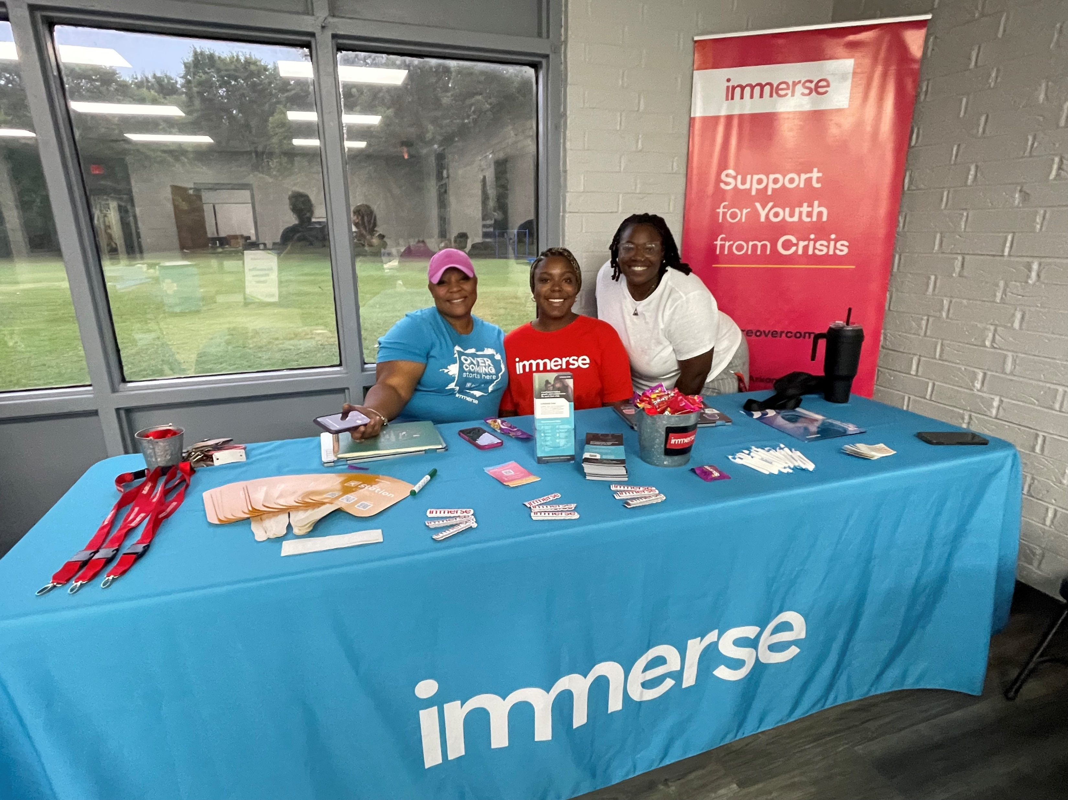
Take Good Care of Her: Women’s health fair events
Bringing care to the community; educating members on services offered at ABCBS and by local partners. Leveraging mobile healthcare services.

Slide 57

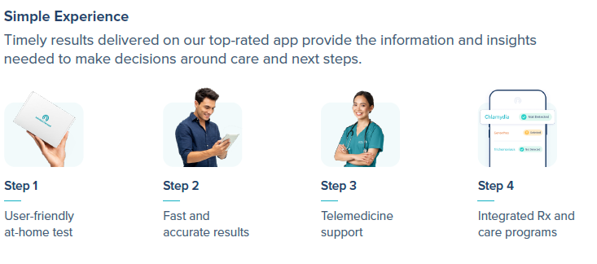
Test Kits Delivered
Offering convenient, alternative options for preventive screenings
Offering chlamydia test kits to all our members
Referring to providers for treatment, if needed and for routine care
Exploring other test kits options for 2025

Slide 58

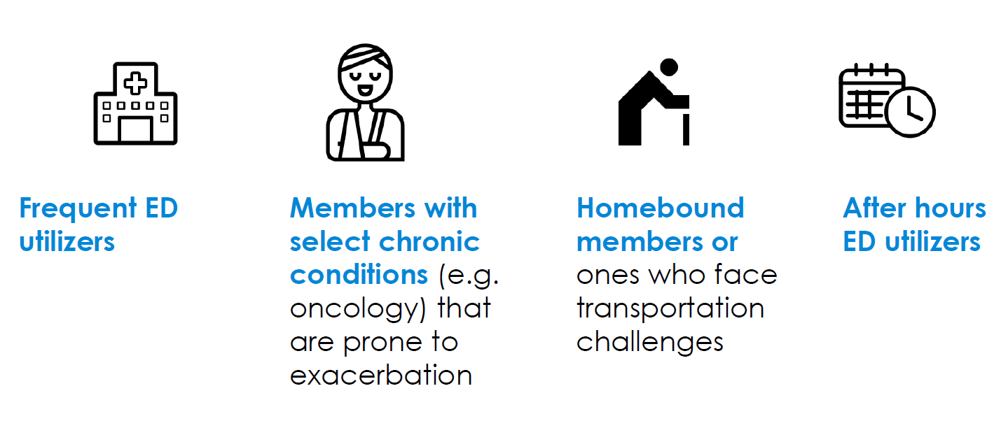
Dispatch Health
Bringing care to members in the central Arkansas area
Key Benefits:
Provides care options to those that might not seek needed care
Breaking down access to care barriers, especially those without reliable transportation
Reducing emergency department utilization
Dispatch is an optimal care alternative for several categories of members

Slide 59
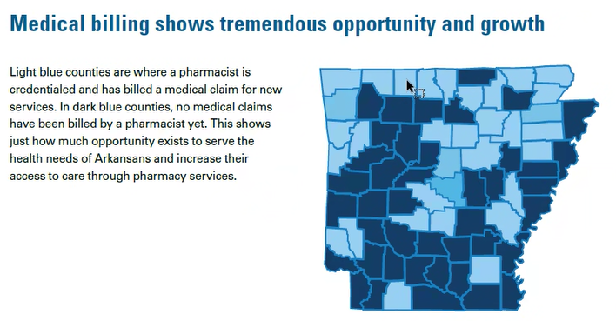
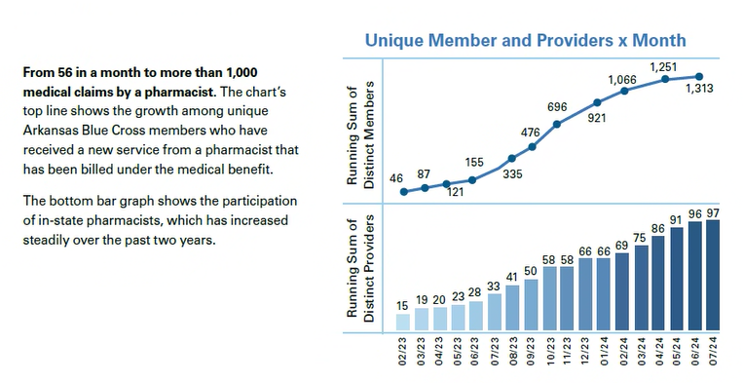
Pharmacists, the most accessible healthcare provider
Arkansas pharmacists can:
Test and Treat COVID
Test and Treat Strep
Test and Treat Influenza
Prescribe oral contraceptives
  Postpartum oral contraceptive counseling and prescribing
Prescribe tobacco cessation
Prescribe Naloxone (Narcan)
A1c testing
  For members with diabetes and for those taking antipsychotic medications
ABCBS approved credentialed pharmacists to medically bill for these services to eliminate barriers for accessible healthcare services.

Slide 60
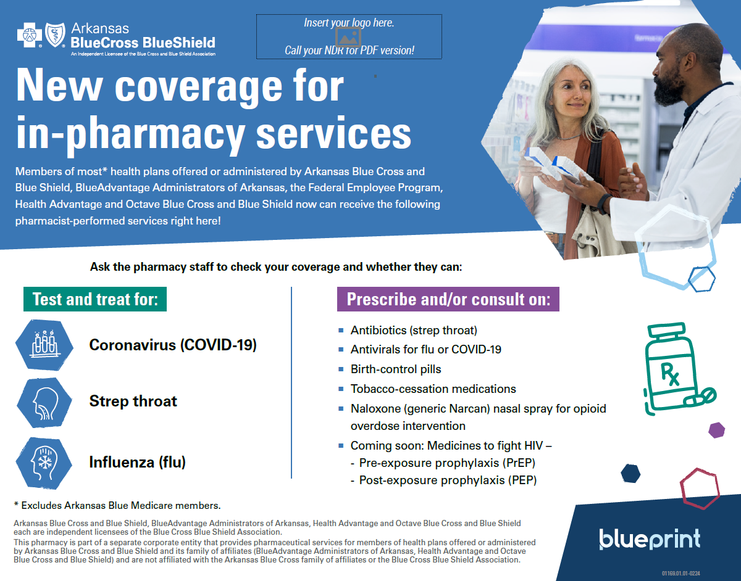

Pharmacy Opportunities for A1c Testing and Beyond
Increasing access to A1c testing and oral contraceptive prescriptions through pharmacies
Pharmacies in Arkansas can provide onsite A1c testing. Members who need A1c tests are identified by ABCBS, and pharmacies are recommended certain interventions.
Allowing pharmacies to provide A1c testing increases accessibility for members.
Members receive incentives for getting A1c testing completed, at a provider’s office or pharmacy.
Pharmacists can also prescribe oral contraceptives and offer counseling services. Helping to advise members on their care options based on their family planning needs.

Slide 61




Economic Independence
Empowering members to sustain themselves financially for improved wellbeing and quality of life
Incentives:
Career Readiness Certificate: up to $200
Measures workplace skills to improve marketability in the workforce, increasing opportunities for career changes and advancement
Continuing education: $50 per year
Reinforces the importance of obtaining skills or education to better career opportunities and to promote lifelong learning
*NEW* Community Health Worker Certification: $200
Helps members navigate the healthcare system, promoting access to health and social services
Educates about LAUNCH and CiviForm

